Slide 1


Slide 2
A History of the Basic Text
1st World Literature Conference, World Convention 10, and the 2nd World Literature Conference.
Wichita, KS
October 2, 2026
“Many of us have never known recovery without the Basic Text.”
Basic Text, 6th ed., p. xvii.
Francis C. and Tim S.

Slide 3
Sources
Special thanks to Chris B. and Boyd P.
Member archives
  WLC Minutes
  Photos
  Tape recordings
  Fellowship input
Member interviews
Member talks
NAWS
Newsletters
Books
  A Matter of Principle
  My Years with NA
  The Story of the Basic Text

Slide 4
Kansas NA Beginnings
1970 Wichita – 1st known attempt at NA, rumored “pot” wasn’t a drug so excluded, as a result didn’t last long.
1971-early ‘72 – Rabbit meetings starting in Wichita and Salina
July 1972 NA started at Pathfinder House in Salina
Six NA meetings throughout Kansas by 1976

Slide 5
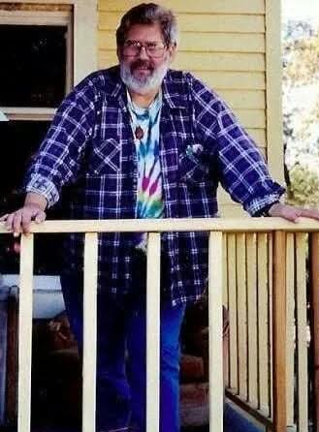


Slide 6
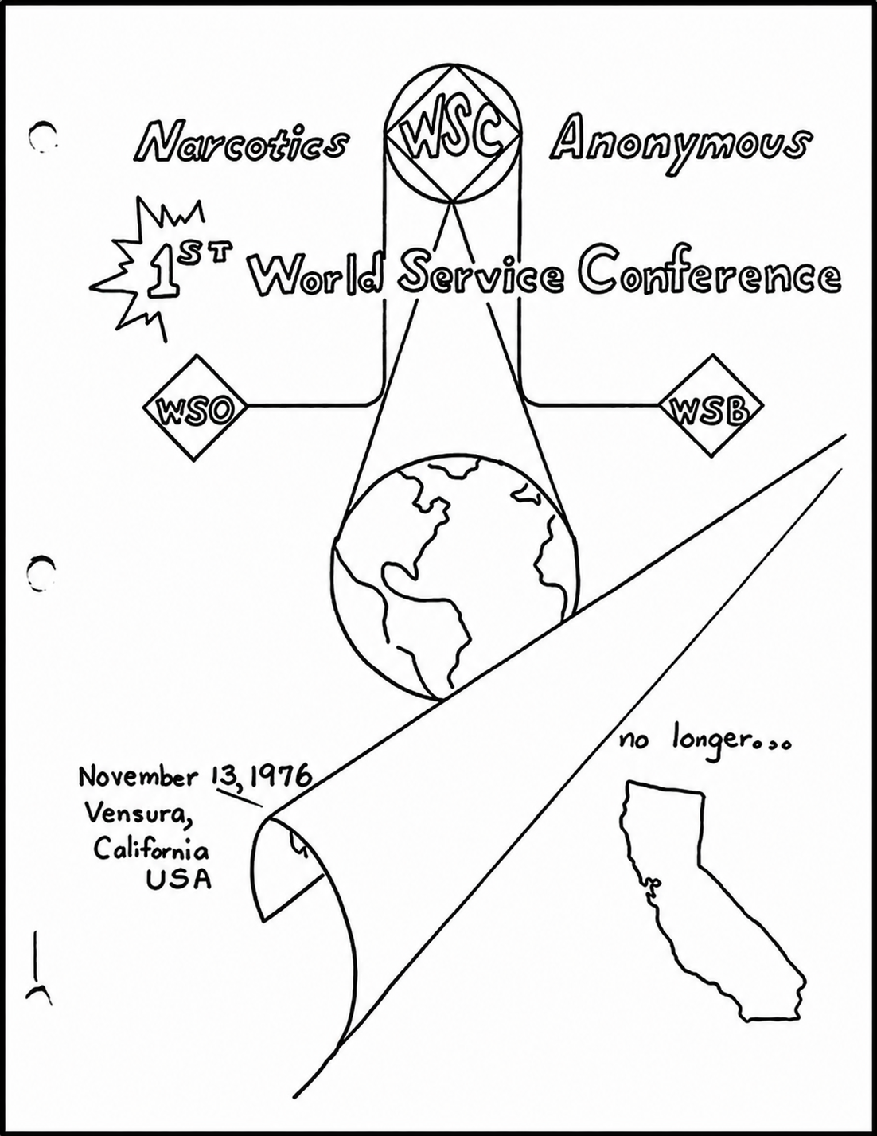

Slide 7
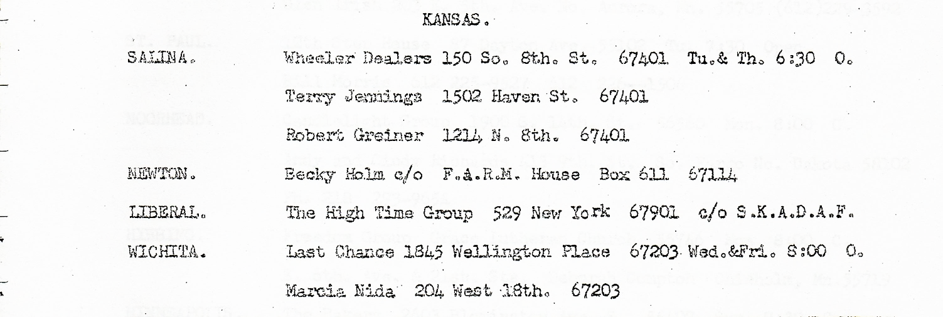
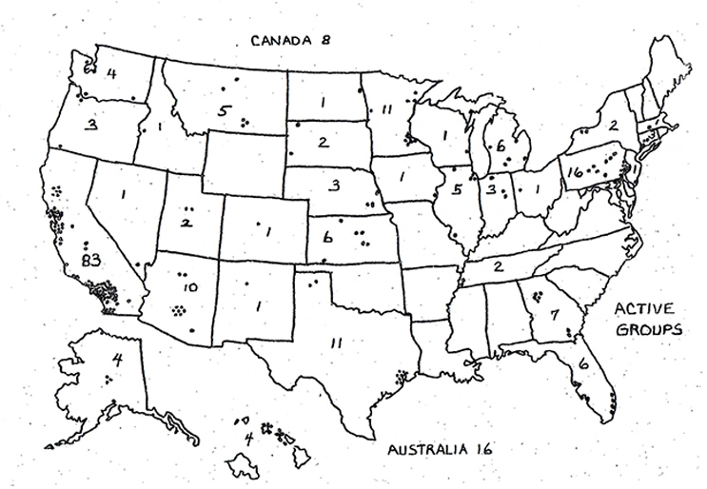
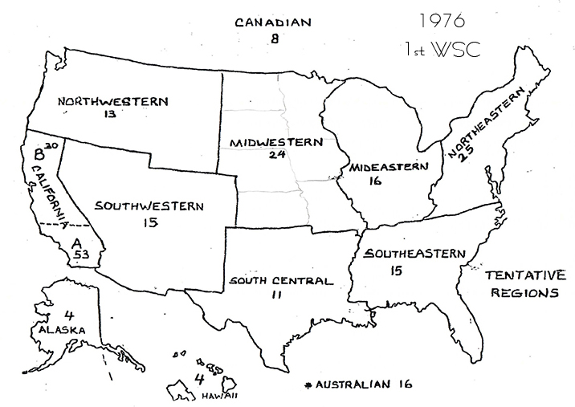
Tentative Regions set at 1976 WSC

Slide 8

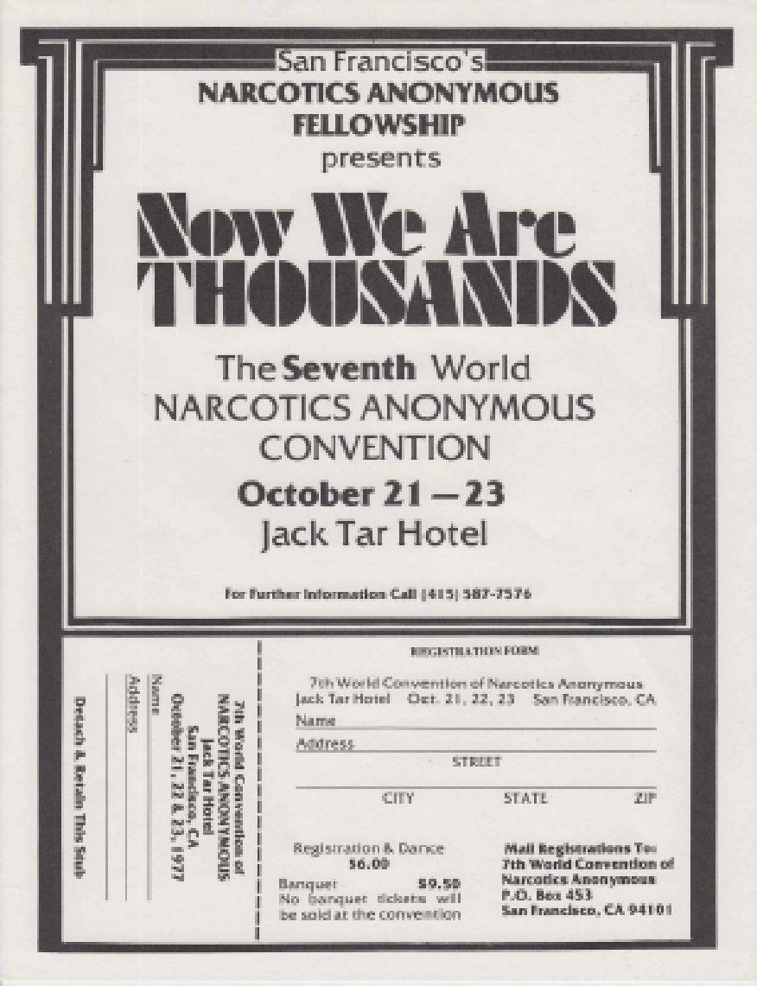

Slide 9
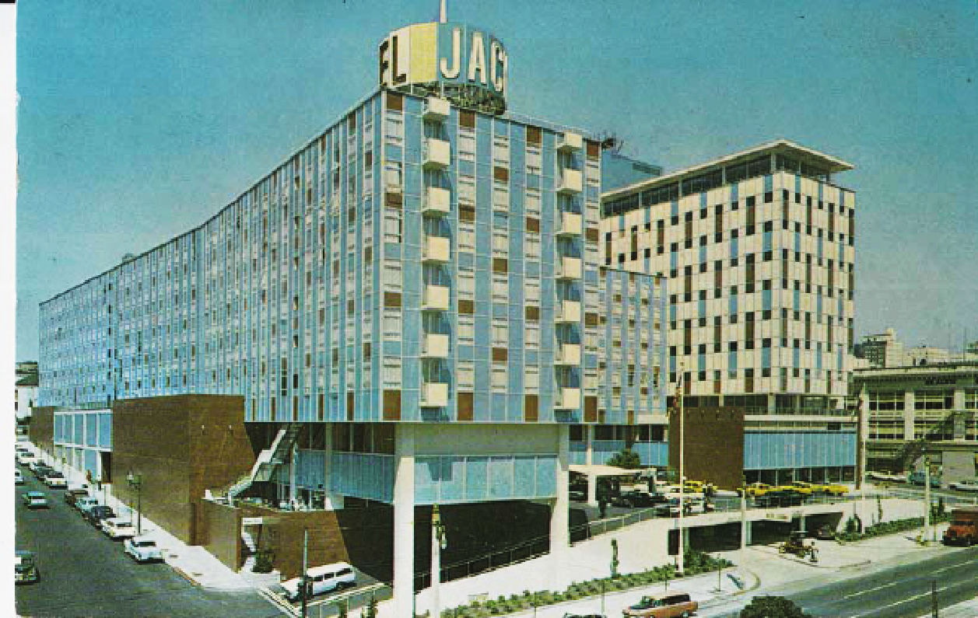

Slide 10
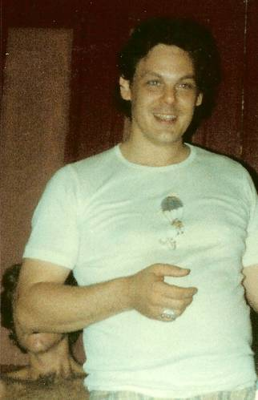
At the 7th World Convention in
San Francisco in 1977:
Bo S. travels to San
Francisco from Atlanta to find out what is happening about a book.
Bo meets Jimmy Kinnon and Greg Pierce
This the where the process for the Basic Text really begins.

Slide 11
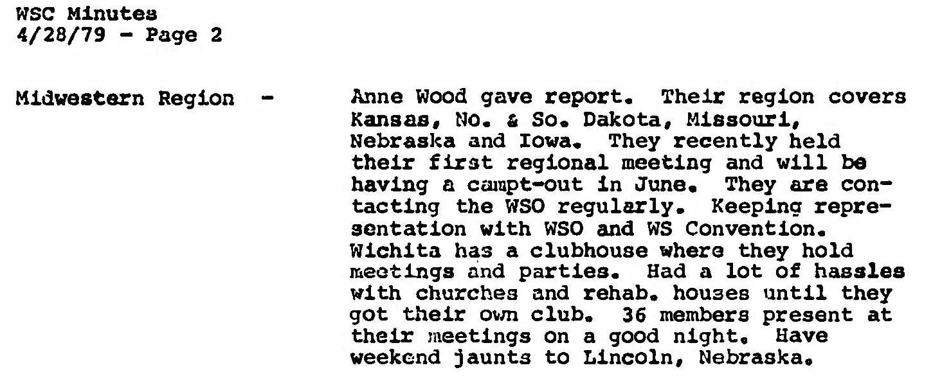
Mary L. from Lincoln, NE
reported for Midwestern
Region at WSC 1978

Slide 12
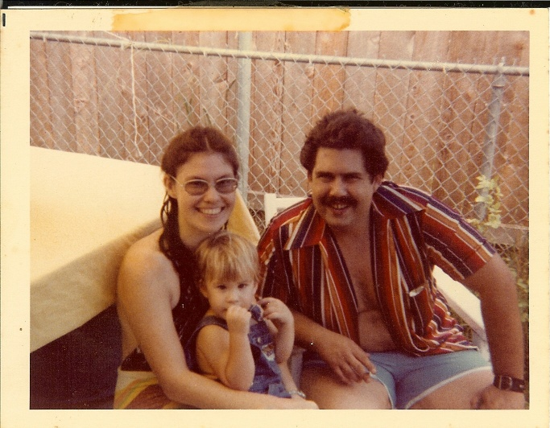
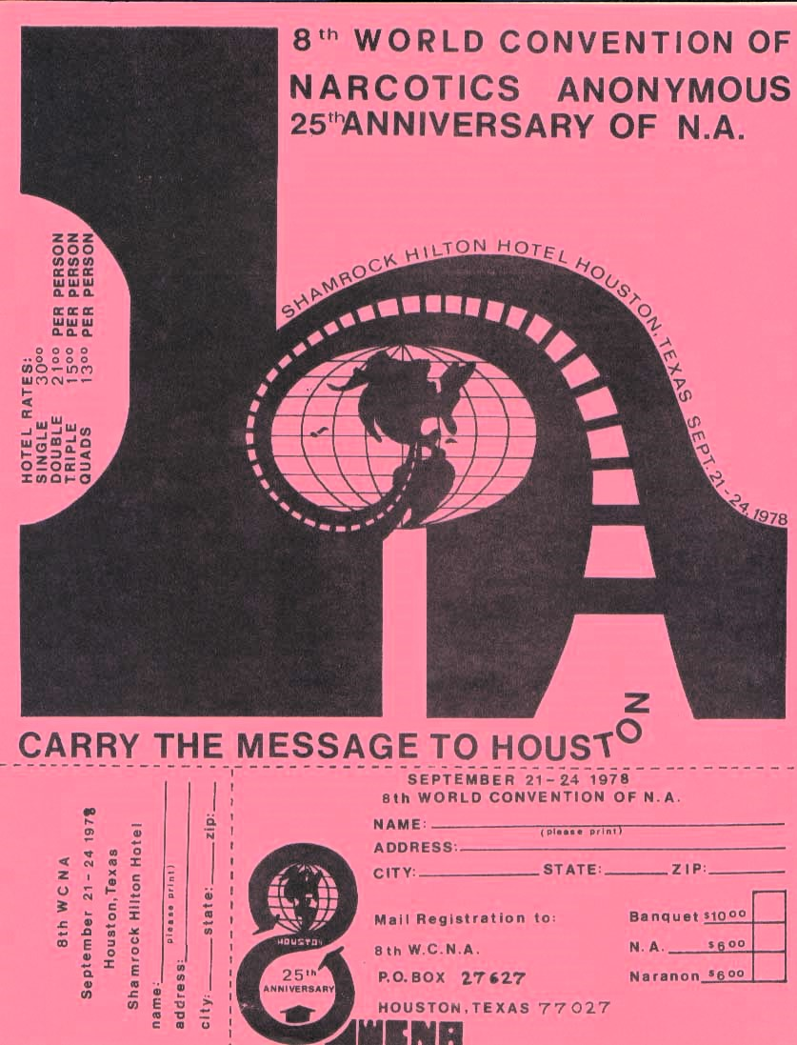
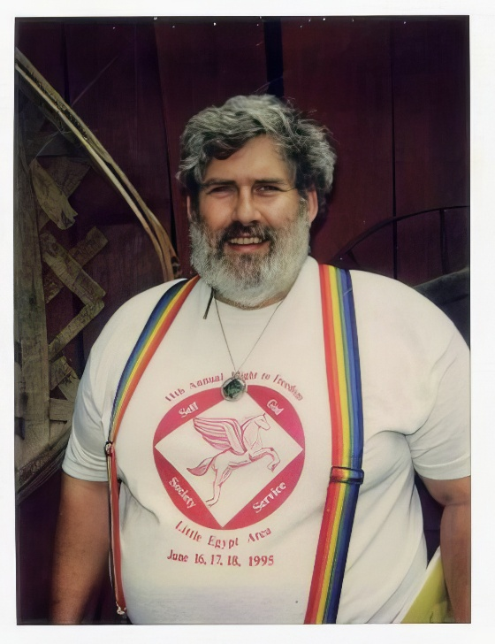
Greg P.

Slide 13
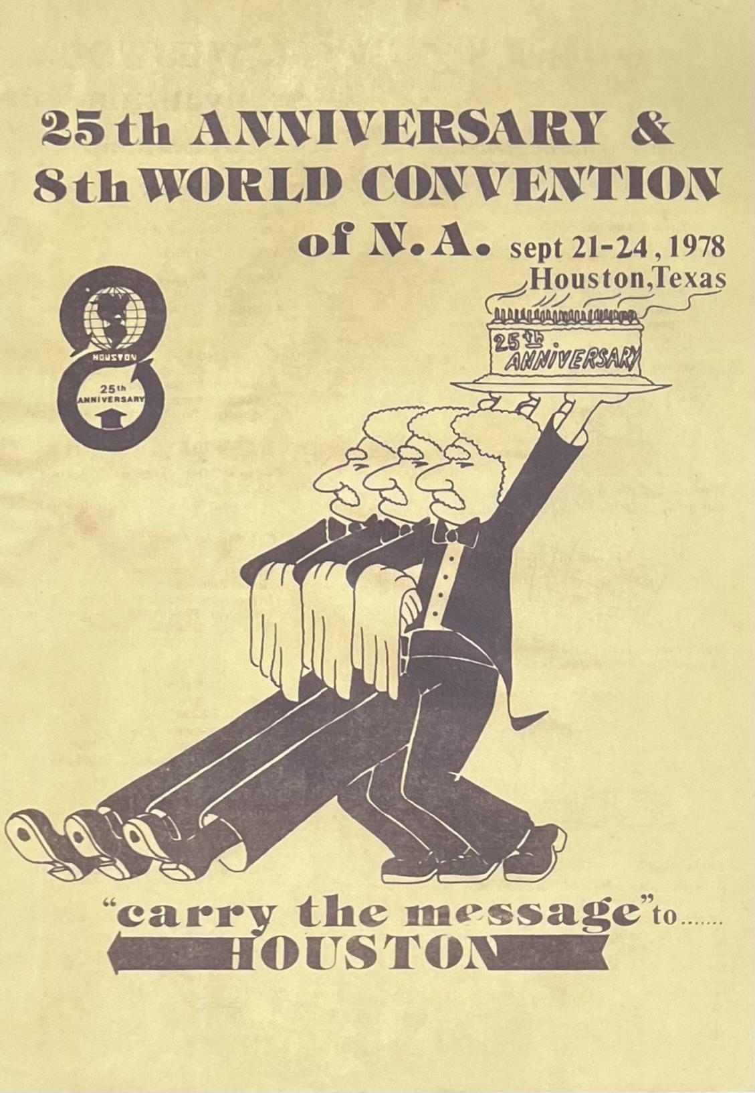
Bid Meeting votes to have WCNA 8 in Texas. It is the first time the World Convention is held outside California

Slide 14
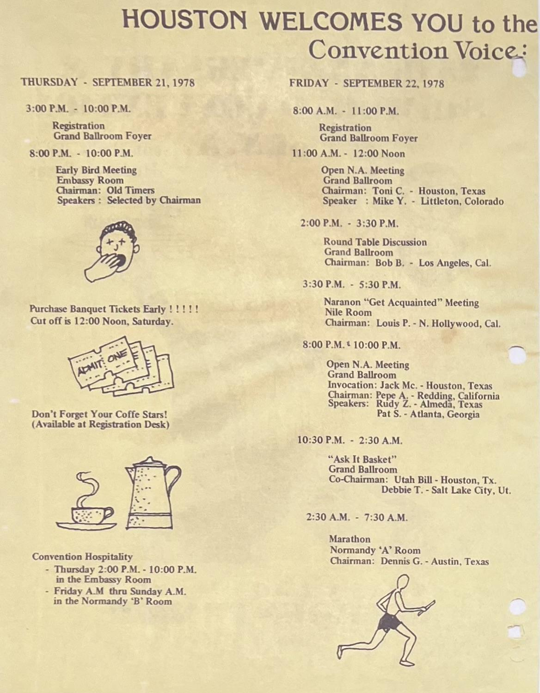
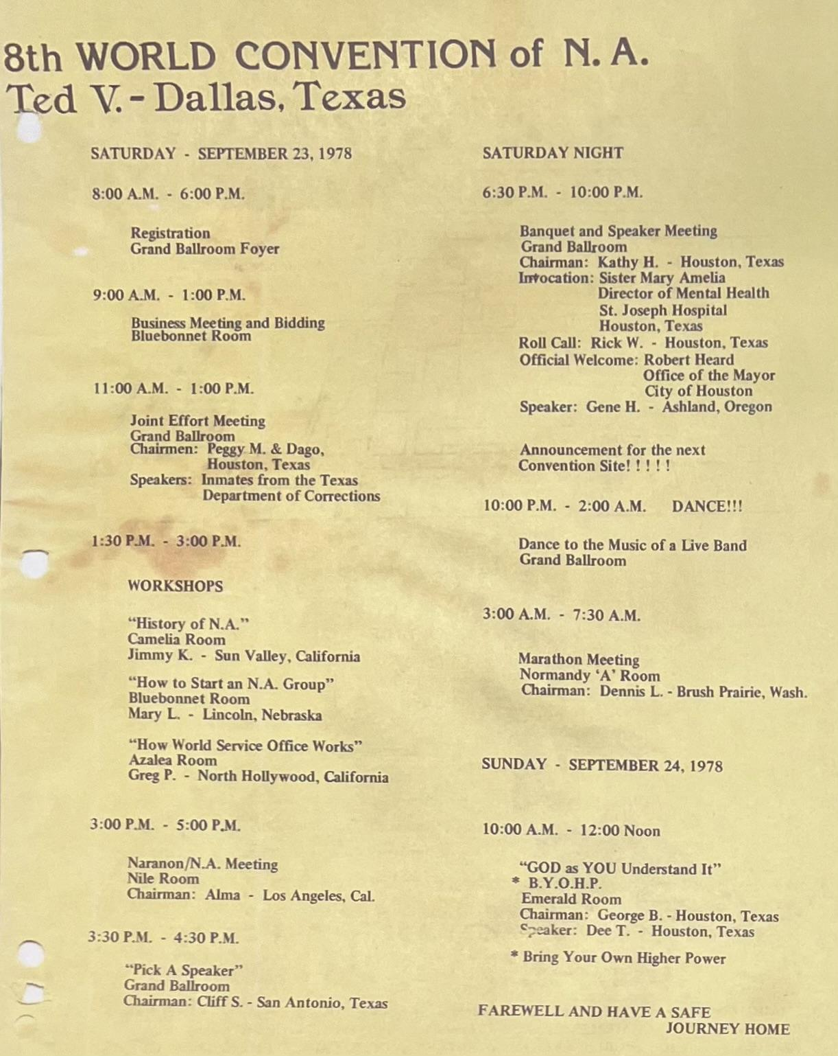

Slide 15
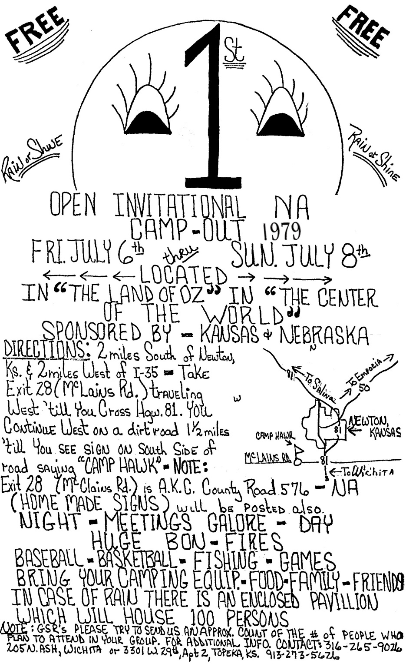
Motorcycle Ed - Atlanta, GA
Vol 1 Issue 1
Rainbow Connection Newsletter

Slide 16
Motorcycle Ed - Atlanta, GA
Vol 1 Issue 1
Rainbow Connection Newsletter

Slide 17
Motorcycle Ed - Atlanta, GA
Vol 1 Issue 1
Rainbow Connection Newsletter

Slide 18
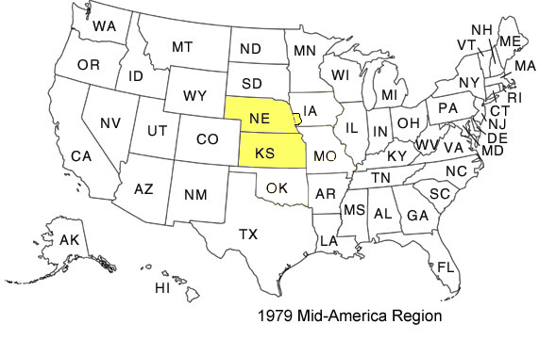
First Version of
Mid-America Region

Slide 19
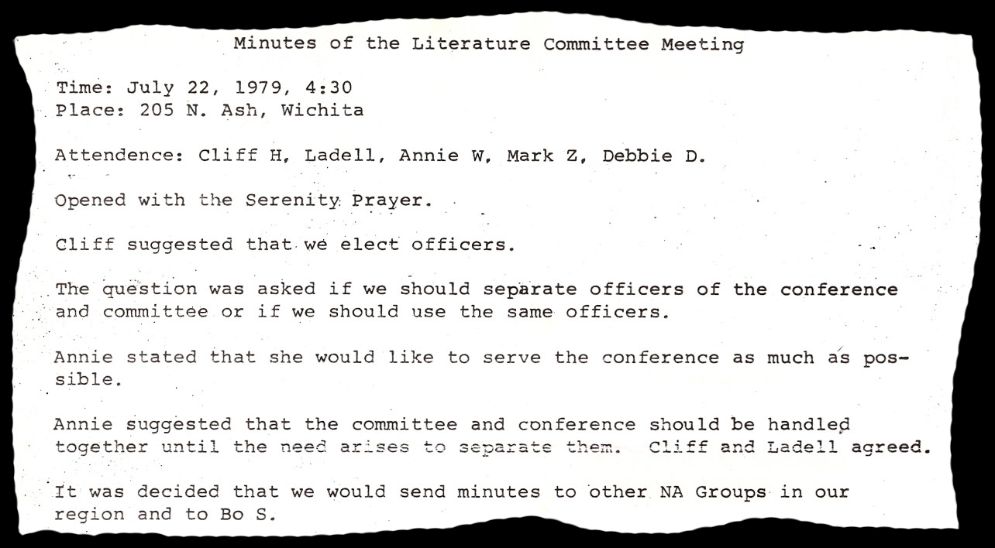

1st Mid-America
Sub Committee

Slide 20
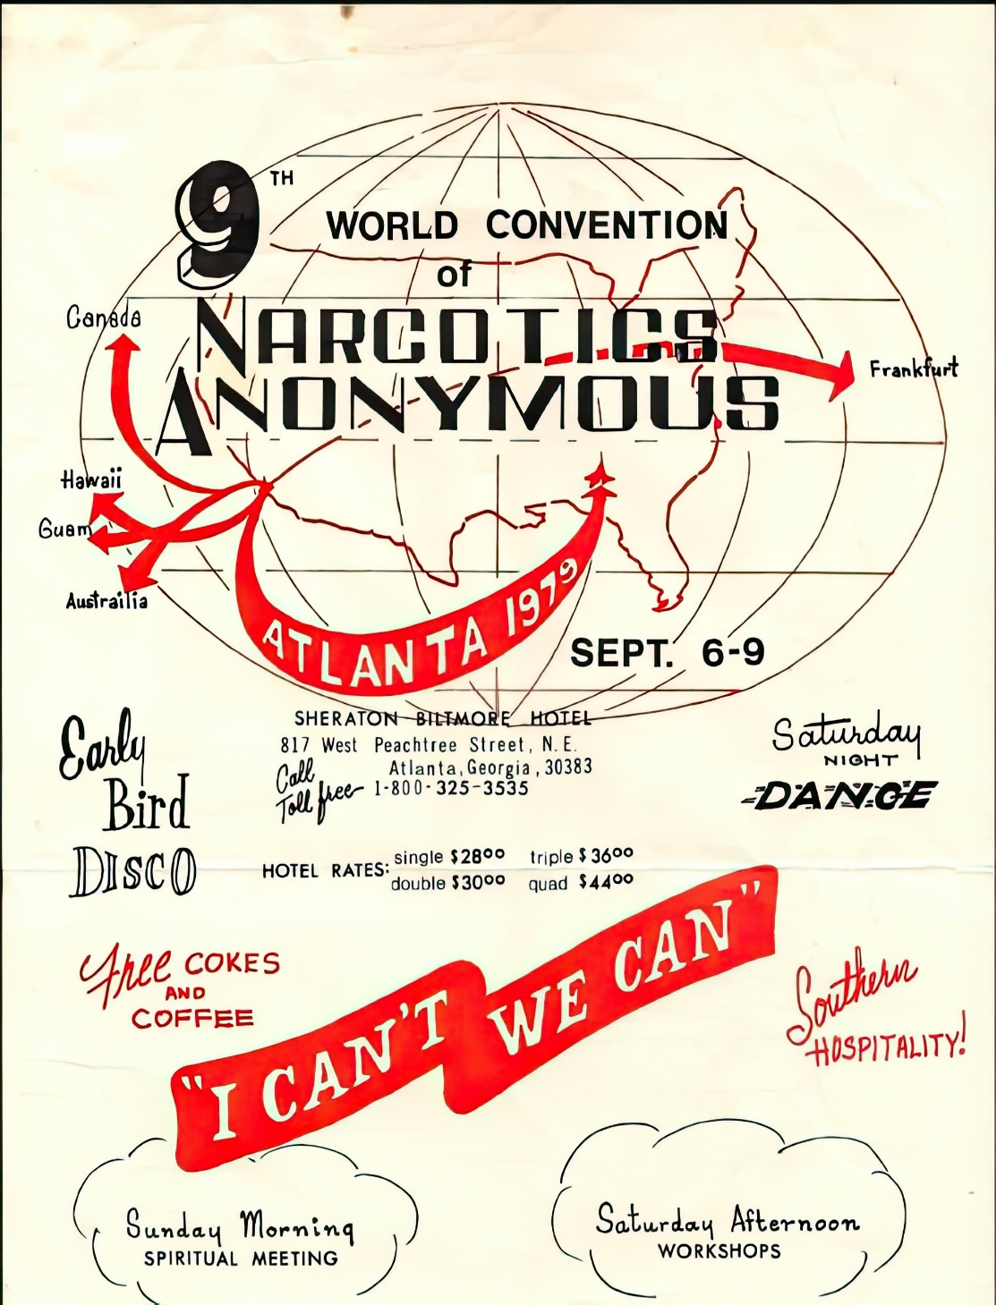
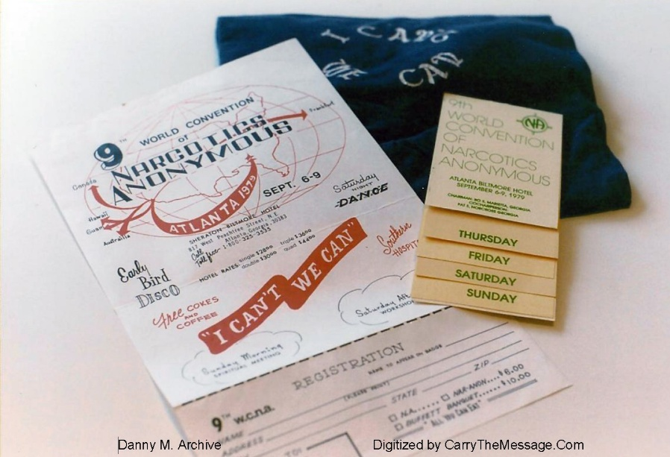
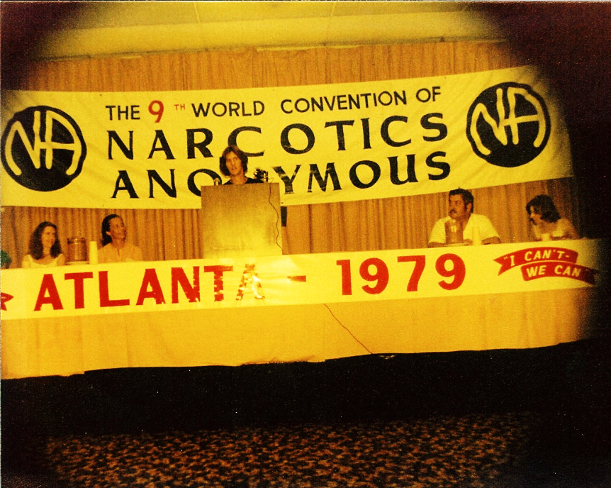

Slide 21
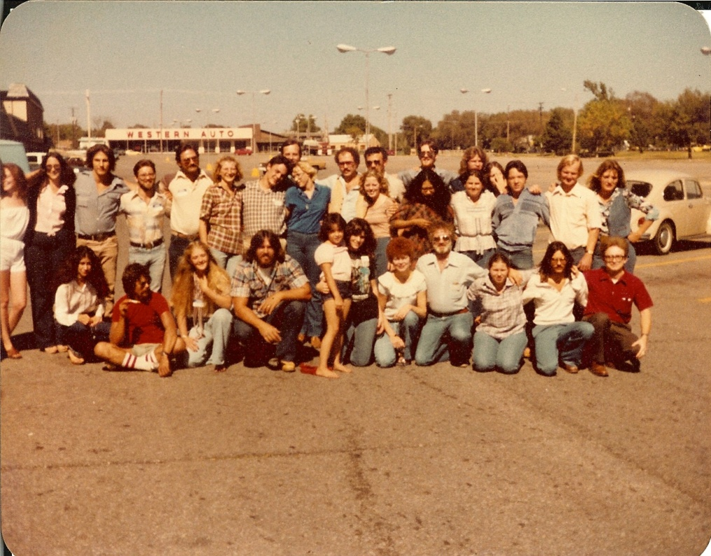
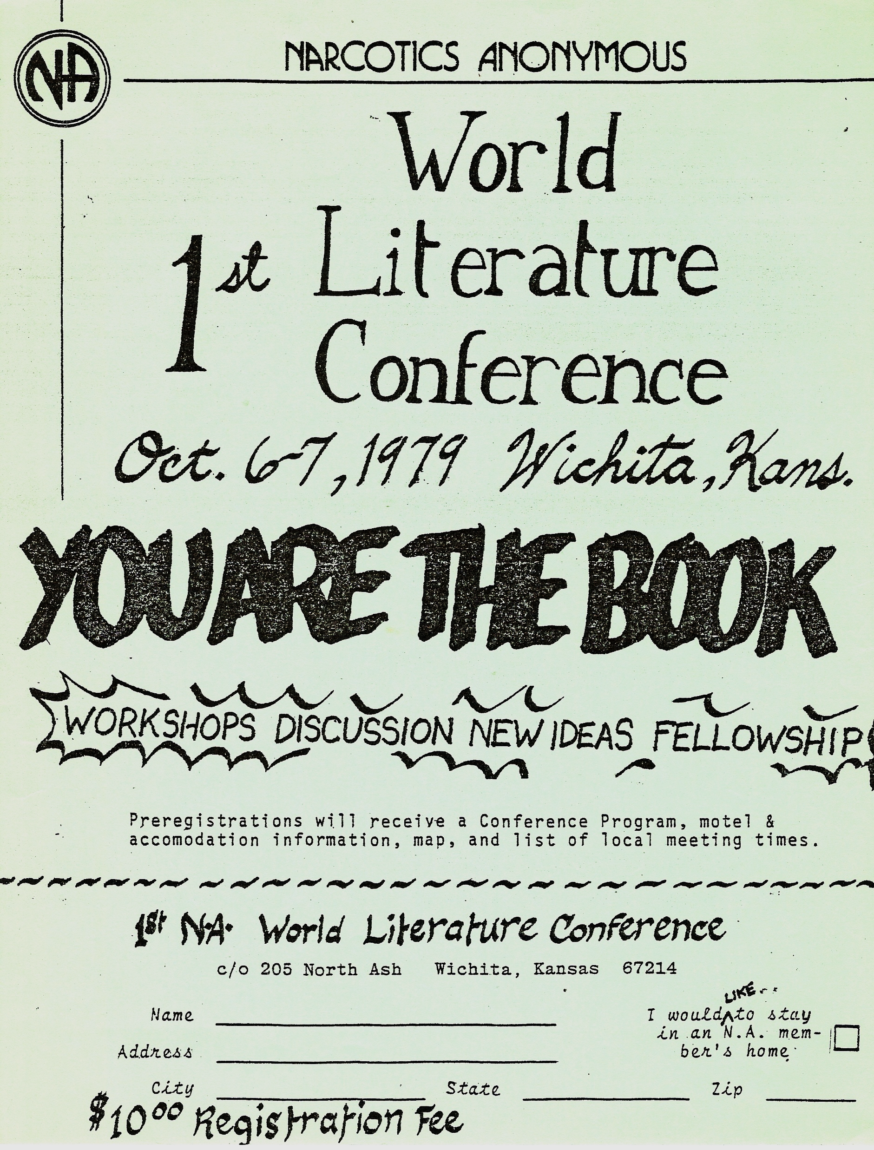


Slide 22
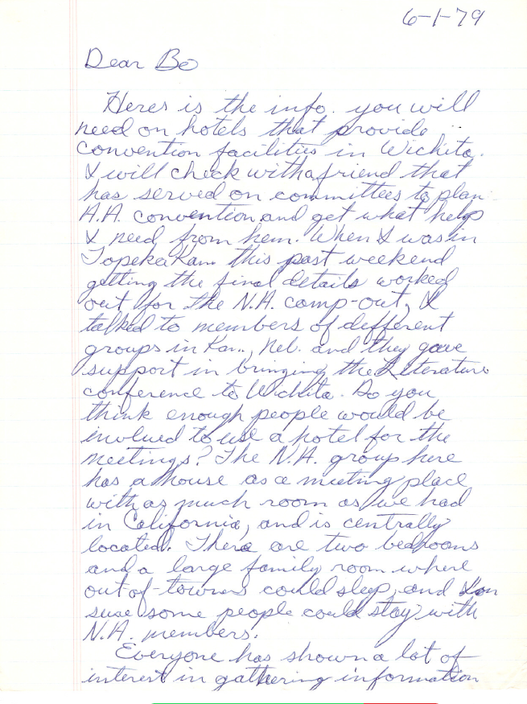
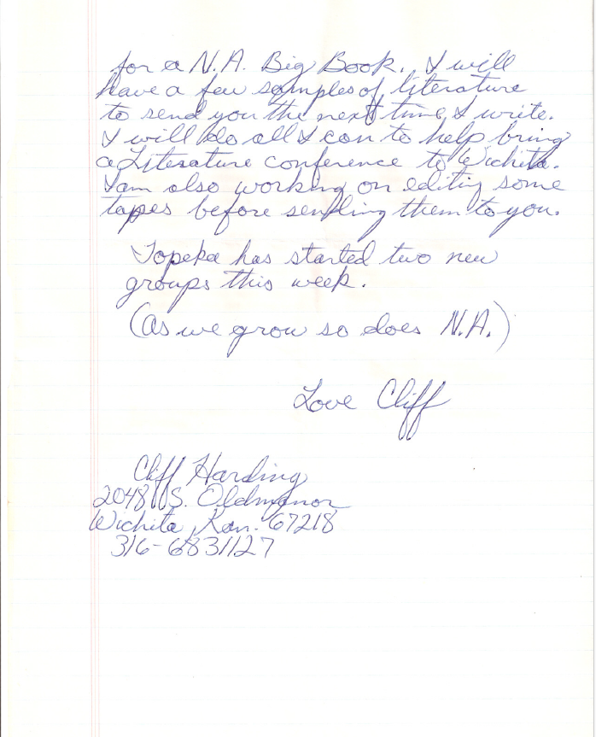
Notes:
Sources: 1st WLC Minutes (Wichita) and 1979 WLC 1 – Wichita Tape 1 Side A

Slide 23
“You Are The Book”
Addicts came from: California, Georgia, Kansas, Nebraska, Tennessee and Virginia
It is unclear if Jim M. from Ohio attended
Kansas and Nebraska comprised 30 of the 39 members listed.

Slide 24
“You Are The Book”
1st World Literature Conference
  Wichita, KS
    October 6 – 7, 1979
Sources for who attended (39 members total)
  Registration forms (25 members)
  Applications for Literature Conference Workshops
  Minutes (34 members)
  Contact list (35 members)

Slide 25
Kansas Representation (19 members)
Kansas
Belinda D. (Salina) | Linda M. (Topeka)
Carol L. (Wichita) | Lona D. (Salina)
Cindy P. (Topeka) | Marcia S. (Wichita)
Cliff H., Chair (Wichita) | Mark Z. (Wichita)
DeAnna S. (Wichita) | Michael M. (Wichita)
Glenda F. (Salina) | Pat H. (Topeka)
Janelle L. (Wichita) | Ron D. (Topeka)
Jimmy T. (Salina) | Samuel L. (Wichita)
Julie W. (Wichita) | Scott F. (Wichita)
Leland D. (Salina)

Slide 26
Nebraska Representation (11 members)
Nebraska
Angie C. (Lincoln) | Kirk D. (Omaha)
Barb H. (Lincoln) | Louis (Omaha)
Bill A. (Omaha) | Lucian N. (Omaha)
Bill K. (Omaha) | Pete A. (Omaha)
Greg L. (Lincoln) | Stan S. (Omaha)
Jim N. (Lincoln)

Slide 27
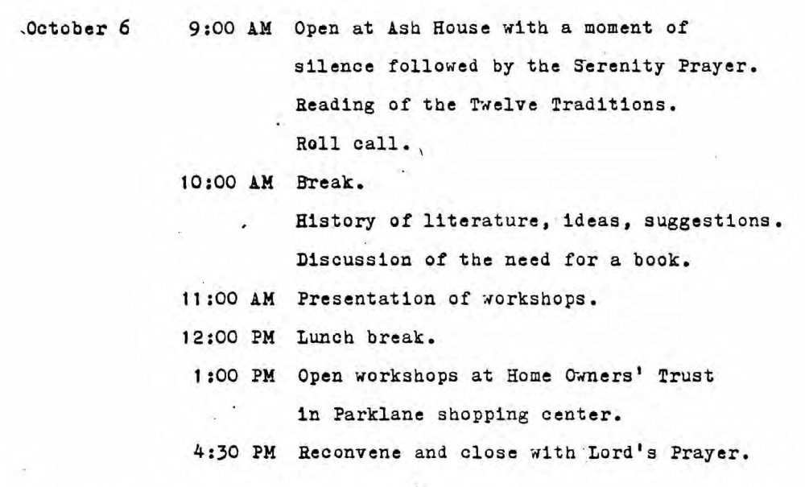
Conference Program

Slide 28
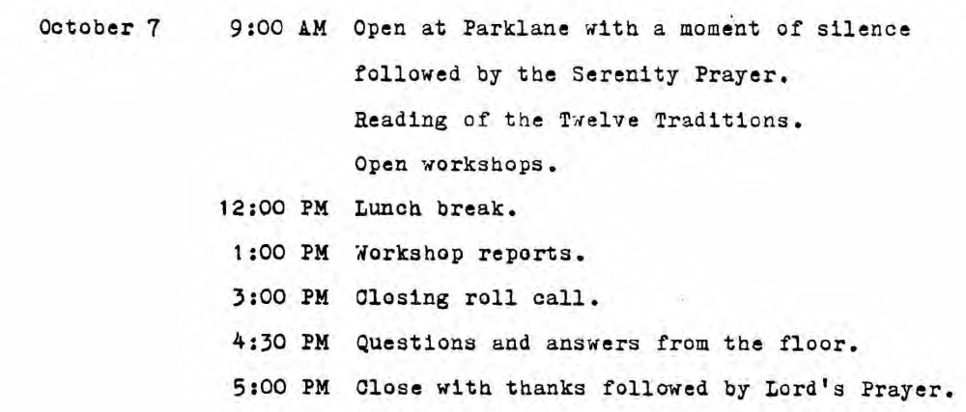
Conference Program

Slide 29
Conference Program

Slide 30
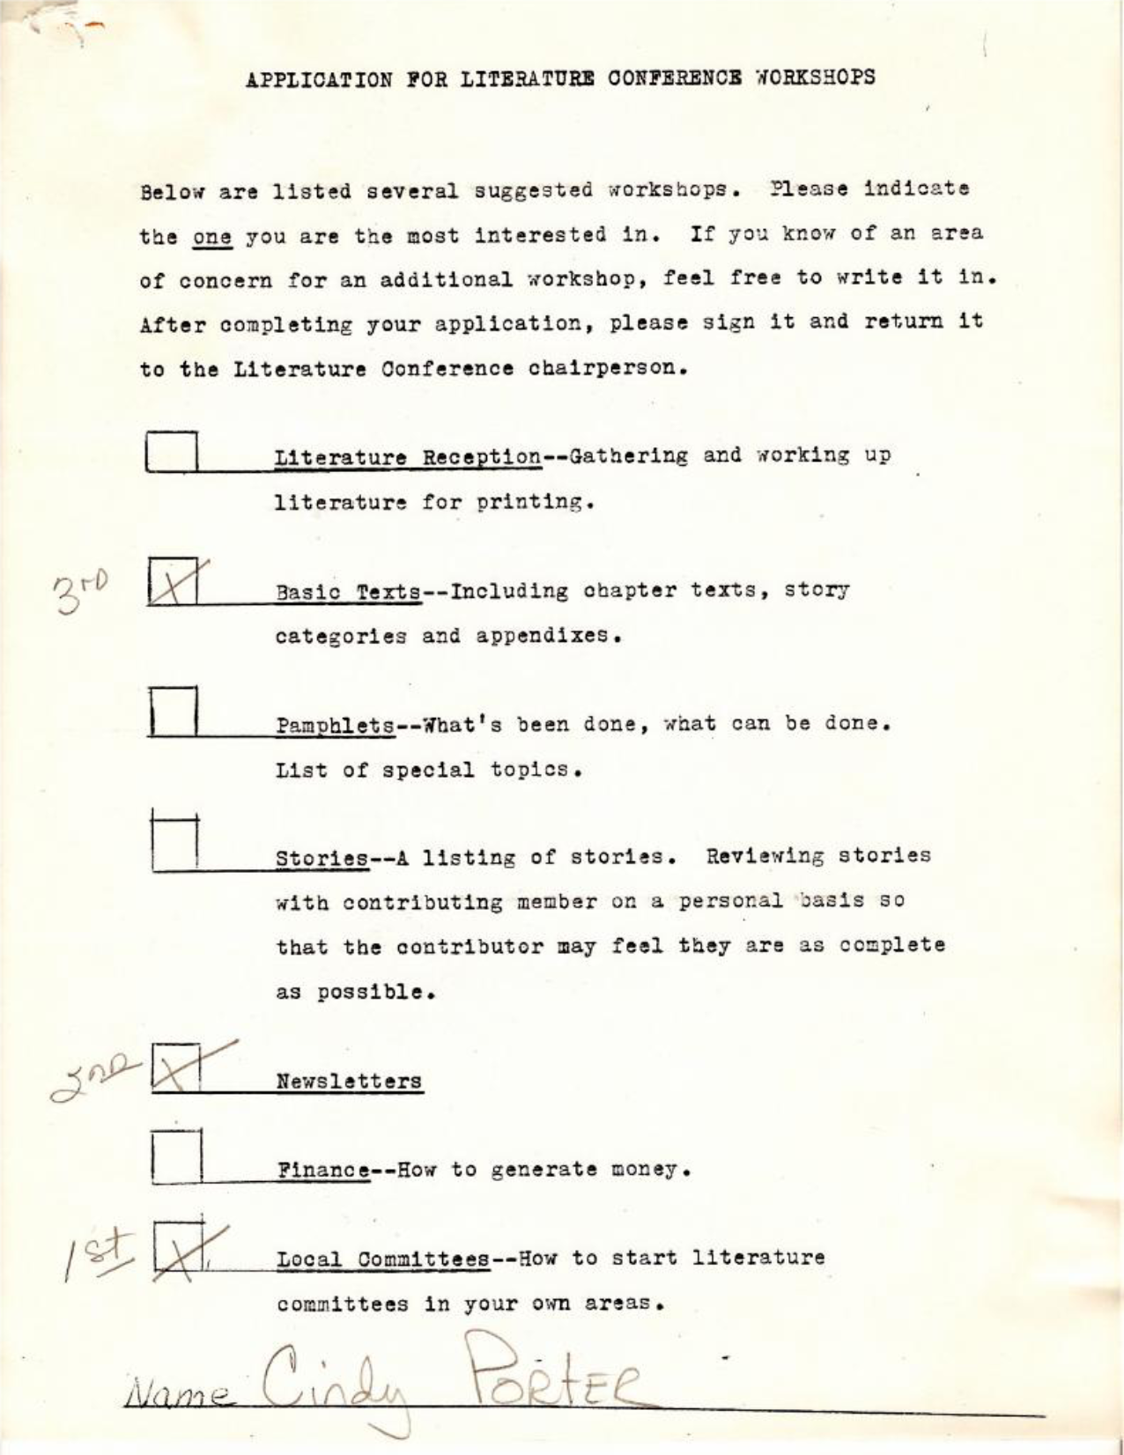
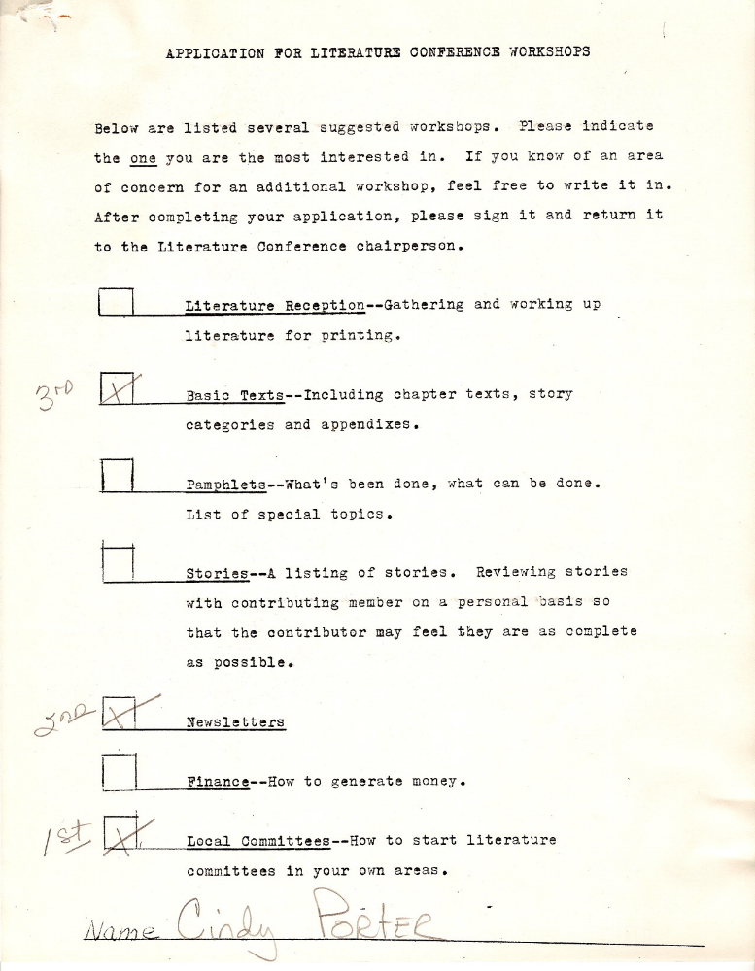
Notes:
Sources: 1st WLC Minutes (Wichita) and 1979 WLC 1 – Wichita Tape 1 Side A

Slide 31
Notes:
Sources: 1st WLC Minutes (Wichita) and 1979 WLC 1 – Wichita Tape 1 Side A

Slide 32
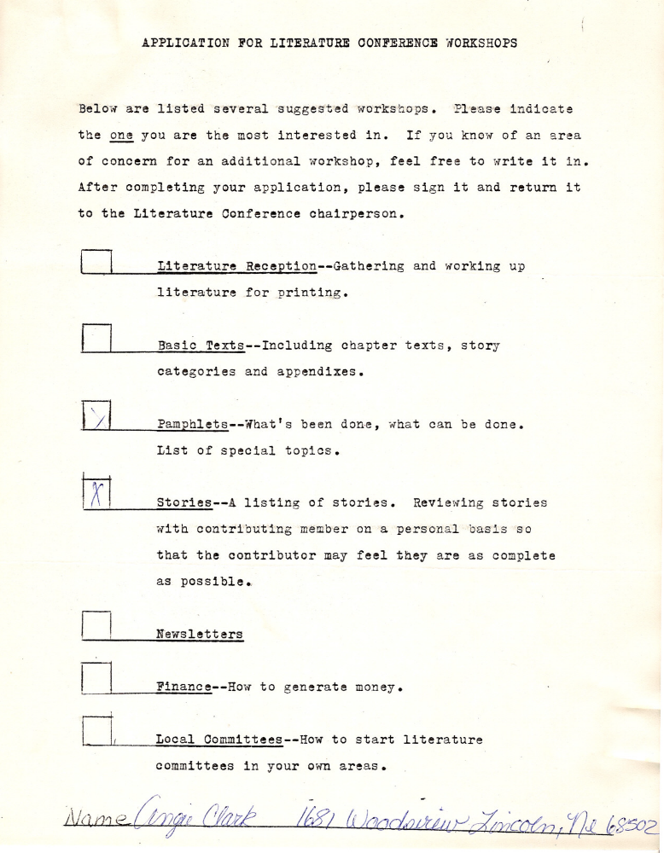

Cliff H.
Audio from 1st World Literature Conference
Literature, literature reception will be here.
Alright.
Basic text at that table.
Pamphlets, this table right here.
Let's go ahead and get…we’re going to have to switch all that stuff around.
Stories in the back corner over there by the flag.
Newsletters in that corner over there.
Okay, we’ll have finance and local committees in the back here.
Let’s do it.
Notes:
Audio Source: Tape 3 Side A

Slide 33
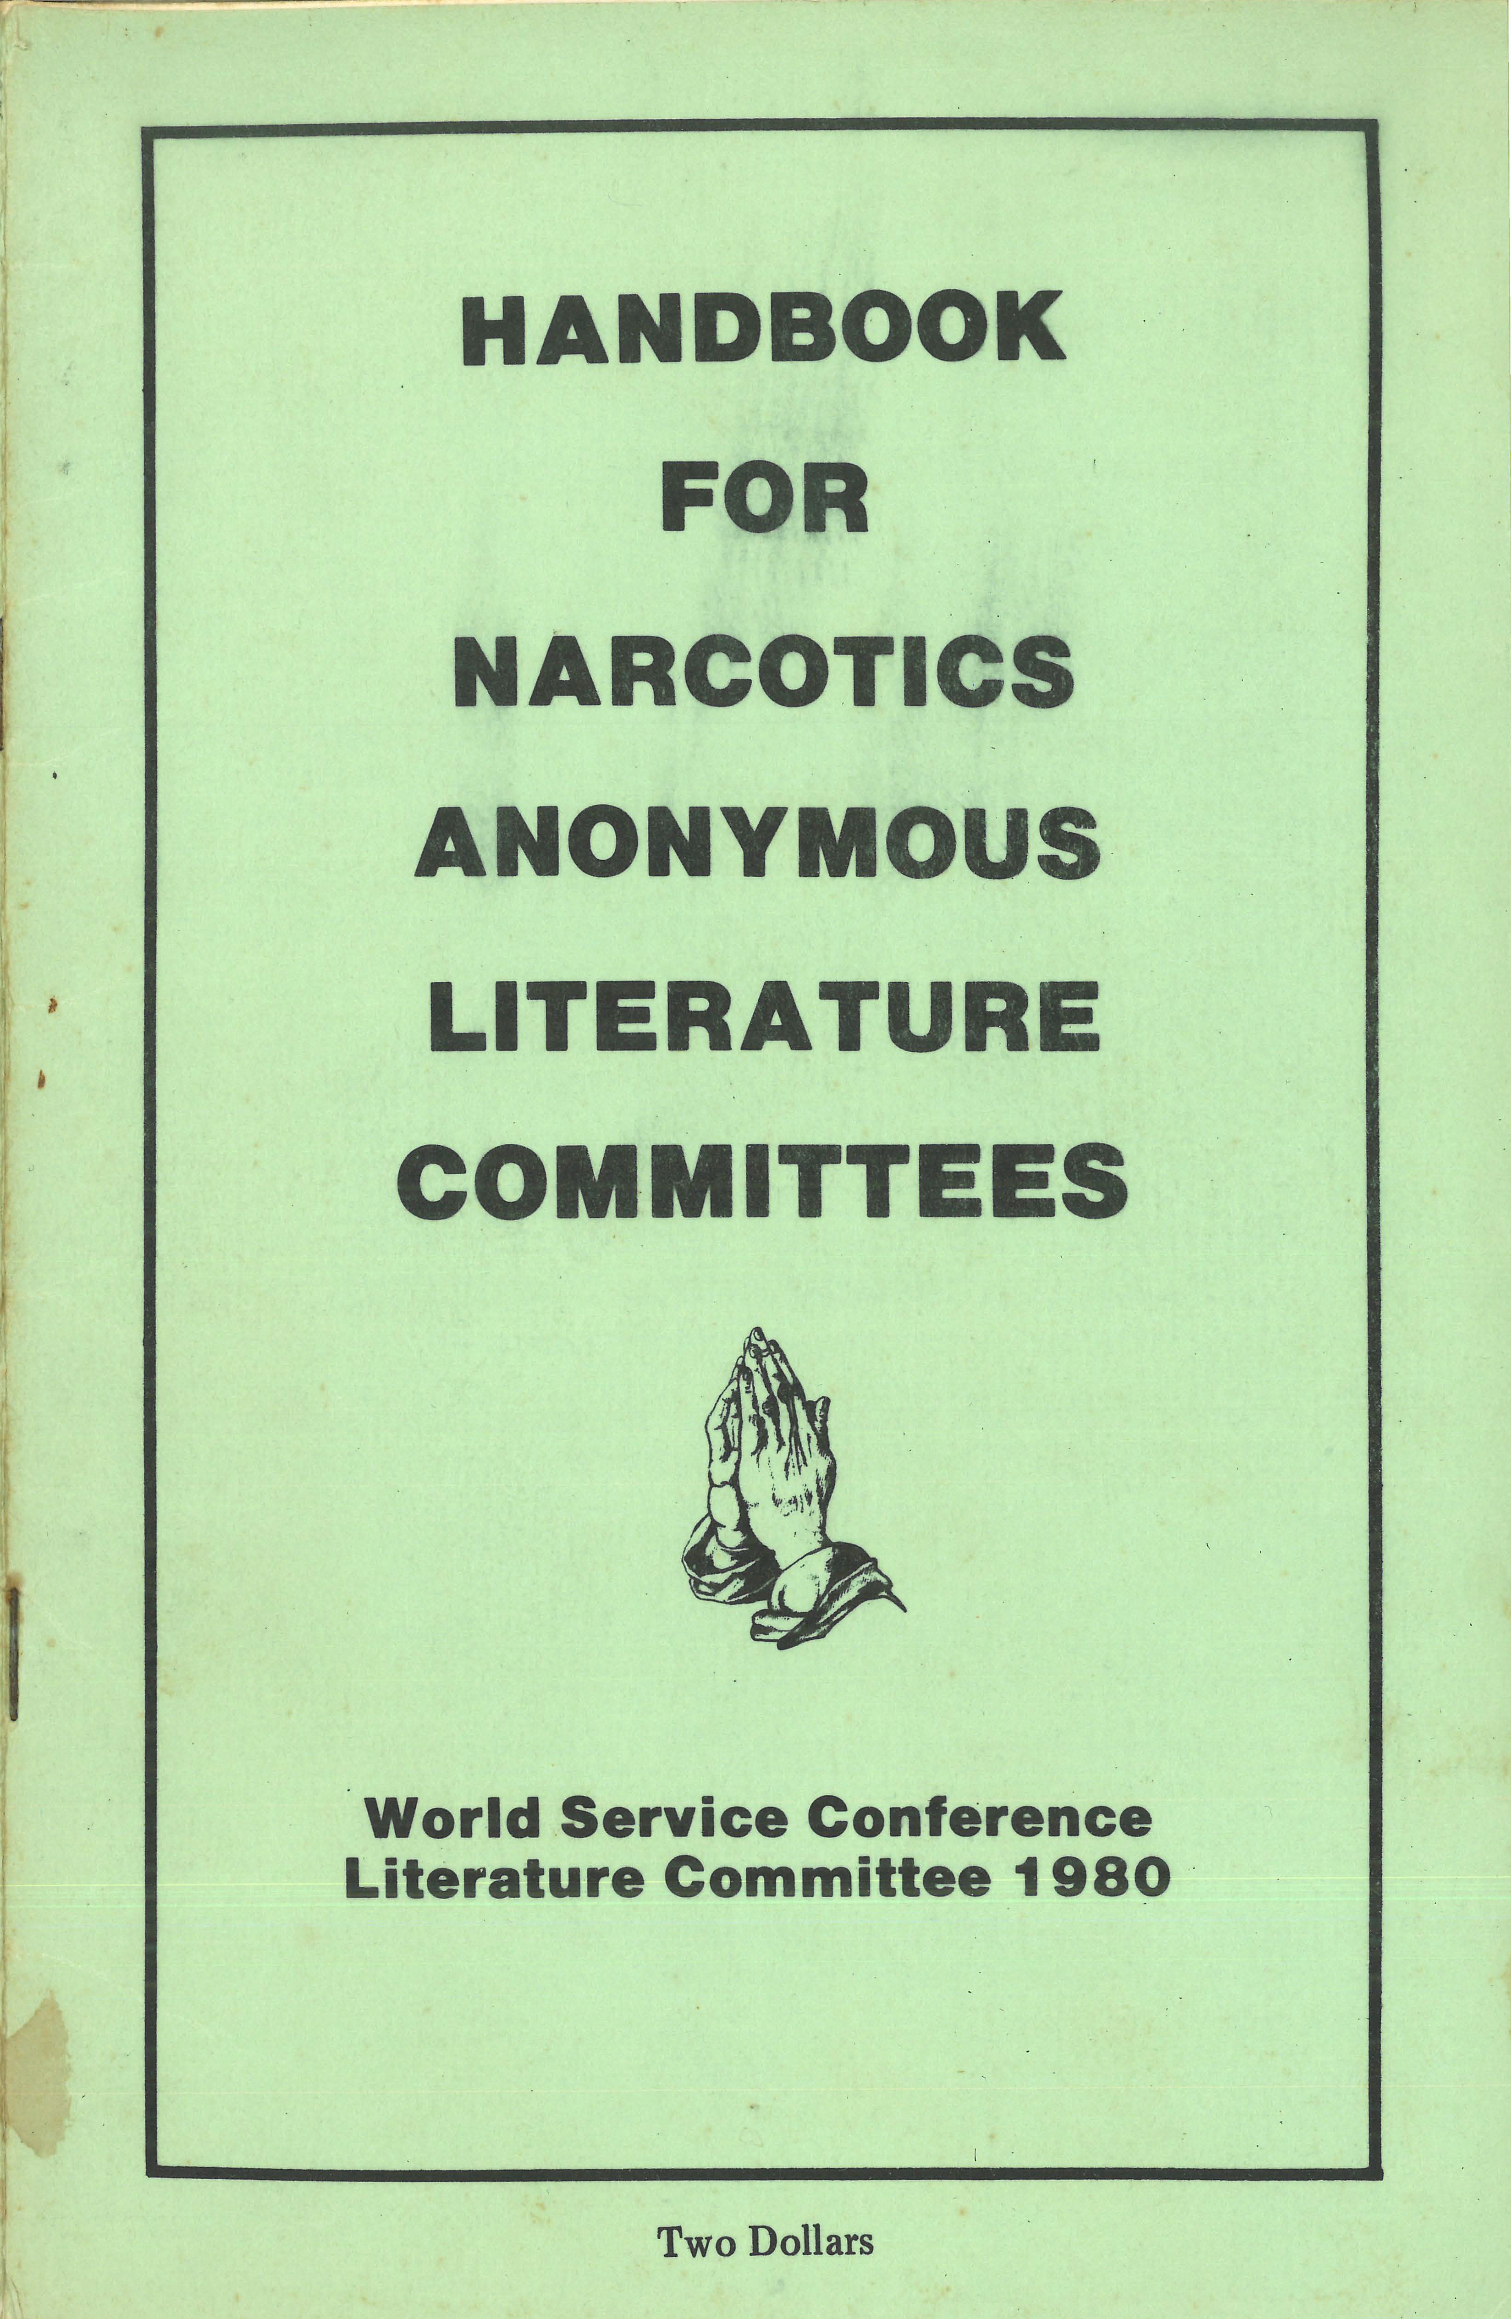
Output from
1st WLC

Slide 34
Output from
1st WLC

Slide 35
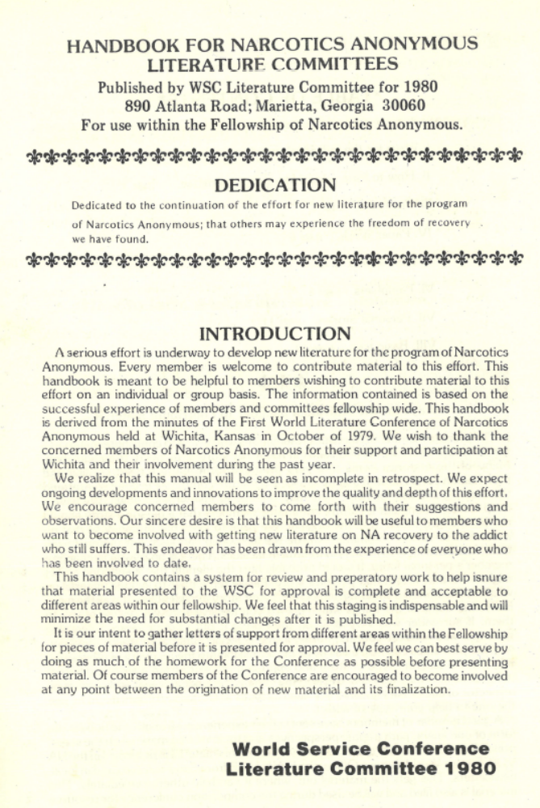

Slide 38
The Foundation for a “We Book”
In this clip, we’ll hear Joseph P. talk about going to Wichita.

Slide 39
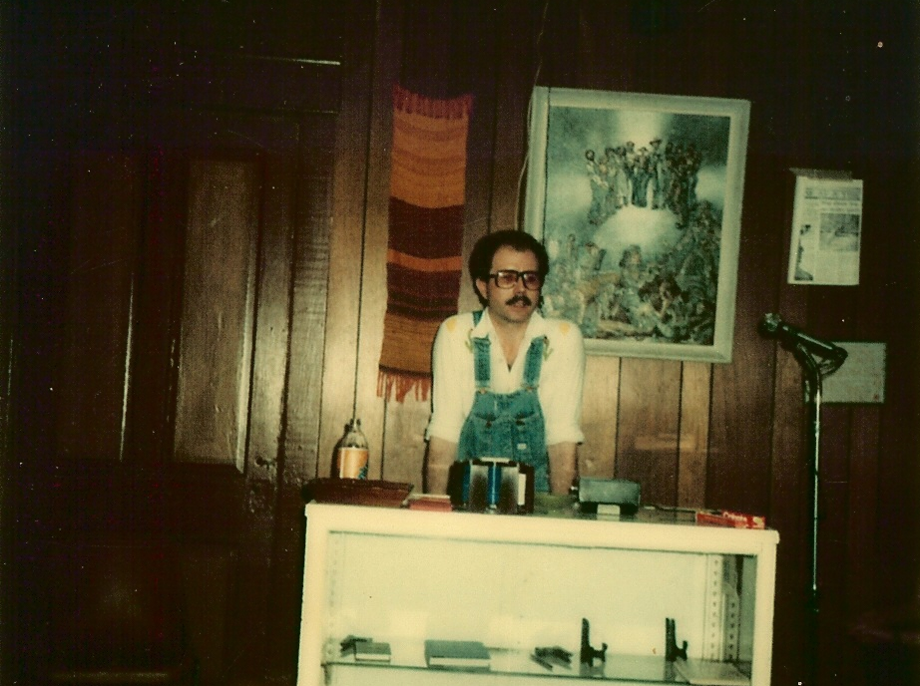
Joseph P.
Passed away May 5, 2011 just shy of his 32nd anniversary
And I was told about the first World Literature Conference that was coming up a few months later up in Kansas.
And so I arranged for Bo to come through Memphis and pick me up and go up there. I didn’t know what it was going to be about.
And it went on and on and on and what I finally figured out after that convention was the “wee book” is “WE together” and not small.
And on the way talked about a lot of things. And we talked about we were going to write this “wee book.”
And they kept talking about for days this “wee book” we were going to write.
And all this information that Greg had and other people had was getting piles and the copy machine was running
and I couldn’t figure out how they were going to get all this material in a small book.
But I’d never asked. So, that’s where I was.
Notes:
Joseph P. – 48 sec. from Madison, AL History Conference (1990)

Slide 40
1st World Literature Conference
Core value emerged from this literature conference:
  Input was encouraged, actively sought and highly valued from all members of the Fellowship, regardless of clean time or experience
This core value is contained in many places within the Handbook for Narcotics Anonymous Literature Committees

Slide 41
Core Value
“Every member is welcome to contribute material to this effort.” (p. 1)
“We need all types of stories, and yours might be just the one to help your type of addict.” (p. 2)
“We ask all members to send in their material without worrying too much if it is any good or not. Some of the best is probably in trash cans right now.” (p. 3)

Slide 42
Core Value
“The theme is: ‘You are the Book!’ This expresses the fact that so much of our program is in the minds, hearts and spirits of our members with time in the program. Those not fortunate enough to live in an area strong in the fellowship have to do without. In a real sense ours is a movement of the message from those who have it to those who are dying for it.” (p. 4)
Notes:
Slide transition at 20 seconds.

Slide 43
Profanity
The Handbook for Narcotics Anonymous Literature Committees emphasized the need to eliminate profanity from any literature (p. 6, 10 & 11):
  “Stories can include slang but not profanity since this would limit the availability of our book in some areas and institutions (p. 6)”
Notes:
Slide transition at 29 seconds.

Slide 44
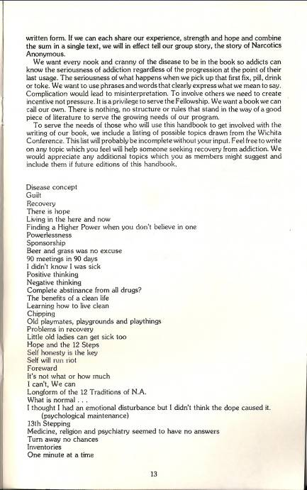

Slide 48
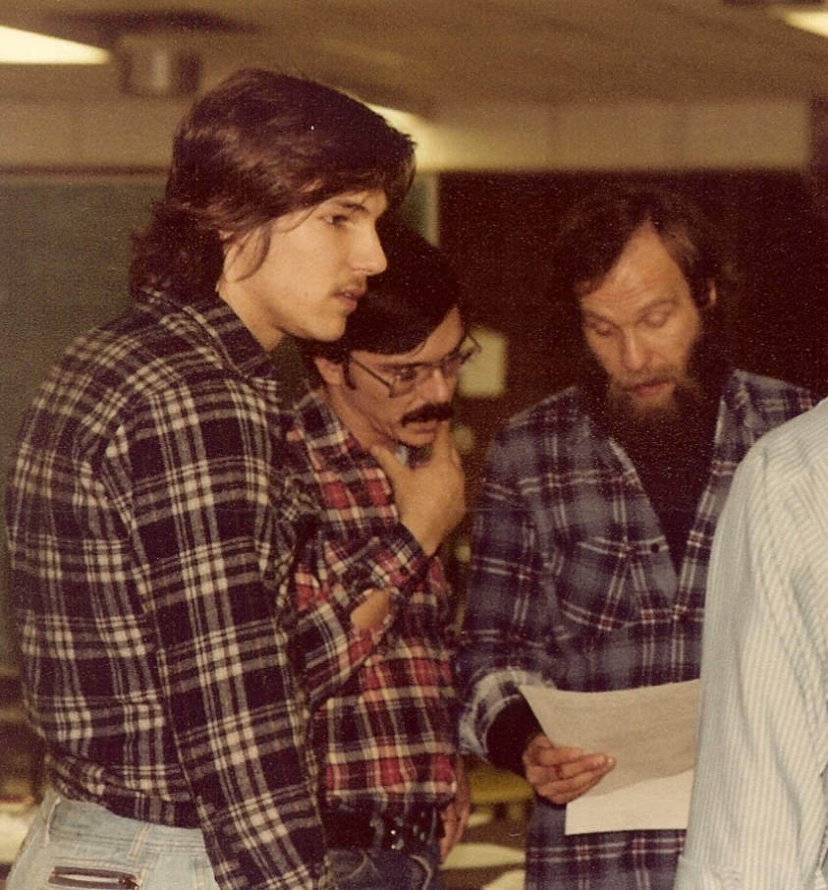
Little old ladies…
Hank F.
October 7, 1979
Basic Text
Committee Report
1st WLC
You know it turned out that this was a very serious, grave matter.
You know one of the topics, and it may sound funny, was
little old ladies get sick too.
There are, you know, senior citizens, so to speak, and
a lot of middle-aged addicts, you know,
out there dying too.
Notes:
Photo & audio courtesy of Bo S.

Slide 49
Newsletters
Newsletters were an important conference workshop.

Slide 50
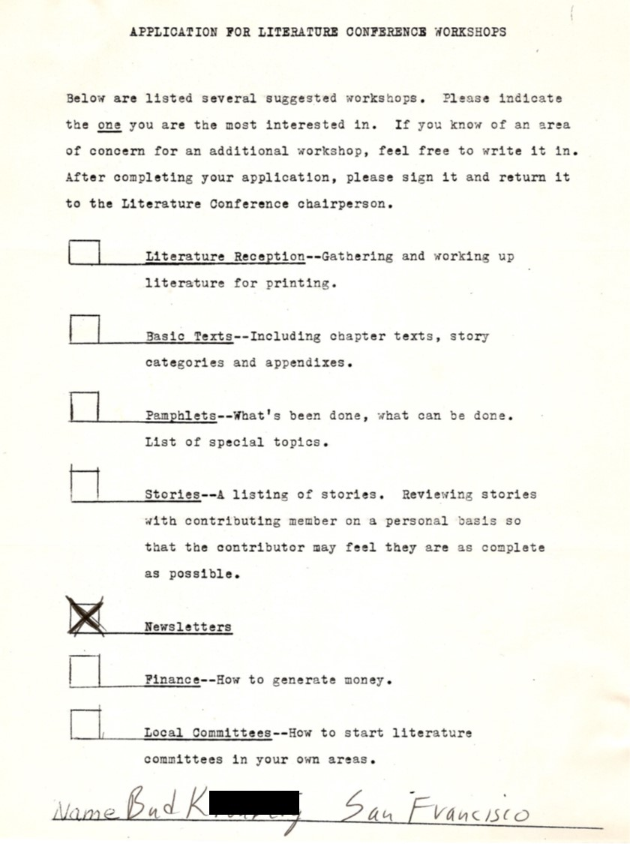

Slide 52
Newsletters
Buddy K.
  September 15, 1976 – A group of addicts, including Buddy, started the Hope without Dope group.
  Buddy and the other members took September 15, 1976 as their clean date.
  This was the first LGBT meeting in San Francisco.

Slide 53
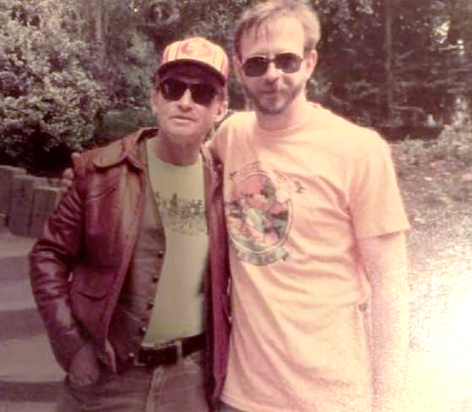
Bob B.
Buddy K.
Notes:
Photo courtesy of Francis

Slide 54
Newsletters
Buddy K.
  Some of his contributions to the writing of the Basic Text were communications through the Main Line newsletter.
  He passed away July 10, 2005.
Let’s listen to Buddy at the 1st World Literature Conference.

Slide 55
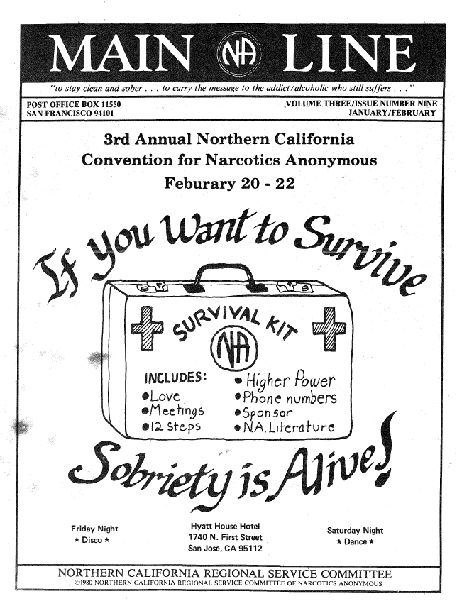
The newsletter is a tool of the committee to publish what the committee needs published.
And how the newsletter can help the literature committee do the job.
Notes:
Audio from 1st WLC 1979

Slide 56
The Main Line (San Francisco)
Several issues featured Wichita.

Slide 58
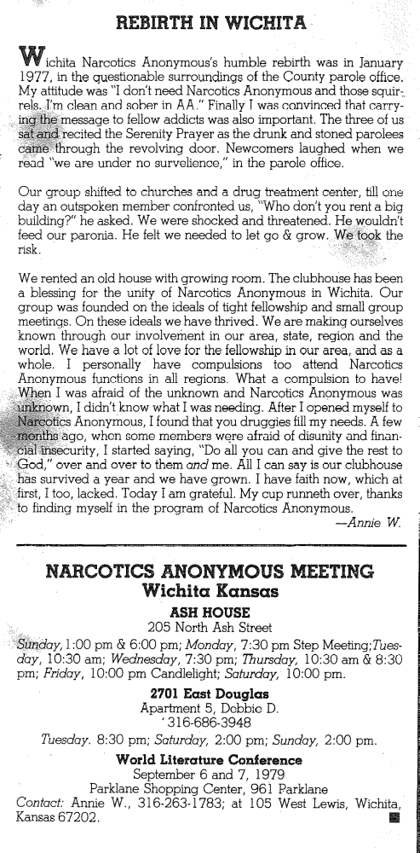

Slide 63
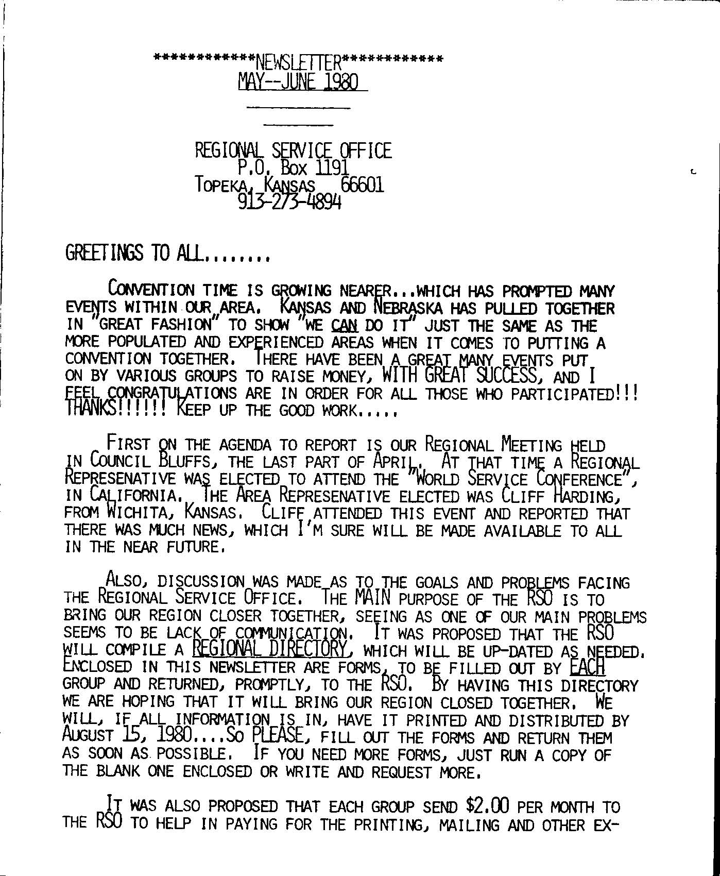

Mid-America Newsletter Started
January 1980 by Cindy P.

Slide 65
And putting, you know, like a slogan on it, “how much is one human life worth?”
Having a jar for change was one of the ideas.
And have it for the literature convention thing that’s going on.
And let them know what we’re doing.
That we’re going to write our Big Book or whatever we’re going to call it.

Slide 66
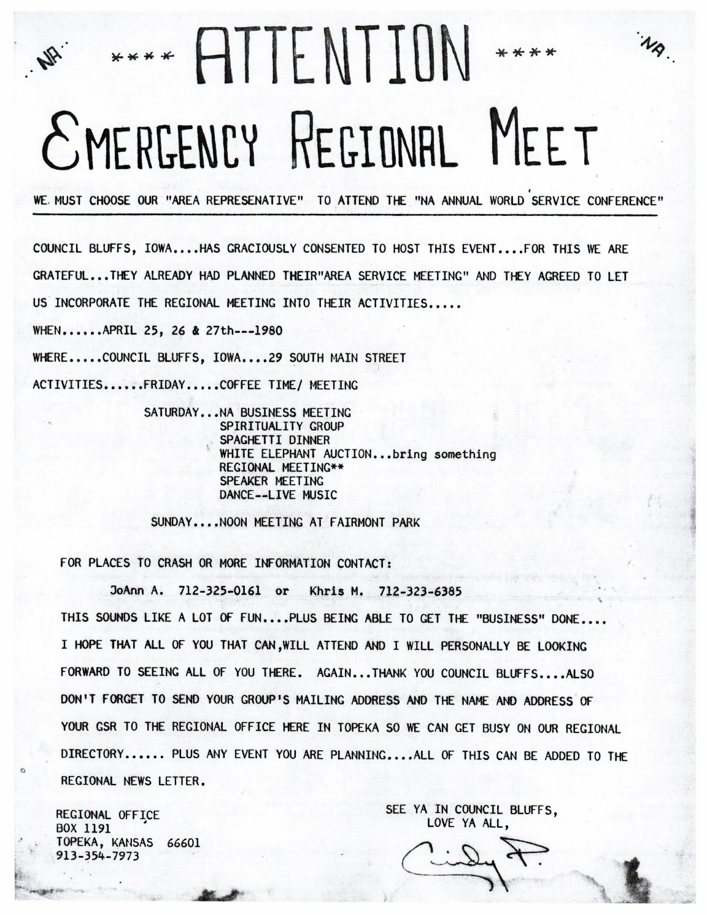
First
Official
RSR
Cliff H.
Wichita

Slide 67
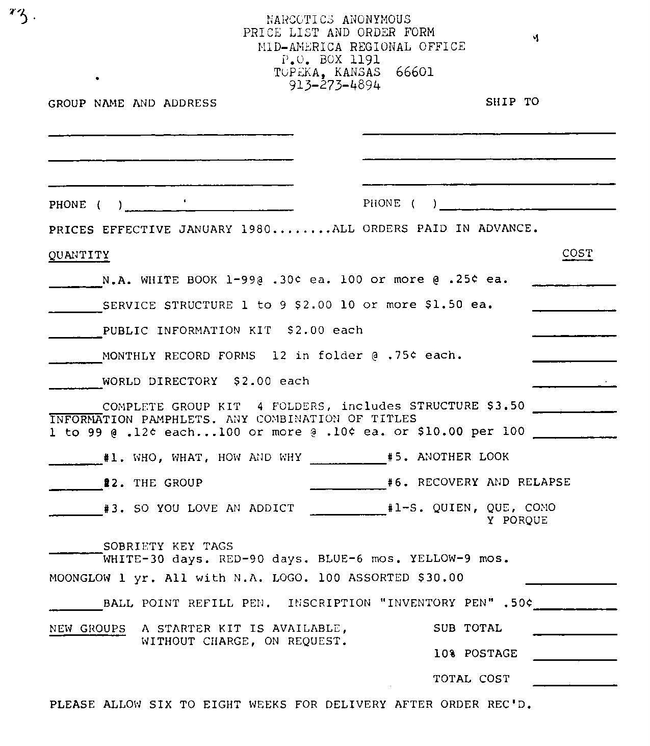
1980
Regional
Service
Office
Order
Form

Slide 68
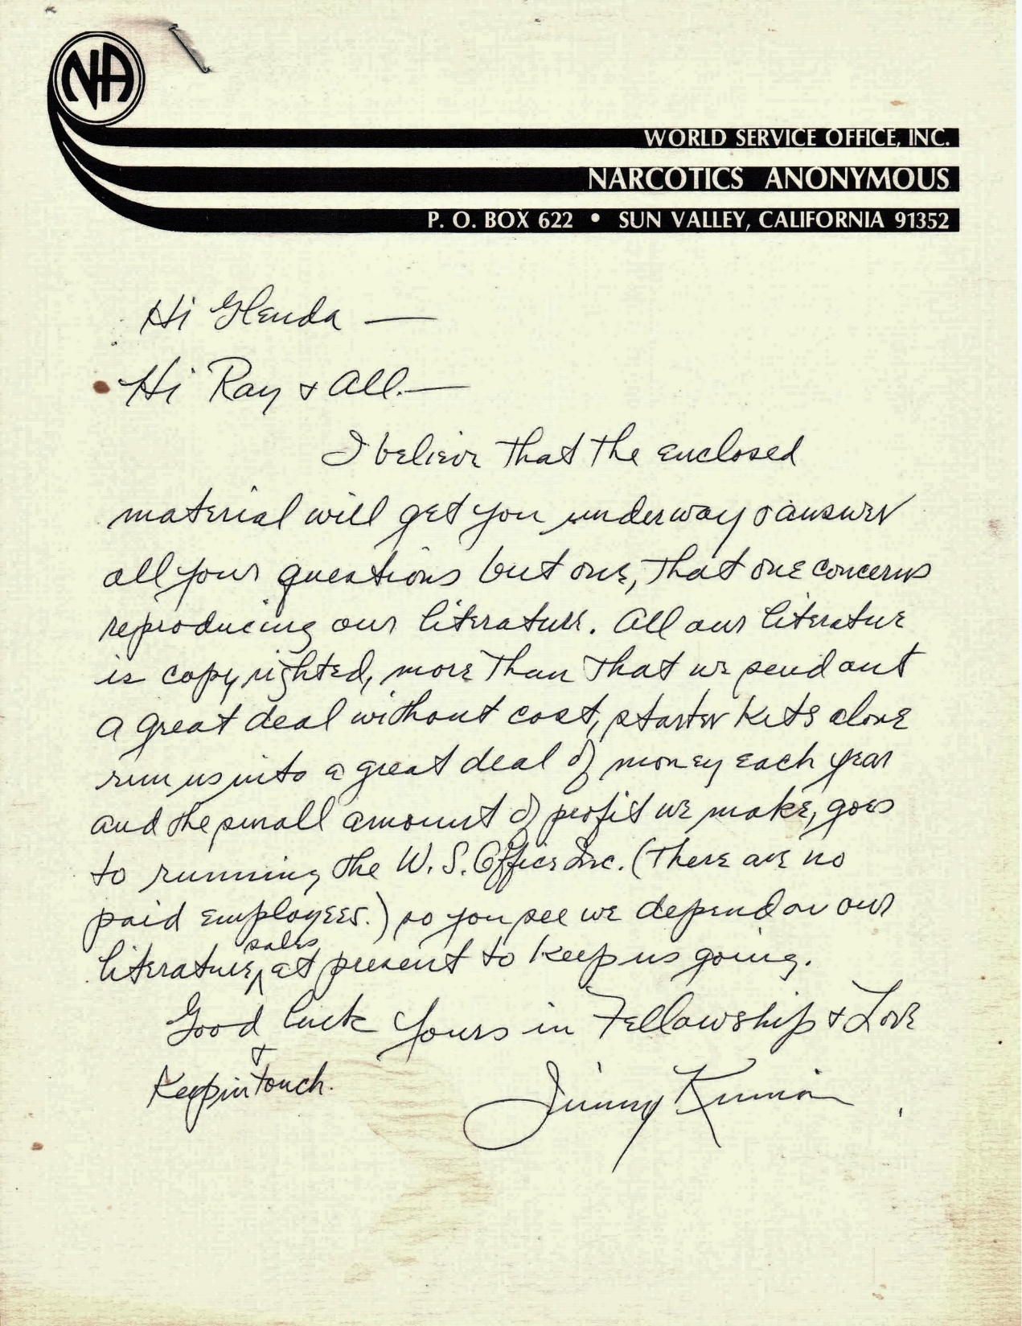
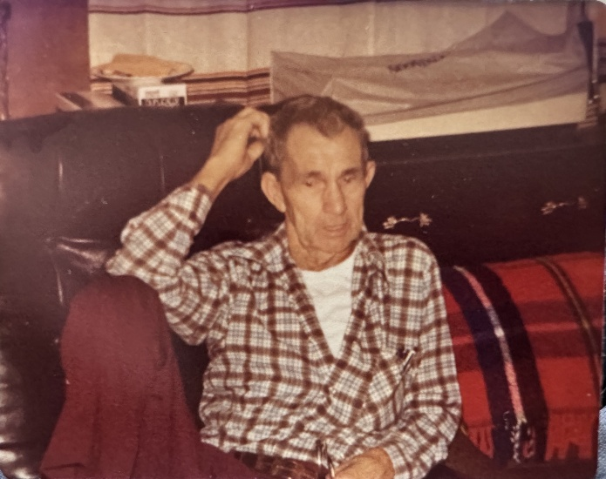
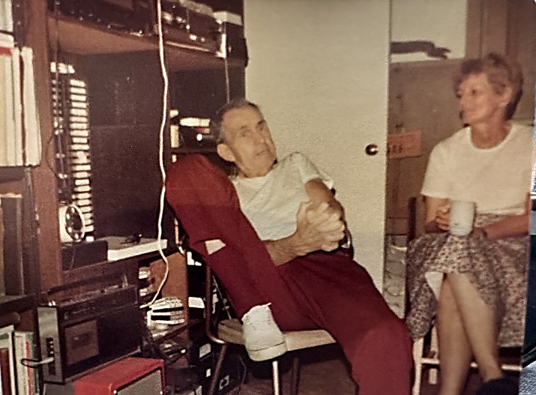

Slide 69
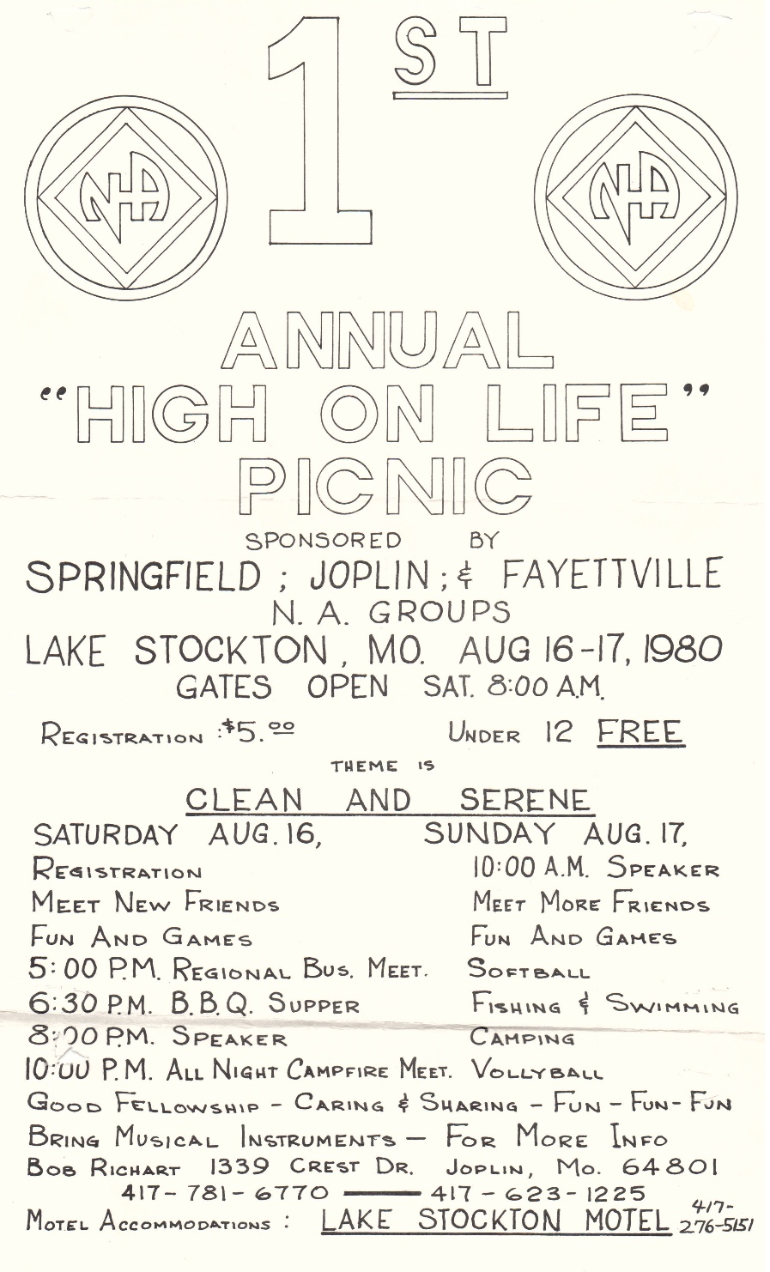
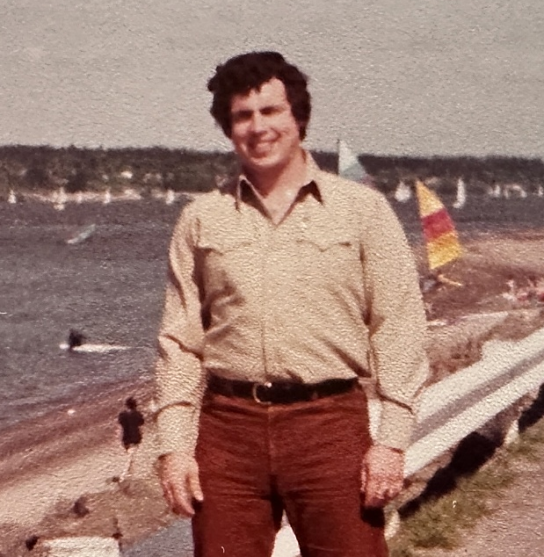
Ron D.
Cindy P.

Slide 70
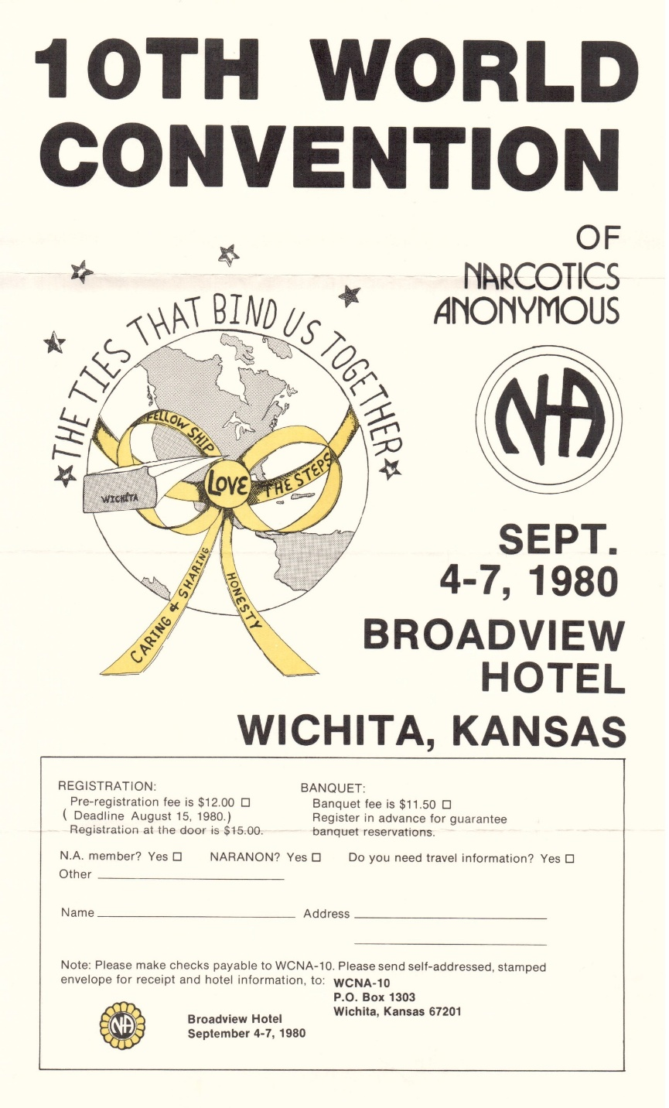
Notes:
Courtesy of Motorcycle Ed’s archives

Slide 71
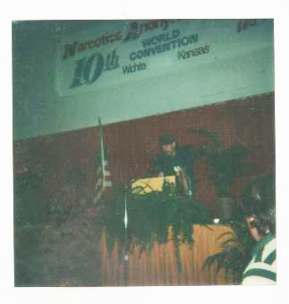
Jim N.
Photo courtesy of Ed S.
Audio from WCNA 10
so that I have something to give this guy besides my story which he may not be able to identify with,
There’s a literature conference in, in, Lincoln, Nebraska starting Monday.
And I’m looking forward to it.
And I feel awfully inadequate, you know.
I don’t know what I’m going to be doing there.
I feel like, you know, it’s a change.
I think it’s a big change. You know.
We’re standing on our own two feet.
A lot of us here had to have A.A. hold our hand.
We’re standing on our own two feet.
And with God’s help, we’ll put together some kind of a book,
and a White booklet that’s, you know, sometimes as inadequate as I feel.
Notes:
C

Slide 72
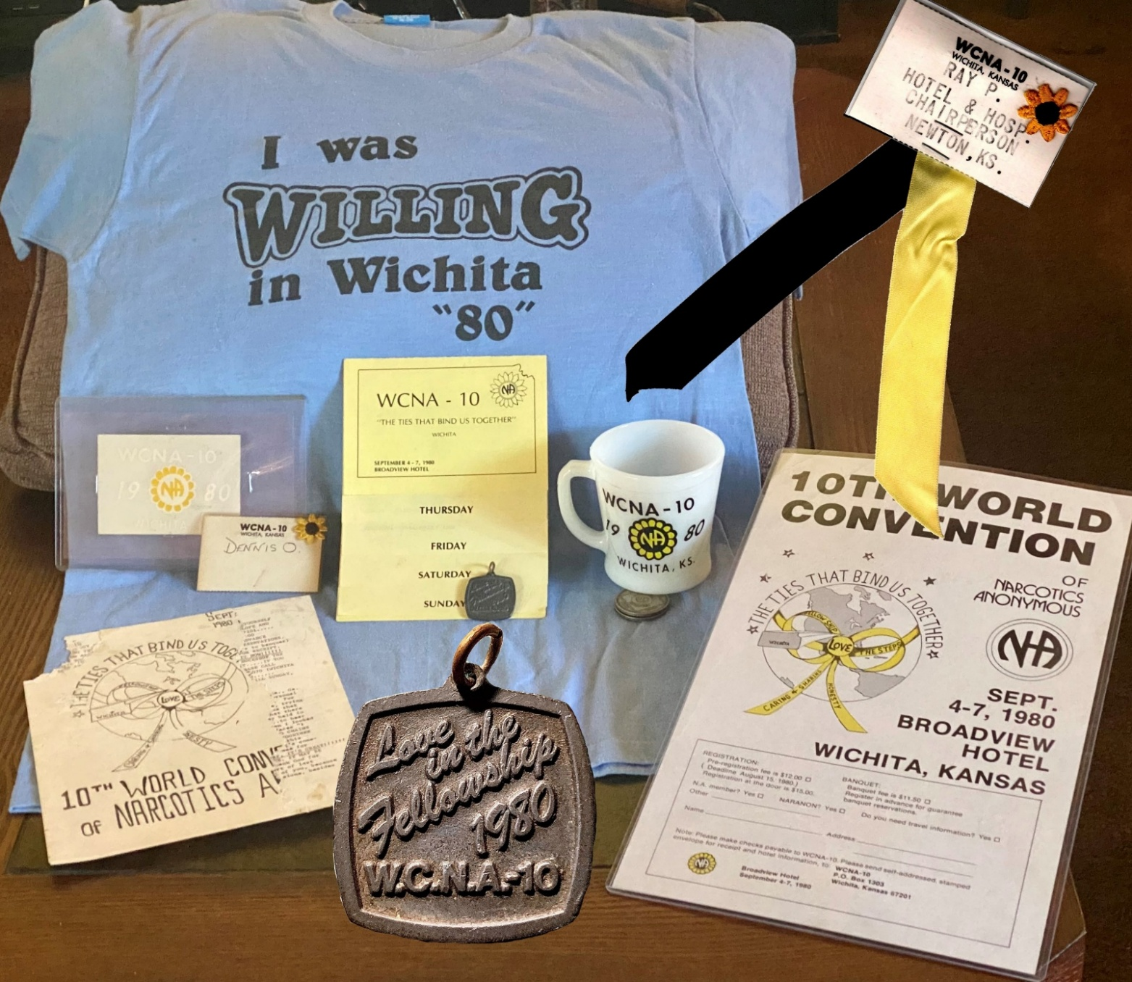
1980 World Convention

Slide 73


Burnalee and Jim N. WCNA10

Slide 74


WLC II
1980

Slide 75

Feb. 1981

Slide 76


Slide 77



Linda M.
?, Cindy P., Linda M.
Linda M. & Bo S.

Slide 78


Cindy P. at Chalk Board
We Have
A Book!

Slide 79


Cindy P. and Jimmy K. c1983
Tim S. and
Cindy 2026

Slide 80



Slide 81




…And then there was one
Iowa formed region October 1981 (seated 1982 WSC)
Nebraska formed region May 1983
Missouri formed Show-Me region August 1983 (both regions seated at WSC 1984).
Oklahoma formed region June 1985 (OK Region seated 1986 WSC)

Slide 82



Multi-Region Events and Zones
1992 - 1996
1995 Plains States Zonal Forum Formed

Slide 83

www.mzssna.org

