Slide 1

MZF LEARNING DAY
GROUP SECRETARY DUTIES
TINA M (WE DO RECOVER AREA)
AMBER R (MULTI-ZONAL AREA)

Slide 2
SECRETARIAL FACILITATIONS
`
Meeting Facilitation
To support the Chairperson in ensuring the smooth functioning of the meeting.
Official Minutes
Responsible for capturing and providing official business meeting minutes.
Submit an archive copy of the report prior to the close of the meeting.

Slide 3

Role & Responsibilities
Core Responsibilities
Term & Attendance
Must attend all business meetings for a twelve month term.
Record Keeping
Maintains records of group activities, attendance, new/old business, key points, and the Financial report.

Slide 4

Role & Responsibilities
Core Responsibilities (Continued)
Meeting Logistics
Ensures the Zoom meeting platform is set up and accessible for meetings (managing links, passwords, waiting rooms).
Communication
Promptly answering and providing assistance within 24 hours to anyone who has emailed meeting.

Slide 5

Role & Responsibilities
Secretary Responsibilities (Cont.)
Phone List Maintenance
Responsible for adding, removing, updating and maintaining both men and women's phone lists.
Minutes Distribution
Posting the Business Meeting minutes onto GroupMe Home Group page no later than 7 days after the meeting.
Clean Time & Steps
Clean Time Requirement is 1 year, actively
working NA steps with a sponsor.

Slide 6

Role & Responsibilities
Transition Duties
Term Transition
Responsible for transferring all group records and documents to the incoming Secretary.
Ensure a seamless handoff of materials at the end of the twelve-month term.

Slide 7
The Area Secretary:
Not just a note-taker
Presented by Mo V. of the
Midwest Zonal Forum
Fellowship Development Subcommittee

Slide 8
Qualifications:
Two years continuous cleantime
Willingness to serve a one-year term
Previous experience at a group or area level

Slide 9
Helpful skills:
• Attention to detail
• Good organizational skills
• Good typing skills
• Familiarity with word processing programs
• Familiarity with file/folder organization

Slide 10
Spiritual principles:
• Commitment • Consistency
• Humility • Respect
• Patience • Flexibility
• Equality • Communication
• Selfless Service • Accountability

Slide 11
ASC Meeting duties:
• Performs roll call of all groups and Trusted Servants and determines
quorum
• Keeps accurate minutes
• May prepare agenda
• Provides minutes for previous month for approval
• Distributes minutes and subcommittee reports via email

Slide 12
Support duties:
• Maintains distribution email list
• Maintains meeting directory and distributes it on a
monthly basis
• Updates GSR attendance spreadsheet
• Checks the secretary email on a regular basis

Slide 13

Conclusion
These may not be all of the duties and responsibilities required for every area but are a collection of the more common ones. They are representative of both in-person and online areas.

Slide 14


The Region Secretary!
Workshop Presenters:
Mark S, Chicagoland & Wisconsin Regions, FD MZF
Patty K, Minnesota Region

Slide 15
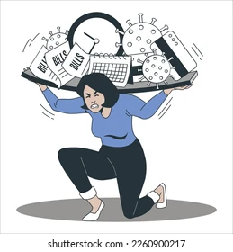

Secretaries are Communicators!
Secretaries
strive to demonstrate the principles of Concept 8:
Attendance
Minutes
Reports
Elections
Motions
Our Service Structure Depends
on the Integrity and Effectiveness of our Communications

Slide 16


What does a Regional Secretary do?
What Are the Qualifications?
There is no established list of Regional Secretaries duties.
Each Region is different! Check your regional guidelines.
It is important to be clear what your responsibilities are prior to accepting the position.
Best practices indicate Secretaries possess Area and Regional experience, as well as a solid understanding of the Regional Guidelines/ Policy.
Secretaries are typically part of the Region’s leadership group/ Admin Team or “executive team”
Necessary skills include the ability to manage email, MS Office and Google Workspace applications or possess the ability and willingness to learn.
The humility to ask questions and
work as a team
are vital to your success!

Slide 17
2026-2029 Conference Cycle Work will include revisions to the Group Booklet and our Guide to Local Services
Based on these discussions, the WSC may decide to offer new insights & suggestions on Trusted Servant roles and responsibilities.
For now, NAWS recommends reviewing the GLS and the Local Service Resource Page https://na.org/service-material/local-service-resources/
Regional Secretary duties in this presentation represent the hard-won experience of some Regional Secretaries.

Slide 18
Regional Secretaries do more than take notes!
Depending on your Region, Secretaries may have many responsibilities
Before, During
and After the RSC

Slide 19
Before the RSC, Secretaries may
Prepare the Agenda – Sometimes Agendas are prepared by others on the Regional team (such as the Facilitator/ Chairperson), or the agenda may be prepared as a group.
The Agenda sets the stage for the RSC and it is important that the secretary ask any questions about the order of business, so they are prepared to take notes and communicate the RSC business.
Send out the “Call to Service” or “RSC Invite” to members on their Regional list via Email, Slack, or other electronic communications. If this is done via email, use BCC for distribution! This communication may include previous “Draft” minutes, the agenda, open service positions, guidelines, blank motion/proposal/project form – or better yet, instructions on where to find these on your Regional website.
HOW does your Region create the agenda?

Slide 20
Before the RSC, Secretaries may
Collect Project, Subcommittee and Area Reports – Hopefully most of our Regions have moved from email attachments to shared drives of some sort (Google Drive, Slack, etc). This takes the responsibility off the secretary and places it on the individual. Secretaries may want to send out reminders with links/instructions on uploading reports.
Check their Regional email or other communication for new motions and agenda additions
Prepare hard copies of agendas, sign-in sheet(s), reports, flyers, motion forms, guidelines, etc to bring to the RSC. Many of our Regions have gone paperless and have virtual meetings. For those of us meeting in-person or hybrid, paper copies may still be a thing. Extra copies may be provided for your RCMs to bring back to their Areas.
HOW does your Region collect reports??

Slide 21

During the RSC, Secretaries may
RECORD ATTENDANCE/ Roll Call (and absences):
Trusted Servants, Areas + RCMs, Project Managers, other Attendees. Different Regions track and publish various combinations of the above individuals in their minutes. (This is important to determine quorum for business decisions)
At a virtual or hybrid meeting, the secretary may need to announce the request for name, area, service position, phone & email numerous times.
At in-person meetings the secretary pays close attention to a physical sign-in sheet as it’s passed around; making sure that late arrivals sign-in. It may be helpful to delegate this duty to another member so the secretary can focus on taking minutes
HOW does YOUR REGION record RSC attendance?

Slide 22
During the RSC, Secretaries may
Record and document old & new proposals/motions and voting
Secretaries record the Maker/ Second, and Results: “favor,” “against,” “abstention,” “stand-aside,” depending on your Region’s decision-making processes
        Secretaries note if new proposals are time-sensitive; require ASCs to return to the next meeting with a group conscience; or if a proposal is recommending a guideline change. The quorum and threshold for approval of different kinds of proposals may vary and the Secretary may help with counts.
How does your Region entertain new proposals?
Notes:
.

Slide 23
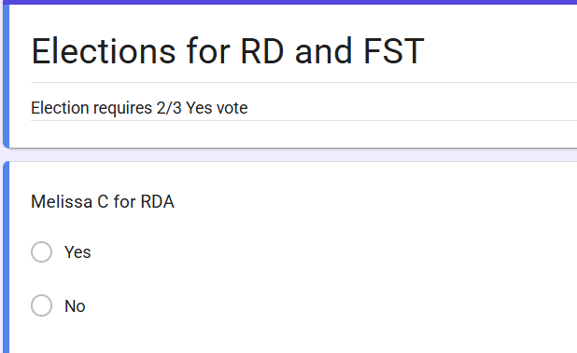
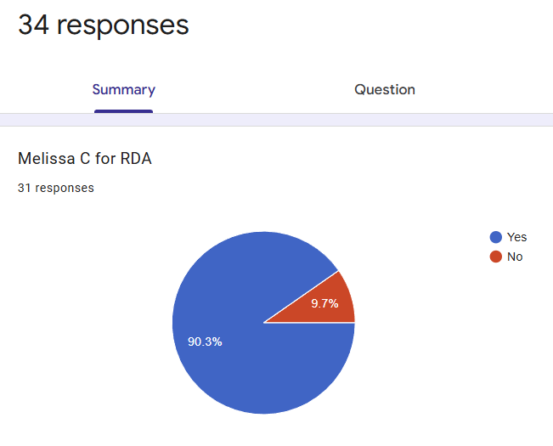
During the RSC, Secretaries may
Record ELECTIONS nominations & results
Secretaries may create ballots or google forms, and document election outcomes
How does your Region manage elections?
Notes:
.

Slide 24

During the RSC, Secretaries
Record the meeting minutes!
    For On-line meetings secretaries may ask the body if we can record the meeting to help ensure minutes are recorded accurately.
    Secretaries can document discussions with summarizing bullet points; not attempting to record everything that is said.
    Secretaries can share the minutes on-screen in real-time offering a shared responsibility for ensuring accuracy. Secretaries can ask for help in a fast-moving discussion and members can offer real-time suggestions, if they believe a discussion should be documented differently.
Sharing note taking on-screen can also give members providing verbal reports, the opportunity to see how their message will come across in the minutes.
How does your Regional Secretary record discussions?

Slide 25
AFTER the RSC, Secretaries
Compile RSC Minutes
Use a watermark to designate the minutes as “Pending Approval” or “Draft”
Provide links to written reports; its ok to simply document “no report” or “verbal report provided”
Compiling minutes and reports are done differently: some secretaries insert links to reports, use a pdf-merge tool to attach minutes and original reports, attach reports separately, &/or maintain separate report files
Publish/archive trusted servants reports & RSC Minutes
Update the Previous Meeting Minutes: Make requested revisions to the minutes, remove the draft watermark & publish/archive
Share your work with the team! Share the responsibility!
How does your Region store and maintain RSC Minutes and Team Reports?

Slide 26
After the RSC, Secretaries may
Update your Region’s Distribution List
Update the Motion log
Update Election History
Publish or Distribute the RSC minutes!
HOW does YOUR REGION share
minutes and reports ?????

Slide 27

HATS OFF TO NARCOTICS ANONYMOUS SECRETARIES!
THANK YOU FOR YOUR
EFFECTIVE COMMUNICATION AND SERVICE TO Narcotics Anonymous!

Slide 28
Thank You!
Contact Info:
Webservant@mzfna.org

