Slide 1

Building Connections to the Isolated
Tim L. (OK Region)
Tom K. (Rio Grande Region)

Slide 2
Building Connections to the Isolated
Who are the
Isolated Communities
and Individuals?
We want your input as well!
Please write on handouts
provided.
Notes:
"This workshop will identify some of those who may be isolated from the NA message while suggesting possible solutions and resources to connect with them.
We also will share some experience, both successful and otherwise, with these efforts."

Slide 3
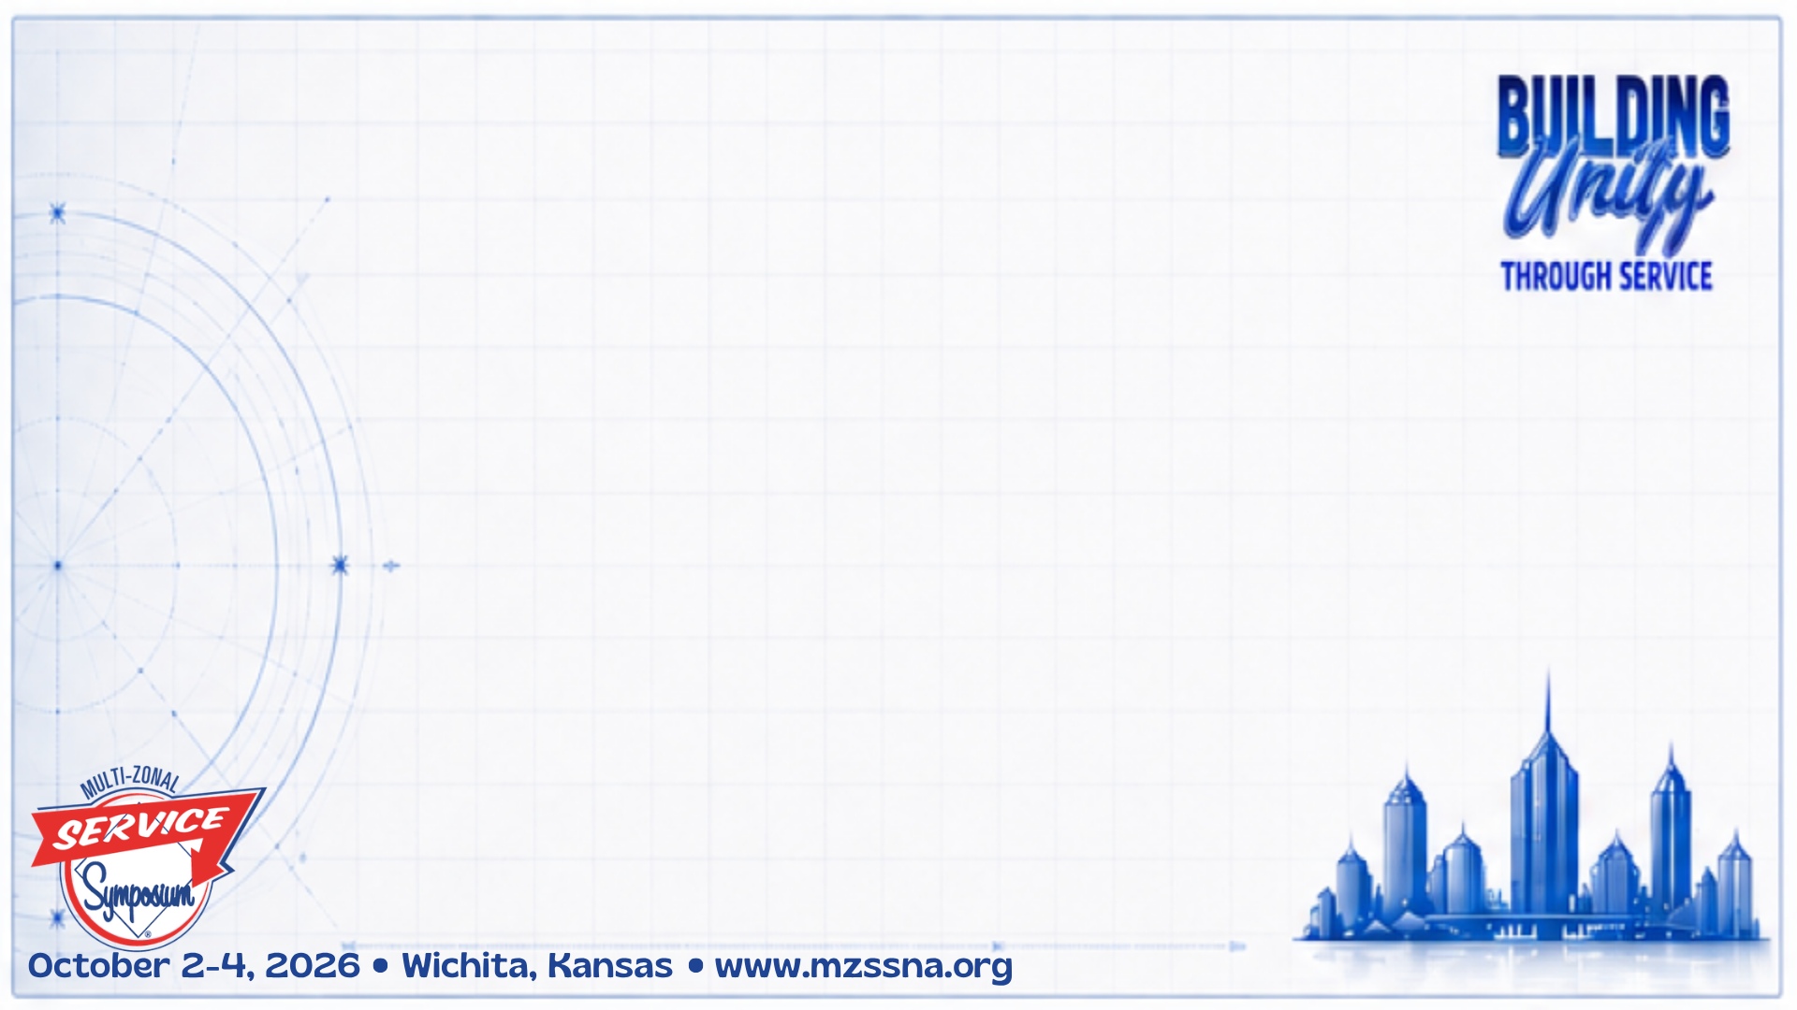
Isolated Communities and Individuals
Isolated by Language barriers
With over 44 million* individuals who speak Spanish in the home, this is the largest group in the United States that falls under this heading.
There are another approximate 29 million* individuals who speak
another language.
Those who speak English, but live in a non-English speaking environment
Cultural Differences
    Examples: Hispanic/Latino, Black/African American, Asian, Native/Indigenous Americans
    Religious or Spiritual Beliefs Examples: Amish, Hasidic Jewish,
    Traditional Islanders
  *The U. S. Census Bureau’s 2024 American Community Survey
Notes:
*********** Add disclaimer about race, etc. that we are doing the best our ignorant selves can do. ********** The isolated we are referencing are in no particular order on our list and may fit just as well or better under a different stub topic then where we have them listed

Slide 4
Isolated Communities and Individuals
Physically Isolated
  Examples: Rural Communities (only 1-2 addicts in a town of 300)
  Incarcerated – jail, prison, mental institution
  Displaced, both long and short term
    Traveling, relocated, temporarily or long term, work,
    Employment keeps them on the road)
    Marine job - on the ocean
  Uncomfortable around people - Phobias
  Physically isolated and lacking knowledge
  of available technologies that might help
  (Technophobes)

Slide 5
Isolated Communities and Individuals
Health Issues
Visually Impaired, Hearing Impaired, Mentally Impaired,
Disabled, Short- or Long-Term Conditions, Hospice, Aged
Care givers for: children, elderly, infirm
Employment Requiring Absolute Anonymity
  Examples: Military - Reserve, Deployed military, National Guard
  (communication under surveillance)
Local police, state and federal police
Undercover agents (retired or active)
  Federal employees with security clearance
  Commercial employees with security clearance
  (e.g. NY Stock Exchange)

Slide 6
Isolated Communities and Individuals
Other Circumstances
  Examples: Old/Long Timers (Trouble relating to younger members,
  lost touch with NA – unintentional or by choice, just drifted away)
  Those who are “All Knowed Up” (Believe they have no more to learn)
  Long or odd work schedules or locations
  (e.g. 4 days on – 4 days off, Cowboys on a ranch can’t get into town)
  Homeless
  Addicts living in a family of addicts (Don’t believe there is any other way)
  Uninformed – Just never heard of NA
  Not an Exhaustive List!

Slide 7
Building Connections to the Isolated
What are our NA Resources?
We want your input as well.
Again, we want you to write.

Slide 8
NA Resources
Tools to reach the Isolated
Websites
  NAWS, Zone, Region (Multi-lingual)
  Meeting info, service materials, event calendar
  BMLT allows planning for travel
  Flyers, etc. to have QR codes to websites
    Places to put flyers: Dumpsters, Laundromat, Community bulletin boards, Hospitals, Methadone clinics, Busses and Bus Stops, Community Benches, Pharmacies, libraries, Homeless Shelters
  Digital Flyers: Grocery receipts, Banks, Digital Billboards
Helplines with Texting support (YAP)
English and Spanish volunteers

Slide 9
NA Resources
Tools to reach the Isolated
Online/Hybrid meetings
Support for those needing extra anonymity (video off),
Geographically isolated, home bound, etc.
Meeting guides to ID language used
and if ASL supported
Online Meetings that include other isolated meetings/members/communities
using their format and service round robin
  Example: “STAR Meeting” Small Town Allied Recovery.
  Several isolated communities have online access and are each
  responsible for format on a rotating basis. Get them into service!
  Virtual Meetings - https://virtual-na.org/meetings/
  Sorted by Language and includes ASL

Slide 10
NA Resources
Tools to reach the Isolated
Literature – electronic and paper
  Books, IPs, Audio books, Reaching Out
  NA.org has IPs in 57 languages – free
  IP 21 – Staying Clean in Isolation
  Iran gives out more Welcome to NA IP #22 than any other language
Speaker Recordings
  NAWS (WCNA 38)
  Many local websites provide free downloads
Convention Support
  Speaker translation: English, Spanish, ASL
  Provide people willing to Sponsor and Childcare
Notes:
NAWS has speaker recordings for free from WCNA 38
An Iranian Group buys the IP 22, and everyone in the Group hands it out.

Slide 11
NA Resources
Tools to reach the Isolated
NAbyPhone.org https://nabyphone.org/
For those with simple phones or no internet
This is a long-standing meeting guide prior to online meetings
Start a Meeting yourself
  Then train your replacement
Long Distance Sponsorship
Event activities that include all generations
Writing: step work, inventory
  Sponsorship behind the Walls
  Outreach committees
Notes:
NAWS has speaker recordings for free from WCNA 38

Slide 12
NA Resources
Tools to reach the Isolated
Social Media
Start social media accounts (Must be moderated)
Brazil has an Instagram account with 60,000 followers!
  Lots more here
PR PSAs
Aimed at isolated communities or communities with no meetings at all
Get in the car!
How it was done in the beginning. Still works!
Grab a couple members and go meet them.
Go post flyers in those rural communities!
Notes:
NAWS has speaker recordings for free from WCNA 38

Slide 13
NA Resources
Tools to reach the Isolated
Reaching Native American or First People
Considerations:
  Often no internet available. Need permission from Elders
  Make sure there are volunteers committed to bring a meeting in
No volunteers? Put a PR rack in place if permitted & keep it stocked
PR presentation to the elders – Commit to a year
Start a meeting
Run it for a year training locals to be self-sufficient including GSR training
    Keep in touch with Elders!

Slide 14
Reaching People to Help NA Reach the Isolated
People Needing Information (PR) to help us reach Addicts
  Examples: Judges, Religious advisors, Therapists, Human Resources in many companies
  Hospital administrators (ambulance drivers otherwise known as Narcan delivery).
  Government officials: Governor, State Attorney General,
  Financial committee that funds prisons,
  State legislator
  How to Present to Decision Makers:
  https://wszf.org/public-relations-presentation-to-vips/

Slide 15
NA Resources
More Tools to Reach the Isolated
Fellowship Developed Resources - NA.org
https://na.org/fellowship-development-resources/
Serving NA in Rural & Isolated Communities - IP
https://na.org/wp-content/uploads/2026/06/Rural-and-Isolated_2025-12-15-1.pdf
Zonal materials
    Southern Zone
    https://szfna.org/presentations/
    Western States Zone
    https://wszf.org/na-public-relations/
    Northeastern Zone
    https://nezf.org/pr/
    Not an Exhaustive List!
Notes:
NAWS has speaker recordings for free from WCNA 38

Slide 16
Reaching People to Help NA Reach the Isolated
How to do a PR Presentation to a Police Department
https://wszf.org/wp-content/uploads/2023/10/police-overview-2021.pptx
Get police to carry NA Business cards!
Some police department now allow people arrested on drug charges an extra phone call to the local NA hotline when being booked. PR is powerful.
  Not an Exhaustive List!

Slide 17

Our Personal Experience

Slide 18

Thank You!
Contact Info:
Tim L. (405) 409-2179
powerlesstim@yahoo.com
Tom K. (408) 857-3438
Tom.na.servant@gmail.com

