Slide 1
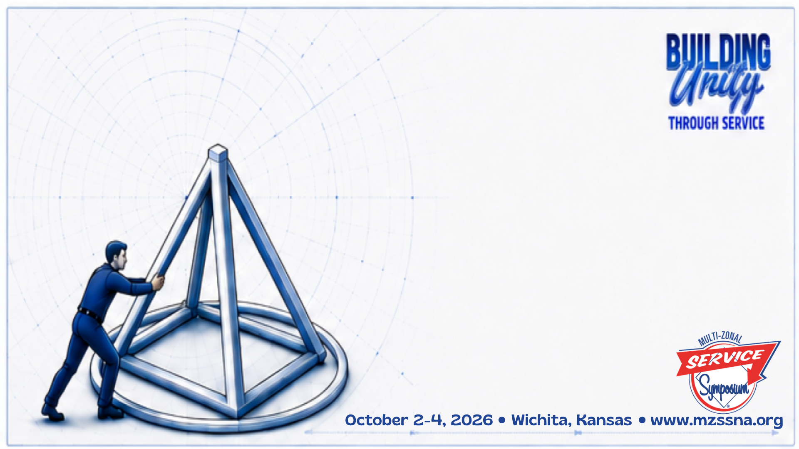
Collaboration in NA Service:
Building Bridges in Service: Together we grow — one member, group, service body at a time
Randie B, Tejas Bluebonnet Region
Craig R, NC Region

Slide 2


Welcome and Today’s Journey
Meaning, importance, methods, benefits — a working session for members, groups, and service bodies.
👥What is Collaboration
💡Why it Matters
🌐Why NA service bodies collaborate
⚙️How Collaboration works in NA
📈The benefits we create together
💬Activities and discussion

Slide 3

What is Collaboration
🎯Shared Purpose
  Two or more service bodies working toward a common goal that none could achieve alone.
🛡️Respect for Autonomy
  Collaboration does not mean merger-each body retains its identity
  and decision making
🧩Mutual Contribution
  Each party brings unique strengths, resources, or reach to the partnership.
🔄Ongoing Relationship
  Not a one-time event, but a sustained commitment to work together over time.

Slide 4
Why NA Service Bodies Collaborate
Why It Matters
Our primary purpose is to carry the message
to the addict who still suffers
No single service body can reach every addict
Resources are stronger when shared
Unity amplifies our message
Collaboration is unity in action
NA service bodies worldwide work together in a spirit of unity and cooperation to support the groups in carrying our message of recovery
Primary Purpose
Unity
Service Support
Communication
Shared Experience
Fellowship Growth
Public Relations

Slide 5

How service bodies can collaborate
Sharing of guidelines, information
Deliver services that help the groups
Fellowship Development
Subcommittees sharing current issues and projects
Joint Events, workshops
CAR motions addressing common issues

Slide 6
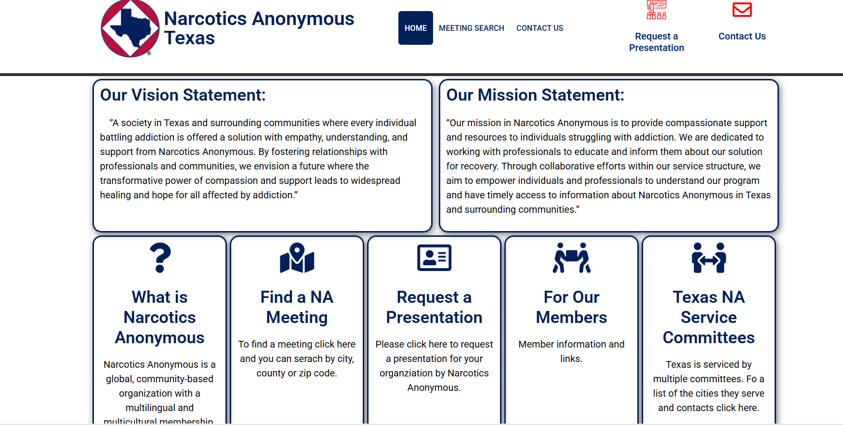
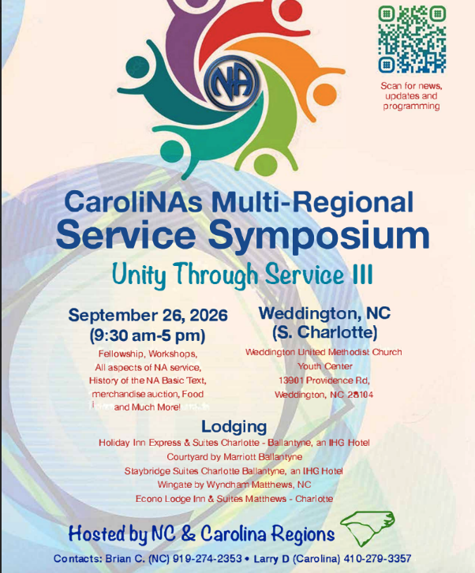


What does Collaboration Look Like
Reimagine Delivery of Services

Slide 7
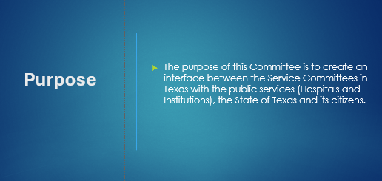
Narcotics Anonymous
Texas

Slide 8
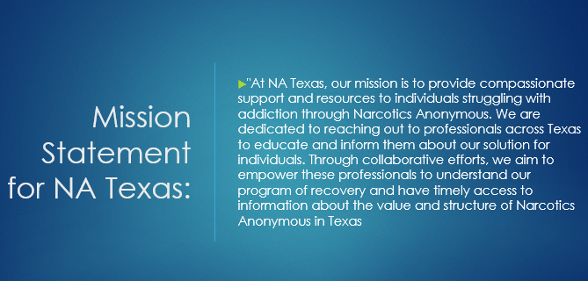
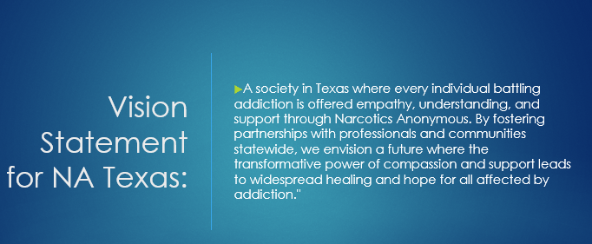
Narcotics Anonymous
Texas

Slide 9
Structure of Committee
Facilitator, Co-Facilitator,
Secretary, Treasurer
and two members from each Region

Slide 10
What…
We are a Committee consisting of the 4 Regions in the State of Texas. Our website has been created to be the interface with outside entities that interact with individuals who could benefit from contact with NA. We have created and will maintain and support Public Relations and H&I activities that impact all meetings and service bodies in Texas.

Slide 11
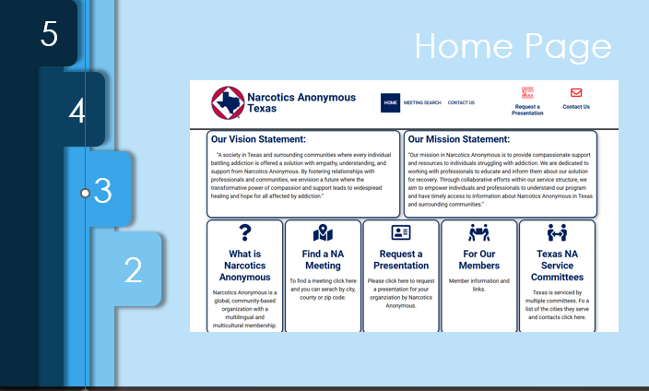

Slide 12
Virtual Committee Meeting
Last Monday of each month
6:30 pm to 7:30 pm
Meeting ID: 836 7215 7065
Password: 984679

Slide 13
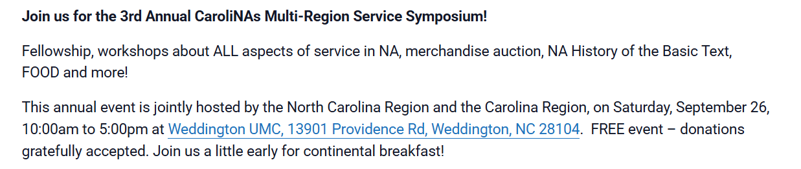
CaroliNAs Multi-Regional Service Symposium

Slide 14
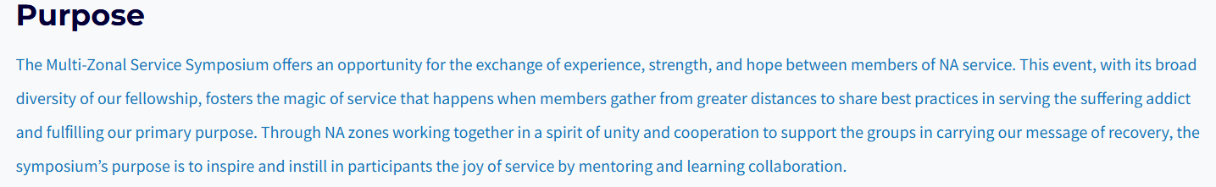
Multi-Zonal Service Symposium

Slide 15
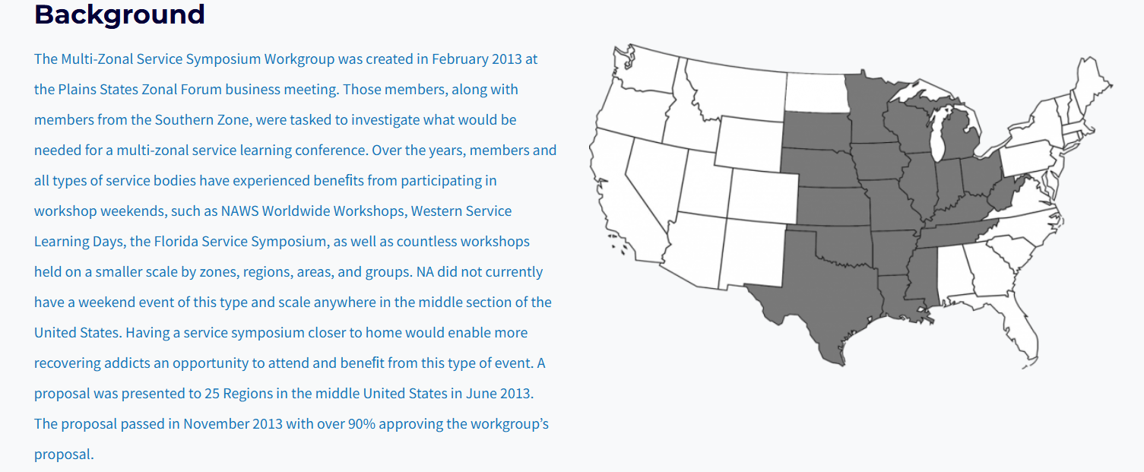
Backstory

Slide 16
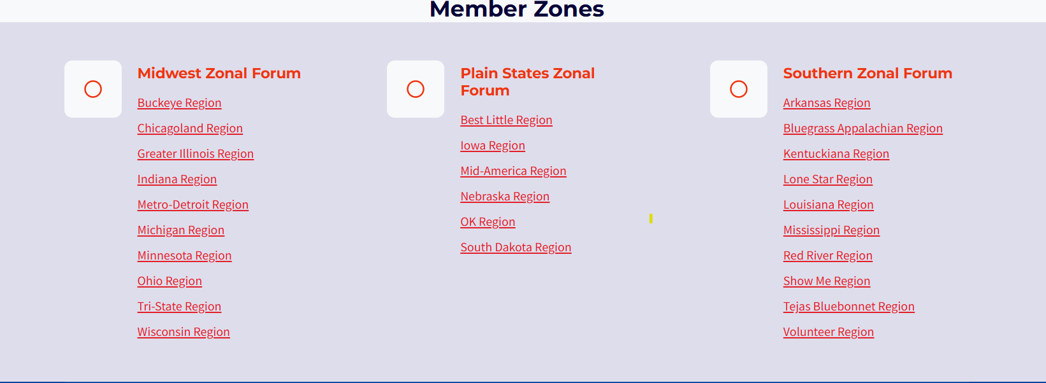
This is Who We Are

Slide 17

US Collaboration of Zones
  Midwest
  Northeast
  Plain States
  Rocky Mount
  Southeastern
  Southern
  Western States
Southern

Slide 18
Communication, Collaboration, Cooperation
Through effective communication and coordination, we will support NA communities in key
service areas, including:
🗣️ Public Relations
🌱 Fellowship Development
🎓 Training and Mentoring
💻 Technology
📊 Planning, Reporting, and Emerging Needs
This Collaboration will serve as a vehicle to identify and fill service gaps, while:
🔄 Complementing—not replacing—existing service structures
🧠 Coordinating existing knowledge and resources
📥 Funneling service requests and supporting local service bodies
Accountability and Reporting: To ensure transparency and consistency, the Collaboration will:
📝 Provide meeting minutes within 10 days of each quarterly meeting, including all voting
results and a financial report.
📘 Produce an annual report for all member zones, summarizing past actions, financial
activity, future considerations.

Slide 19
Mission and Vision
The US Collaboration of Zones will serve as a single national point of contact for Narcotics
Anonymous within the United States, establishing a consistent and visible national presence.
A national presence enables expanded Public Relations opportunities, including:
🏛️ National & Federal Engagement
Working with national and federal agencies that are currently inaccessible to NA in the U.S.
🌐 National Connectivity Tools
Providing a national website and related tools that connect addicts and the public to local NA
meetings, helplines, websites.
📢 Public Service Announcements (PSAs)
Making national PSAs available to increase awareness of Narcotics Anonymous across
the U.S.
📍 Accurate Meeting Information
Improving the quality and consistency of meeting information nationwide—locally and
on na.org.

Slide 20
Workgroups and Task Teams
🗣 Communications
💻 Information Technology (IT)
📣 Public Relations
🌐 Fellowship Development Task Team

Slide 21
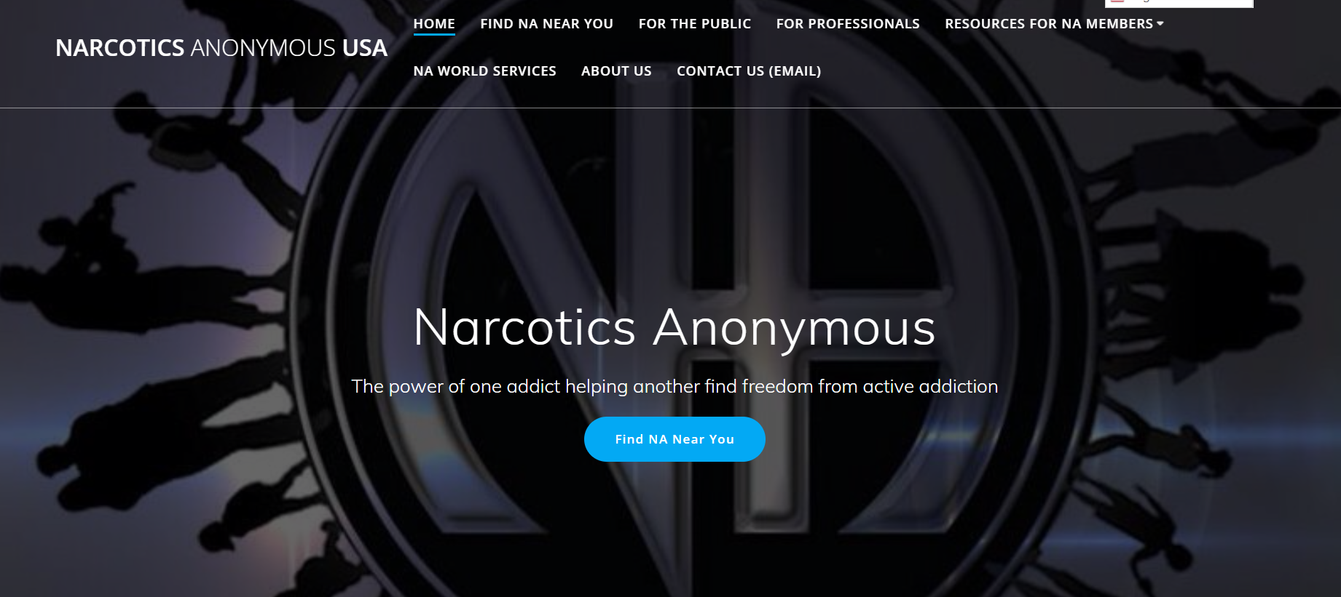
Narcotics Anonymous USA https://usa-na.org/

Slide 22
US Collaboration of Zones Meeting Schedule
🌍 Quarterly Collaboration Meeting
  When: 2nd Sunday of January, April, July, October: 3 PM Pacific / 6 PM Eastern
  Zoom ID: 884 5012 6881/ Password: usa-na
🧩 Communications Workgroup
  When: 4th Tuesday monthly: 6 PM Pacific / 9 PM Eastern
  Zoom ID: 818 2584 3132/ Password : usa-na
💻 IT Workgroup
  When: 3rd Sunday monthly: 6 PM Pacific / 9 PM Eastern
  Zoom ID: 852 6997 3189/ Password : usa-na
📣 Public Relations Workgroup
  When: 2nd Sunday monthly: 10 AM Pacific / 1 PM Eastern
  Zoom ID: 864 4927 0474/ Password : usa-na
🌱 Fellowship Development Task Team
  When: Last Sunday monthly: 10 AM Pacific / 1 PM Eastern
  Zoom ID: 850 3127 0562/ Password : usa-na

Slide 23
Tips for Collaboration
1
Identify the Need
What challenge, project, or goal requires more than one service body to address?
2
Find Common Ground
Identify shared values, purpose, and desired outcomes among the parties.
3
Define Roles & Contributions
Be clear about who brings what — funding, volunteers, facilities, expertise.
4
Establish Communication
How often to meet? Who reports to whom? How are decisions made?
5
Execute & Adapt
Launch the work. Build in checkpoints to evaluate progress and adjust as needed.
6
Celebrate & Sustain
Acknowledge successes. Document lessons learned. Plan for continuation.
PRO TIP A written Memorandum of Understanding (MOU) aligns expectations and prevents misunderstandings before they arise.

Slide 24

Let's Practice: Collaboration in Action
Break into tables for focused conversation
Each table identifies one collaboration opportunity
Using the tips for collaboration process map out how you would approach it
Benefits to collaboration
Share back with the full group — 5 minutes each

Slide 25
What We Gain When We Work Together
Better decisions
More experience in the room means fewer blind spots and outcomes the fellowship will support.
Innovation
Diverse perspectives from different service bodies generate more creative and effective solutions.
New trusted servants
Working alongside experienced members is how the next round of leadership is trained.
Spiritual Unity
Service practiced with others exercises the principles: patience, humility, open-mindedness, tolerance.
Resource Efficiency
Shared costs and volunteer pools reduce burnout and budget strain across service bodies.
A message that reaches further
Coordinated effort puts NA in front of more addicts who still suffer.

Slide 26

Thank You!
Contact Info:
Multi-Zonal Service Symposium – Hosted by Plains States, Southern, and Midwest Zonal Forums of NA
https://mzssna.org/
NA Texas – NA Texas Public Relations
https://natexas.org/
Narcotics Anonymous USA – Freedom from active addiction
https://usa-na.org/
Randie B
randiebenno@gmail.com
Craig R
craigrobertson87@yahoo.com

