Slide 1

Disruptive and
Predatory Behavior
MZSSNA Workshop
Building Unity Through Service

Slide 2

Resources Grounding this Conversation
na.org/sps: Disruptive & Violent Behavior Service Pamphlet written in 2007
na.org/localresources: resources from local service bodies
2023 – 2026 Conference Cycle surveys

Slide 3
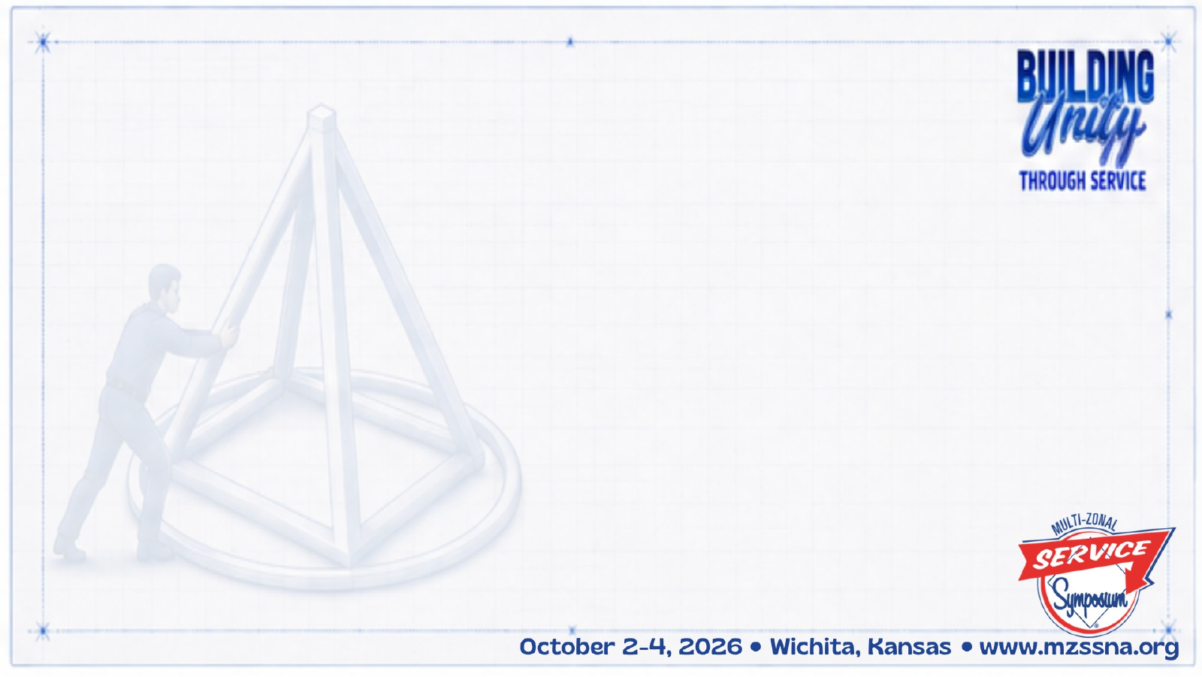
Why This Topic Matters
2023 Conference
Guided by Fellowship input and response to the CAR survey, the 2023 World Service Conference selected this as an Issue Discussion Topic, or IDT.
Dealing with disruptive and predatory behavior is part of the work of building unity.

Slide 4
Why This Topic Still Matters
2026 Conference
Fellowship input continued to identify Disruptive & Predatory Behavior as a priority.
874 survey responses helped identify members’ experiences and the resources groups need to respond.
The World Board recommended moving the work forward as a new recovery IP on Disruptive & Predatory Behavior.
The Fellowship has moved from identifying the problem toward developing tools to address it.

Slide 5

Our Ability to Carry the Message
This topic, at its heart, is about our ability as a Fellowship to carry the message —
if new members do not feel safe,they won’t stay
if professionals hear negative things about NA, they will stop referring clients to us
and addicts who need us may never find us.

Slide 6

From Living Clean…
“All our lives we had looked for the peace and safety we experience in recovery.”
Addressing predatory and disruptive behavior is part of how we give it away.

Slide 7
Atmosphere of Recovery
An atmosphere of recovery is about making sure everyone who needs NA feels safe and welcome.
Anonymity, sharing, listening, respect, no judgment, and safety.
What else characterizes an atmosphere of recovery?

Slide 8
Ideas to Increase the Atmosphere of Recovery
• Leading by example
• Welcoming and paying attention to newcomers
• Creating a safe meeting environment
• Sharing in a way that members can identify
• Mentoring trusted servants
• Group unity
What else contributes to an atmosphere of recovery?
How do I contribute?

Slide 9
Negative Behaviors
We need to come to a common understanding of the problem before we can seek a solution.
One way to think about disruptive behavior generally is behavior that interferes with the peace, security, and integrity of a meeting and its members.

Slide 10
Negative Behaviors
Predatory behavior happens when a member knowingly or unknowingly takes advantage of another member’s vulnerability.
Sometimes blatant, sometimes subtle
Characterized by manipulation
Sexual connotation or targets sexuality

Slide 11
Examples of Disruptive and Predatory Behaviors
Stalking
Violating restraining orders
Use phone to record during meeting
Loud family members / pets (virtual)
Disruptive children (in-person)
Interrupting when a member is sharing
Making unwanted sexual advances
Bullying / picking on / harassing
Threatening physical violence
Racist words or actions
Homophobic words or actions
Theft
Asking members for money
Private messaging members (virtual)
Distribution of non-approved literature

Slide 12

What are some other examples of disruptive and predatory behaviors?

Slide 13
Positive Solutions
We should be clear to all addicts:
You are welcome.
Behavior that harms others or disrupts the atmosphere of recovery is not welcome.

Slide 14
The Group Booklet Reminds Us…
“Common sense, open minds, calm discussion, accurate information, mutual respect, and healthy personal recovery enable a group to deal effectively with almost anything that comes its way.”

Slide 15
Positive Solutions
The worst thing we can do for a newcomer is make NA feel like where they came from.
We need to do our best to protect our members, while respecting their right to make their own decisions.
It can be a fine line between being protective and overbearing
Am I the right person to offer help?

Slide 16
Possible Solutions
Add a paragraph to the group format
Approach new members and make sure they feel welcome
Join another member(s) and pull aside the member exhibiting the behavior and try to talk to them
If someone is violating a protective order, have a couple of people offer to go to another meeting with them
Discuss behavior in a group business meeting
Temporarily suspend meeting
Call law enforcement
Chairperson / leader / group secretary can request a short break or ask the group to join in a prayer or moment of silence
Hold a recovery meeting focused on atmosphere of recovery
Discuss with other groups at a local service body meeting
Approach member in a loving and caring way
Mute or turn off a camera
Restrict screen sharing
Close down the chat feature
There are tools and suggestions in Virtual Meeting Basics: na.org/basics

Slide 17
Small Group Discussion
The example we are discussing is ____________
What is our responsibility as members?
What is our responsibility as groups and service bodies?
Given that, how do we address the behavior?
  How do we ground our approach in spiritual principles?

Slide 18
Let’s hear back from your discussions!
Tell us what example(s) you discussed and some of the solutions you talked about in your group.

Slide 19
What Can I Do?
What will I take back to my home group from this conversation?
What does courage look like when speaking up might be uncomfortable?
How can I help create a meeting where people feel safe enough to stay?

