Slide 1
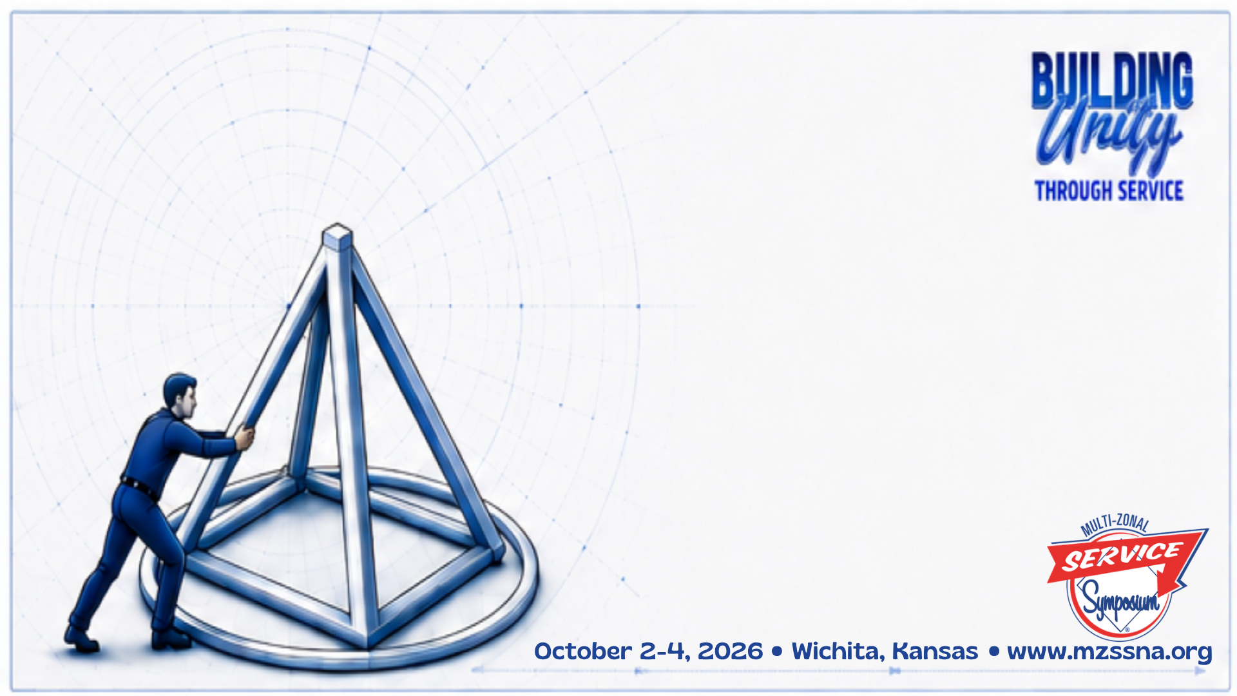
From Conflict to Consensus:
Facilitation Skills for Service Bodies
Ruben P Tejas Bluebonnet Region
Laura B Rio Grande Region

Slide 2
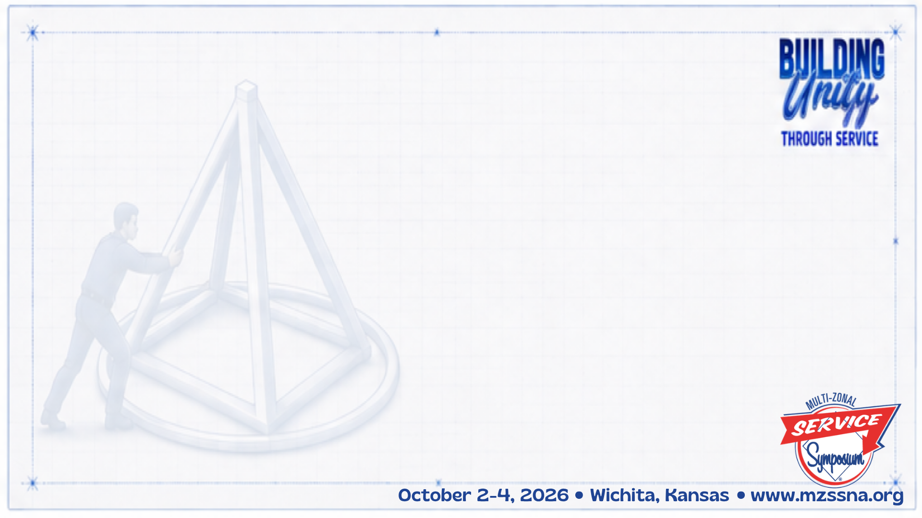
Every service body has a mission
Beyond our primary purpose, service bodies come together to do their jobs:
Put on a convention
Organize a service event
Create guidelines
Conduct an inventory
Do planning

Slide 3
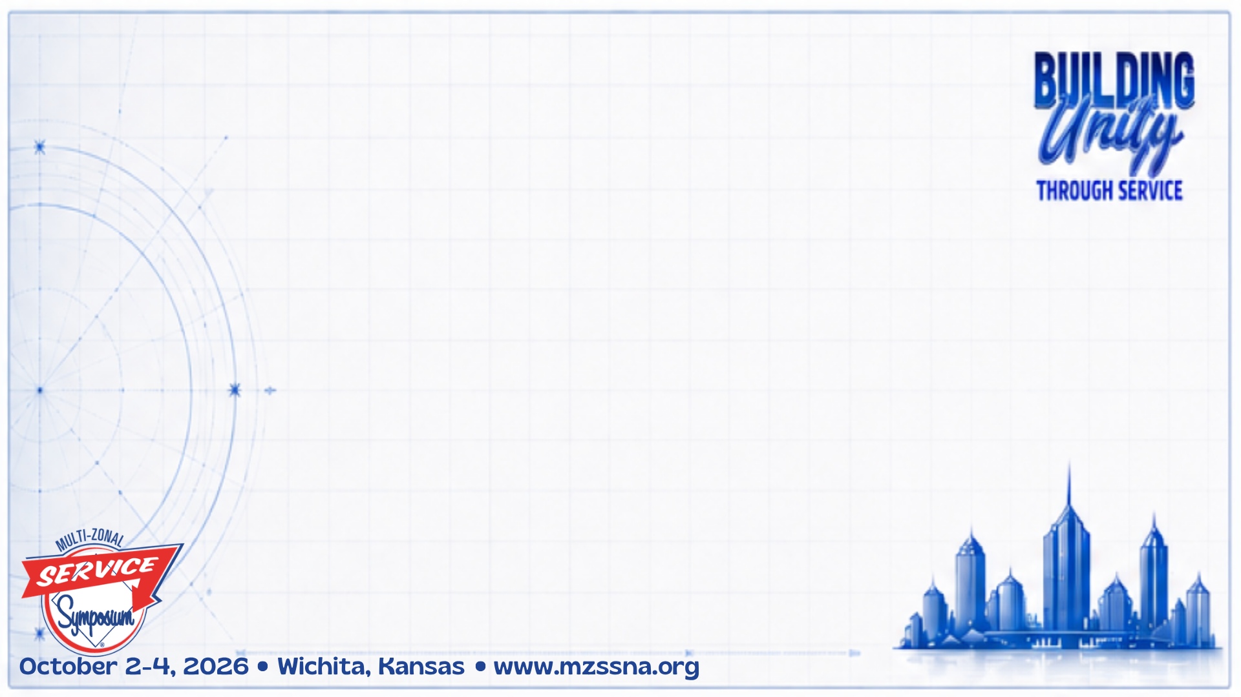
Points of Conflict in Service Settings
Differences of opinion
Strong personalities
Old way vs new way
Different interpretations
Some others??

Slide 4
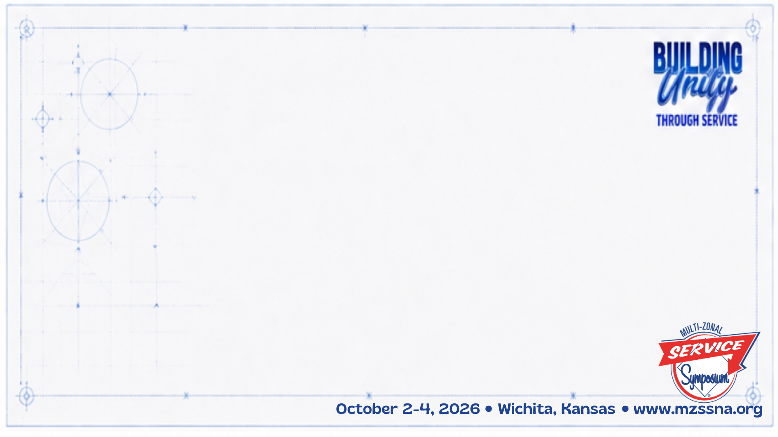
How can we overcome these conflicts so we get on with the work at hand?

Slide 5
Discussion & Decision-Making
The Consensus-Based Decision-Making Process is a cooperative process for discussing and making decisions in which everyone consents to the decisions of the group.
•Not everyone’s first preference necessarily, but true consent
•Decisions should reflect the integrated will of the whole group
•Preserves the interests and integrity of all participants
Notes:
Even if your service body does not use CBDM for making decisions, this format is in alignment with creating group conscience through discussion. When it comes to the actual decision, your service body may use some form of CBDM or Robert’s Rules of Order.

Slide 6
Discussion & Decision-Making
CBDM is a problem-solving orientation for people who wish to work together
•Not a process for determining whose ideas are best, but searching together for the best solution for the group
•A questioning process, not just a rubber stamp
•An understanding that no one person has the answer, but in participating together the best outcome can arise

Slide 7
What is required for an effective consensus process?
A skilled facilitator
A defined process
Willing, informed, committed participants
Spiritual principles in action
A commitment to take the time required to make good decisions
Notes:
Everyone benefits from a well run meeting, and it makes service so much more enjoyable

Slide 8
An Effective Facilitator
•A commitment to take the time required to make good decisions
•Clear understanding of the process and the ability to effectively communicate it to the body
•Sharp listening skills
•Commitment to have all voices heard
•Ability to recap and feed back the broad voice of the body
•Instinct for knowing when to refocus, take a break, poll the body or call for a decision
•Skill in dealing with difficulties during the process

Slide 9
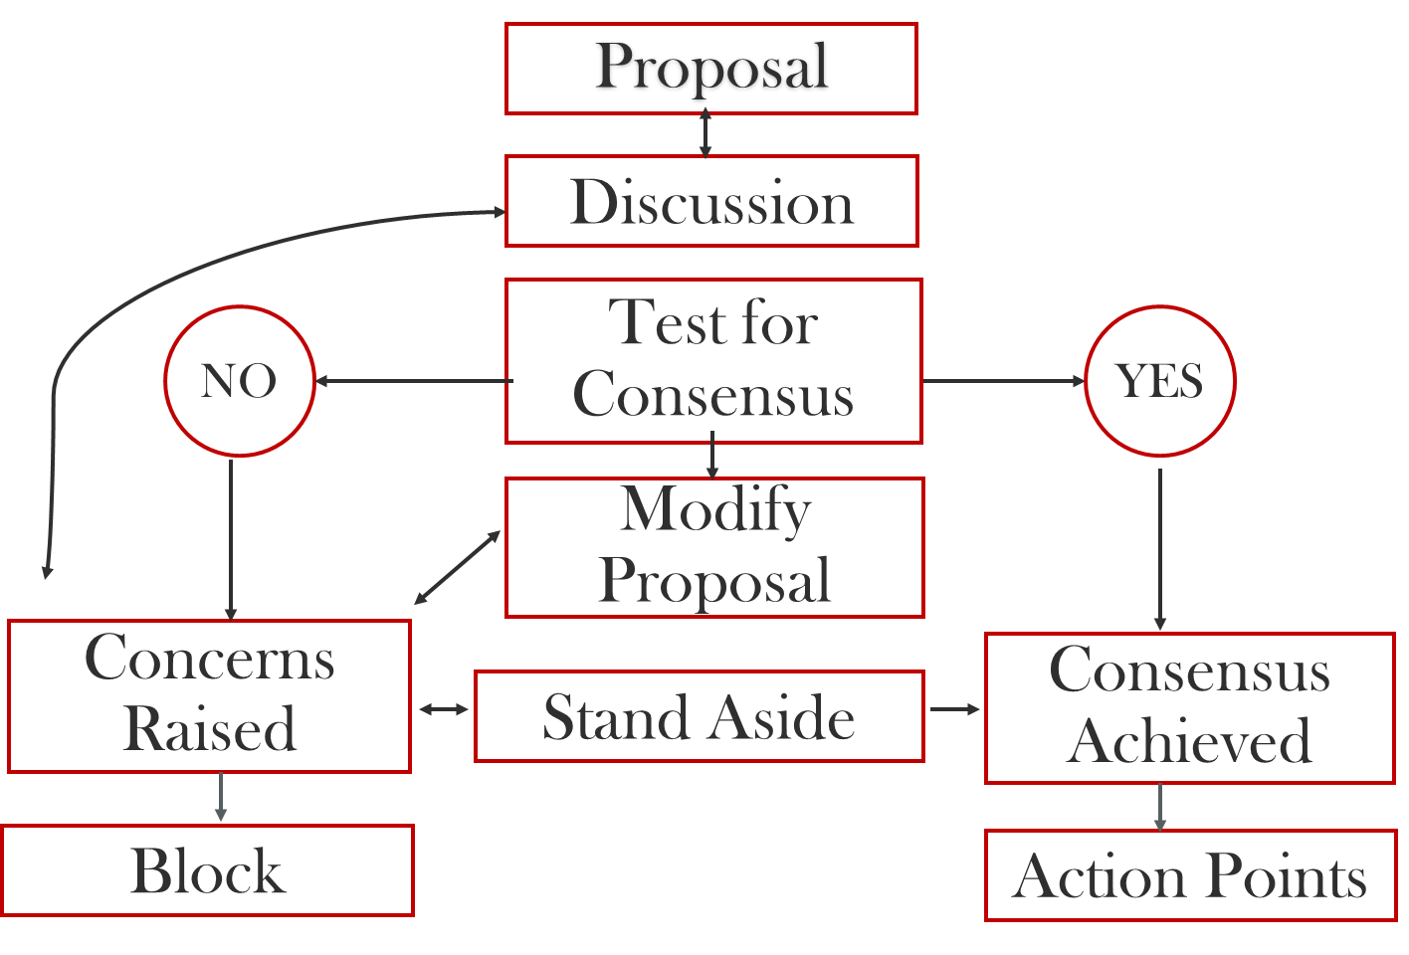
A Defined Process

Slide 10
Process Elements
•A threshold for consensus
•Available options for decision, e.g, yes, no, abstain, present not voting, stand aside, block, and a clear understanding of what each of those means
•How to deal with modifications, or amendments
•Defining any time limits for the process, e.g., timer for each participant, how many times any participant may share on a topic, or how long the body may give to each proposal
•Who may answer qualifying questions
•What happens after a decision is made

Slide 11
Effective Participants
•Understanding of the process
•Willingness to bring spiritual principles to the process
•Willingness to participate by adding meaningful content to the discussion
•Willingness to stay silent if their point of view has been voiced
•Willingness to listen to all points of view with an open mind
•Commitment to the process
•Willingness to allow the facilitator to facilitate

Slide 12
How Can a Facilitator Best Prepare Participants for the Meeting?
Inform participants:
Goals of the service body
Goals of the upcoming meeting
The agenda
Meeting length
Any preparations they should make to be ready for the meeting
What to bring to the meeting
The decision-making process

Slide 13
Spiritual Principles
•Patience
•Open-mindedness
•Trust
•Faith
•Goodwill
•Honesty
•Commitment
•Anonymity

Slide 14
What Difficulties Might We Encounter?
•Dominating voices, e.g., strong opinions, campaigning, wanting to speak multiple times
•Discussions going off topic
•Frustration with the process, e.g., the time it takes, circular discussions, the inability to achieve consensus
Notes:
Engage discussion about how to best handle these situations
What have you encountered in a consensus process that bogged it down? Brainstorm how those difficulties might be managed more effectively

Slide 15
Strategies for Moving Through Difficulties
Dominating voices, strong opinions, campaigning, wanting to speak multiple times:
Guidelines for speaking, e.g., if you have already spoken, go to the back of the line
A strong agenda defines the time each item will be given. This is balancing act between hearing all viewpoints and the time allotted.
Facilitator asks for different opinions
Facilitator asks clarifying questions to ascertain motive or underlying concerns
Other strategies??

Slide 16
Strategies for Moving Through Difficulties
Discussions going off topic:
Facilitator puts topic in the Parking Lot
Facilitator refocuses the discussion on the topic at hand
Other strategies??

Slide 17
Strategies for Moving Through Difficulties
Frustration with the process:
Take a break
Facilitator reminds the body of their mission and the value of group conscience
Reminder that some decisions need to be made right now, and others do not
Serenity Prayer
Other strategies??

Slide 18
Strategies for Moving Through Difficulties
Find common ground:
Principles in the Steps, Traditions and Concepts
  Unity & our Common Welfare – Tradition 1
  Our Primary Purpose – Tradition 5
  Anonymity: All voices are equal – Tradition 12
  Practicing principles in all our affairs – Step 12
  Turning our will over to our Higher Power – Step 3
  Group Conscience in our decision-making – Concept 6
  Responsibility in making decisions – Concepts 7 & 9
Other strategies??

Slide 19
Resources
www.na.org For Our Members – Local Service Resources
•CBDM Basics
•Basic Facilitation Guide
•Flowcharts, guides, processes, guidelines, workshop PowerPoints, supplies

Slide 20
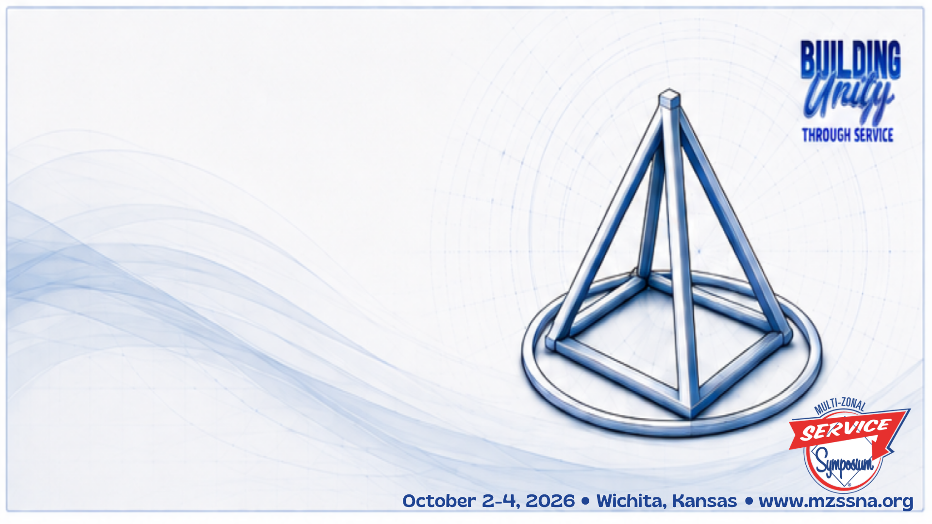
Thank You!
Contact Info:
Ruben P: 512-554-7245
Laura B: 505-250-0987

