Slide 1

Never Send an Addict
to the Wrong Address
MEETING LIST TOOLS
Adam H. (Connecticut Region)
Patrick J. (Carolina Region)
Notes:
Welcome. Ninety minutes, four tools, two presenters. Everything here is free, and already running in regions across the fellowship.

Slide 2






Who this is for
You run a website
You answer the phoneline
You maintain the meeting list
People call you when it's wrong
You're trying to find a meeting
Notes:
Quick show of hands on each. This tells us where to spend our time. If the room is mostly webservants, lean Crumb and Mayo. If it is phoneline people, lean Yap. The last card is everyone - every one of us has been the person looking for a meeting, and that is who all of this is for. We are not going to make anyone a sysadmin in 90 minutes - the goal is that you know what exists, what it costs, and who to ask.

Slide 3


The problem
Website
Printed list
Phoneline
Apps
Each copy is maintained separately,
so they fall out of sync.
Notes:
Ask the room: how many places does your area's meeting data currently live? The answer is always more than people expect. Then the one that matters: a newcomer drives to an address that closed eight months ago. This is a message-carrying problem, not an IT problem.

Slide 4

BMLT
The Basic Meeting List Toolbox
Notes:
Adam takes this section. Twenty minutes.

Slide 5

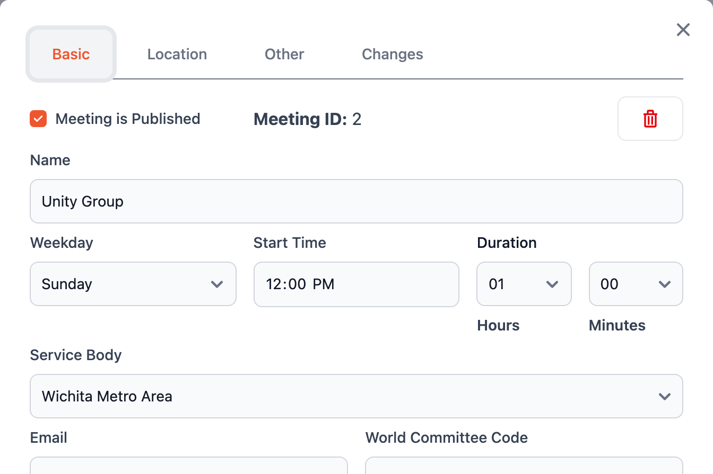



What is the BMLT?
One server for your meetings
Servants edit their own
Websites, apps and phonelines read from it
Free and open source
Notes:
The whole idea: one BMLT server, trusted servants edit in one place, and everything downstream reads from it - your website, your phoneline, printed schedules, apps you did not build. That is how you never send an addict to the wrong address. Built for regularly scheduled, weekly, recurring meetings - deliberately not an events system, which is why Mayo exists. A service body stands up a BMLT server and usually hosts others on it. Permissions follow the service structure: editors only see their own service body's meetings, no database access required. Every client today speaks the same documented API - anyone can write one, and your data leaves the way it came in. Ask who knows their server URL off the top of their head. If the room has wifi: change a meeting time live, then refresh a Crumb page - that is the whole pitch in thirty seconds. Screenshot: the new admin UI editing a real Wichita Metro Area meeting (the area's public listings, loaded into a local test server).

Slide 6
The aggregator
Searches every BMLT server at once.
579K
48
AI
requests in 30 days
outside apps and directories
assistants read it too
When you update your BMLT server,
all of these get the change.
Notes:
aggregator.bmltenabled.org federates BMLT servers worldwide and answers like one big server. From the aggregator's own logs: 578,868 requests from about 55,000 addresses in the 30 days to September 21. Over 90 days, 48 independent apps and directories identified themselves pulling our data, plus about ten phone apps - nobody announced it to them; people building recovery tools went looking for where NA sites get their meeting data and found it. AI assistants use it too: ChatGPT fetched it live 680 times when people asked it about meetings, and crawlers from OpenAI, Anthropic, Perplexity, Google, Apple and others index it. None of them had to coordinate with any region. Your region joins by being listed - nothing happens to your data, it stays on your server. Numbers are from the aggregator's load-balancer logs; no app names or contacts on the slide on purpose.

Slide 7
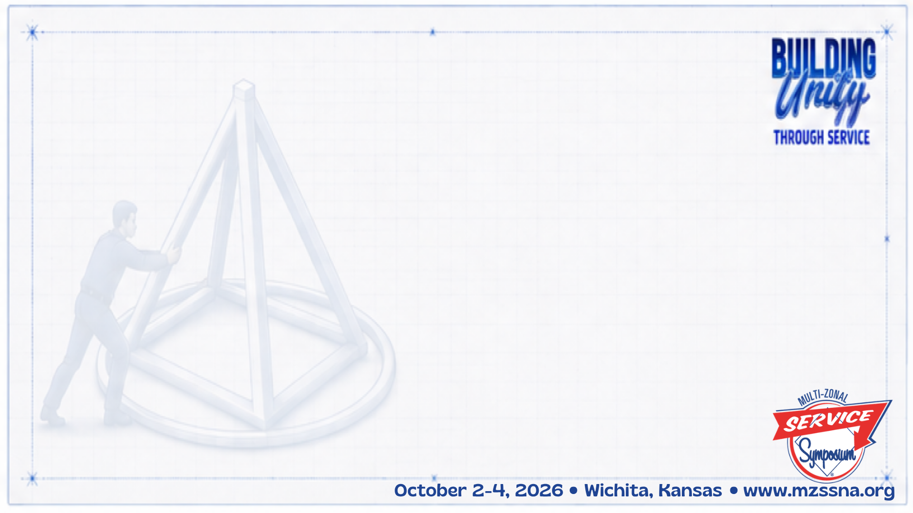
Yap
The phoneline
Notes:
Presenter to be decided (Steve can no longer make it). Twenty minutes.

Slide 8
The phoneline, end to end
What a caller hears
Where the call goes
1
Find someone to talk to
— Routed by location
— Volunteer schedules
— Voicemail if no one answers
2
Find a meeting
3
Just For Today
Notes:
Yap takes your BMLT meetings and plays them back over the phone. Twilio is the paid service that owns the number and the minutes; Yap is the free software that decides what happens on the call. That is the default menu, and every option and the order are configurable - most regions reorder it, some strip it to one option straight to a volunteer. Cost for context: North Carolina ran its whole statewide line for roughly $675 in 2019. Honest caveat: this is the heaviest lift of the four and needs a technical trusted servant. Docs at yap.bmlt.app. Dialback is the feature that sells this to volunteers - they answer from their own phone without the caller ever seeing their number. Meeting search is tunable too: grace period, search radius, texting results instead of reading them. Pronunciations always gets a laugh - every region has a town the robot mangles. Also available: extension dialing, forced routing, hidden service bodies for internal routing, SMS volunteer routing, and music on hold.

Slide 9
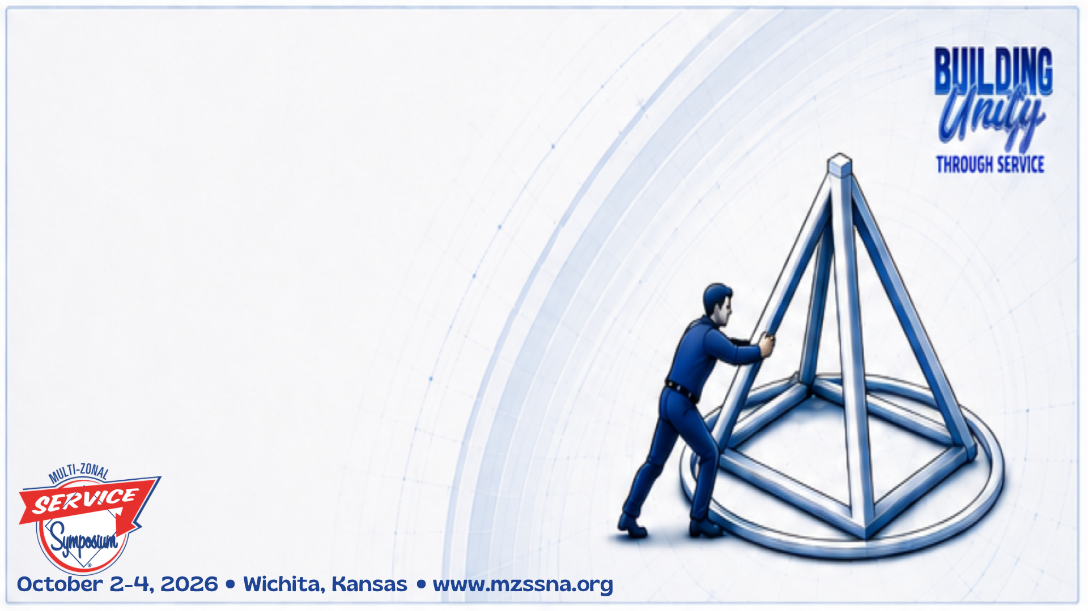
Mayo
Events and announcements
Notes:
Fifteen minutes. Lighter section - it is a WordPress plugin, so the bar to try it is low.

Slide 10

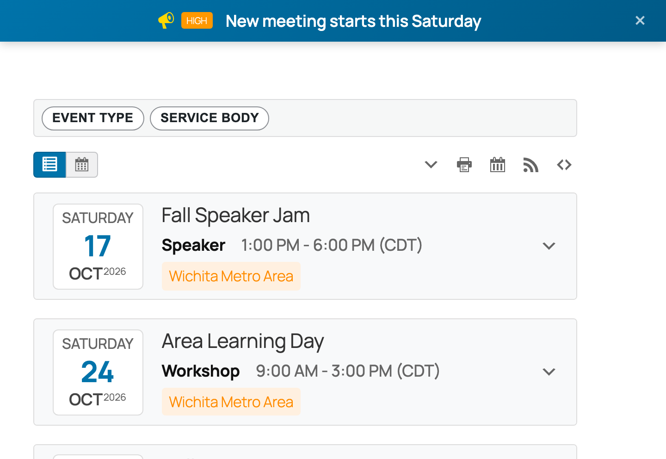



What is Mayo?
Pronounced "my-oh"
Events, not weekly meetings
A WordPress plugin
Groups submit, you approve
Notes:
The Spanish word for May. Fills the gap BMLT leaves - campouts, speaker jams, one-off events. Deliberately simple: a list, not a full calendar, but it exports a feed if you want one. Groups submit through a public form, it saves as pending, you approve in one click instead of retyping an email. Recurring events are supported. Screenshot: Mayo on a demo WordPress site. The events are samples, not real Wichita events.

Slide 11

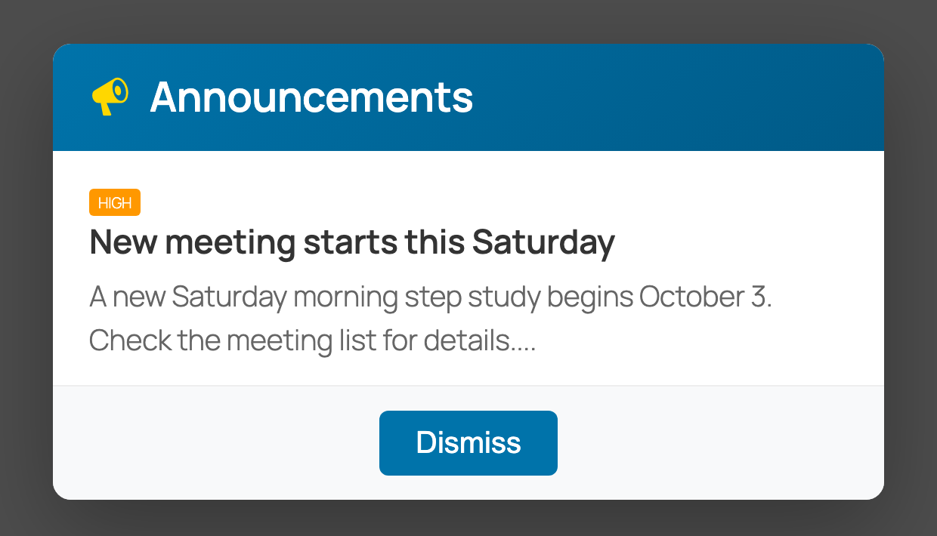


Announcements
Closures and urgent updates
Banner or pop-up on your site
Takes itself down when done
Notes:
The feature people miss. A group's meeting closes for a holiday, someone posts it, the banner shows while today is inside the date range and disappears after. Nobody has to remember to take it down. It is one shortcode or a site-wide widget; filter by category to control what shows where. Screenshot: the modal version; the banner version is the blue strip on the previous slide.

Slide 12
Demo
Notes:
Switch to the live demo: the Mayo event list and submission form, then the announcement banner going up. Come back to the deck for NA Meetings Near Me.

Slide 13

NA Meetings Near Me
The mobile app
nameetingsnearme.app
Notes:
A short one: an example of what anyone can build once a region's meetings are on BMLT.

Slide 14
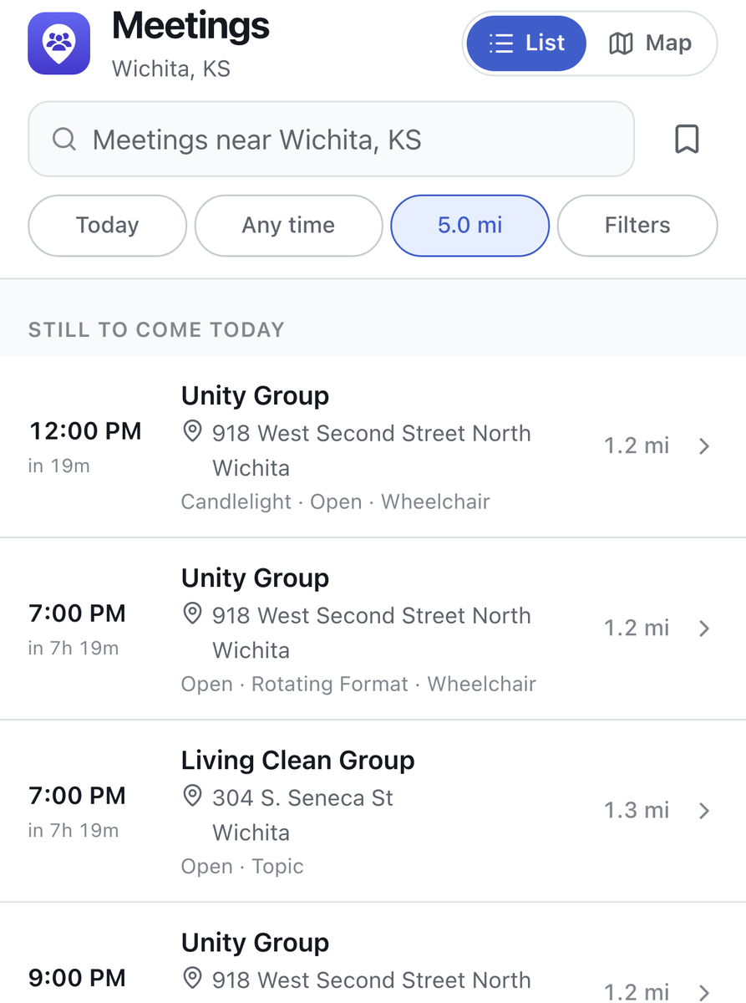
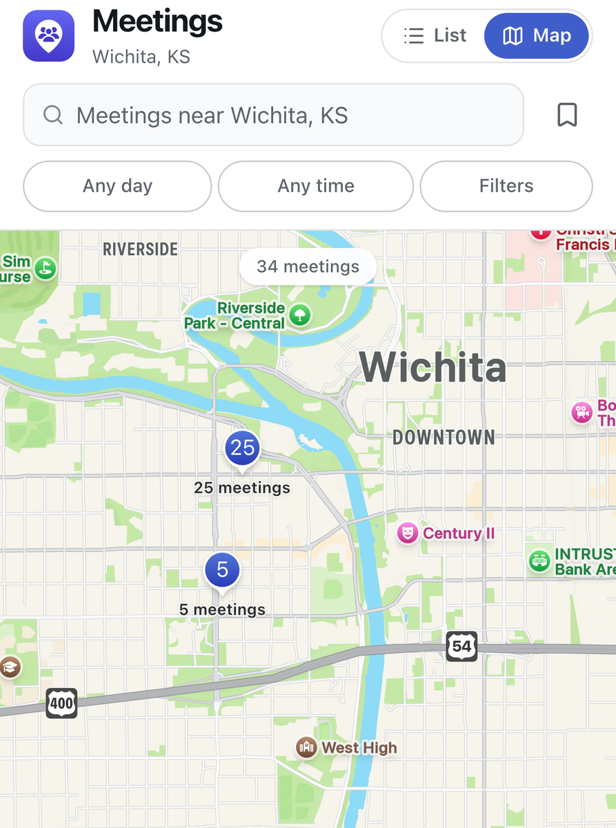
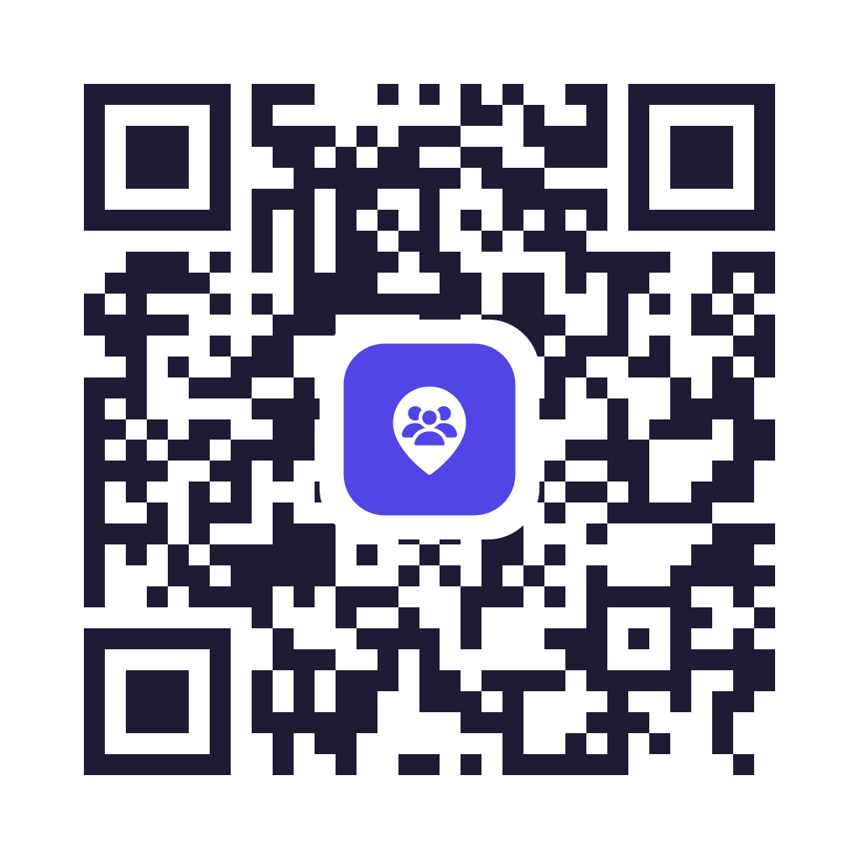


NA Meetings Near Me (Mobile App)
— What's starting near you, first
— Directions and shareable links
— Meeting data comes from BMLT
— On BMLT? You're already in it
nameetingsnearme.app
Notes:
It opens with an answer, not a search form - what is starting near you, soonest first. Every meeting has directions and a share button; the link opens straight into the app if the person has it installed. No account, no tracking. Web, plus iOS and Android - both live in the App Store and Google Play. The point for this room: a region maintained its own list, and a member three states away got the right address. nameetingsnearme.app Screenshots are Wichita at 11:41 on Friday, October 2 - the day of this workshop. The noon meeting is 19 minutes out. The QR code opens nameetingsnearme.app - leave this up for a moment so people can scan it.

Slide 15
Crumb
The meeting finder widget
crumb.bmlt.app
Notes:
Patrick takes this. Twenty minutes. This is the one most of the room can actually deploy this week.

Slide 16
The entire installation
<div id="crumb-widget"
data-server="https://your-server.org/main_server/"></div>
<script type="module"
src="https://cdn.aws.bmlt.app/crumb-widget.js"></script>
Paste those two elements into any page. That is a working meeting finder.
Notes:
Crumb is an embeddable meeting finder for any website - list, map, search, directions, virtual join links. One file, no build step. Live demo here if the room has wifi - crumb.bmlt.app/meetings.html. If not, this slide is the demo. Let it sit; the brevity is the argument. One extra attribute, data-service-body, limits it to your area.

Slide 17
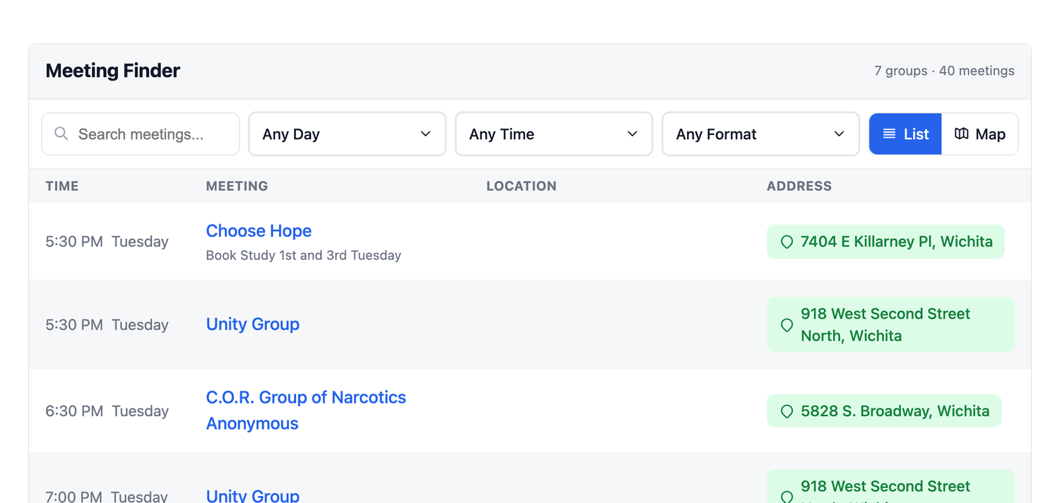
What members see
Notes:
Those two lines, pointed at the Plains States zonal server with data-service-body set to the Wichita Metro Area. Forty meetings, live - nobody typed them into the website. Click Map if you are demoing live.

Slide 18








Works wherever your site already lives
Install a package
Paste a snippet
WordPress
Wix
Drupal
Squarespace
Joomla
Google Sites
Plain HTML
npm for developers
Notes:
Whatever the room is running, there is a path - the Squarespace and Wix answer matters more than people expect. Worth mentioning if asked: 13 languages, shareable links to a single meeting, a printer-friendly list for the paper schedule, and an optional 'Update Meeting Info' link so the person who found the wrong address can report it.

Slide 19
Demo
Notes:
Switch to the live Crumb demo - crumb.bmlt.app/meetings.html, or a page with the two-line snippet pointed at your own server. Land it on the way back: your webservant should not have to write code; the tools exist so that service position turnover does not take the meeting list down with it.

Slide 20
BMLT Workflow
Meeting change requests
bmlt.app/bmlt-workflow
Notes:
How the people who notice a wrong meeting get it fixed - without knowing who maintains the list.

Slide 21
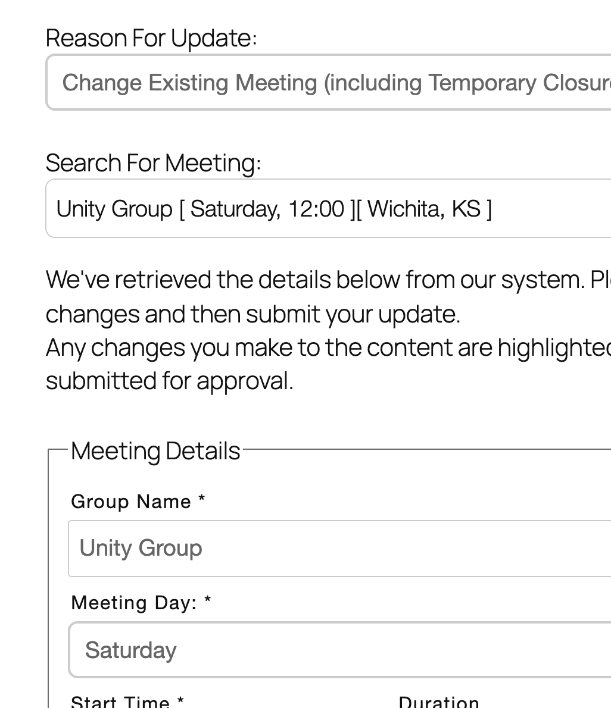


What is BMLT Workflow?
A WordPress plugin
Groups request meeting changes
Trusted servants approve or reject
Approved changes go straight into BMLT
The group hears back by email
Notes:
A WordPress plugin for meeting adds, changes and closures. Built for the NA Australian Region and now used more widely. A group fills in a form on your site - most details are pulled from BMLT, so there is little typing. The trusted servants for that service body get an email, approve, reject or quick-edit it in one place, and on approval the change is written straight into BMLT - no retyping into the admin screen. The person who asked gets the approval or rejection by email, with a message from the servant. It is one shortcode: [bmltwf-meeting-update-form]. This is the other half of keeping the list right: the people who notice a wrong time or a closed meeting can report it without knowing who maintains the list. bmlt.app/bmlt-workflow Screenshot: the public form. A group picks its meeting, BMLT fills in the rest, and the changed start time is highlighted. Real Wichita meeting, sample submitter.

Slide 22
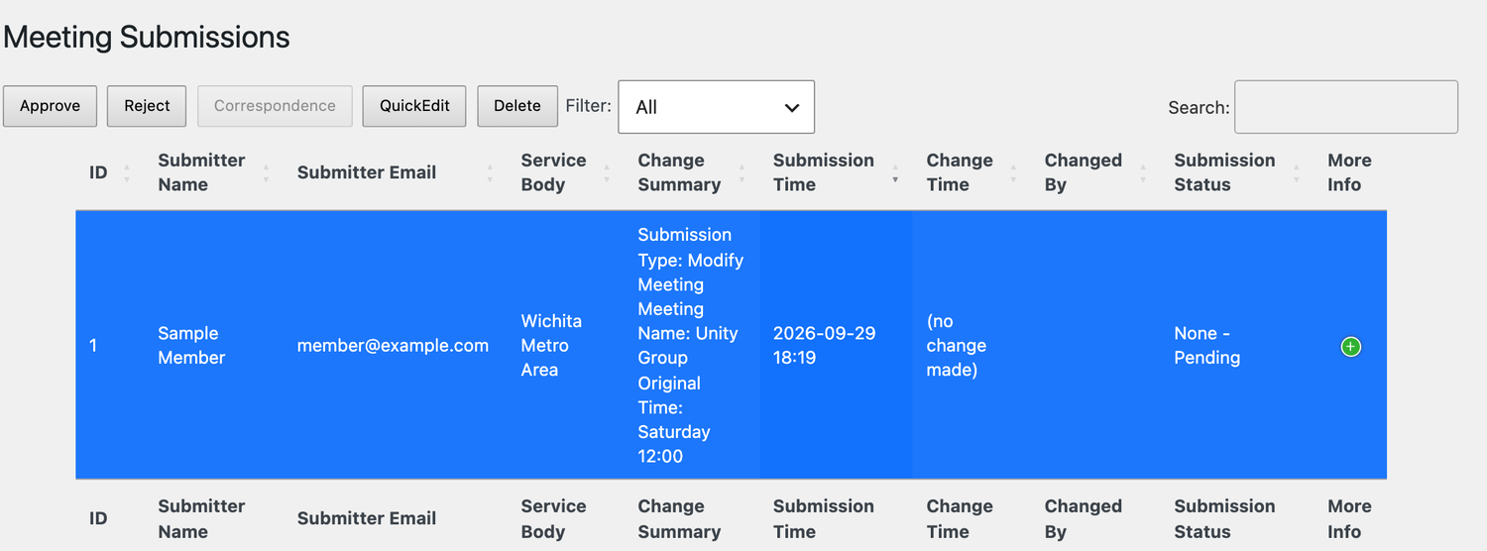
What the trusted servant sees
Notes:
The same request, waiting in the trusted servant's queue: who asked, which meeting, what changed. Approve writes it straight into BMLT and emails the group; Reject sends them your note; QuickEdit lets you fix it first. Sample submitter.

Slide 23
Bread
Printable meeting lists
bmlt.app/bread
Notes:
The paper meeting list, without anyone retyping it.

Slide 24
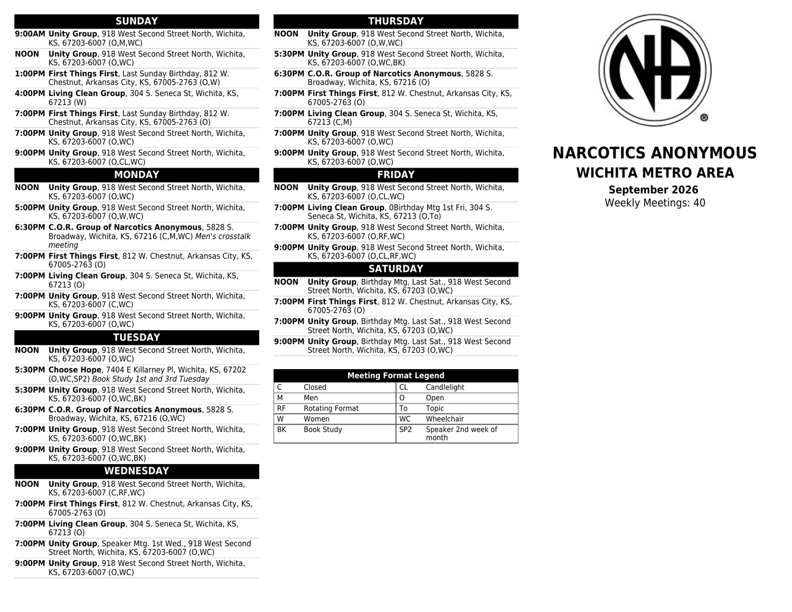


What is Bread?
A WordPress plugin
Builds a PDF straight from BMLT
Always current, never re-uploaded
Trifolds, booklets and more
Notes:
Set the layout up once and the PDF is regenerated from BMLT every time someone opens the link - no Word file, no monthly upload, and it matches your website's meeting list. One shareable link per list; you can keep several (letter and legal, area and region). Export your configuration before big changes. No WordPress? nameetinglist.org does the same thing. Screenshot: a real Wichita Metro Area trifold, all 40 meetings, generated live from the Plains States server.

Slide 25

A region's stack, end to end
Update once
Accurate everywhere
Website Crumb
Phoneline Yap
BMLT server
Events Mayo
Edited by its own servants
or requests via BMLT Workflow
Printed list Bread
Apps NA Meetings Near Me
Notes:
Fix the list in one place and every one of these is correct the same afternoon.

Slide 26
When you get home
No BMLT server?
Stale website list?
Phoneline on someone's cell?
Events on Facebook?
Ask your region
Crumb
Yap
Mayo
Notes:
Already running all four? Come find us - every one of these projects is maintained by a handful of members and could use more hands.

Slide 27

Thank You!
Contact Info:
help@bmlt.app
github.com/bmlt-enabled
bmlt.app · yap.bmlt.app · crumb.bmlt.app
nameetingsnearme.app · app@nameetingsnearme.app
Notes:
Leave this up through Q&A so people can photograph it. Tell people to open GitHub issues rather than emailing individuals - it is how things get fixed, and the next person finds the answer. There is also the BMLT Facebook group.

