Slide 1


Making our NA Message Available to Members Behind the Walls
Paul M – Cental Ohio Area
Steve S – Arizona Region

Slide 2
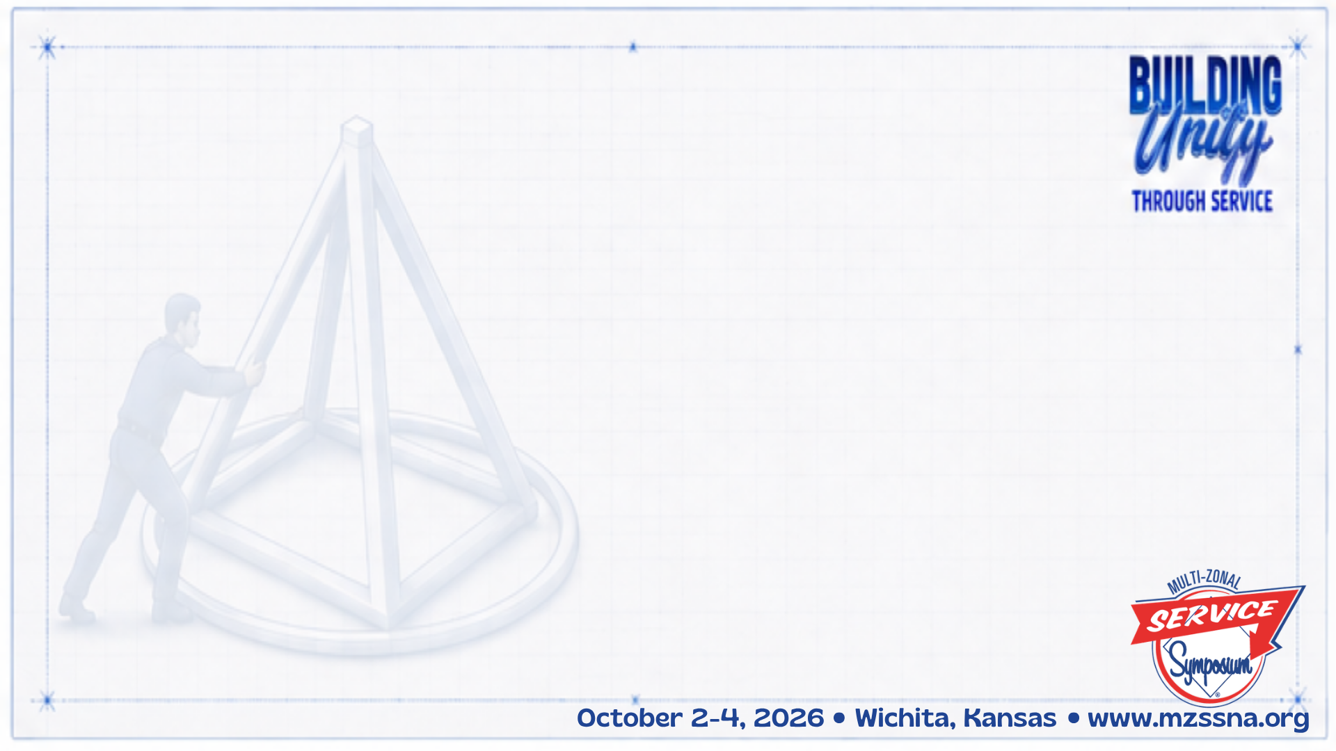
This workshop explores how tablets in prisons and virtual H&I are opening new doors for carrying the NA message, and how relationships built with patience, persistence, and consistency have turned ideas into real services for members behind the walls.

Slide 3
We’ll share what we’ve learned about electronic literature, virtual meetings, working with correctional decision makers, and collaboration among H&I, PR, Areas, Regions, Zones, and NAWS, then invite you to share what is working in your communities at the end of this session.

Slide 4
Building unity means more than working together. It means using our collective experience and today’s technology to move closer to a simple goal - making the NA message truly available to any addict, anywhere.

Slide 5
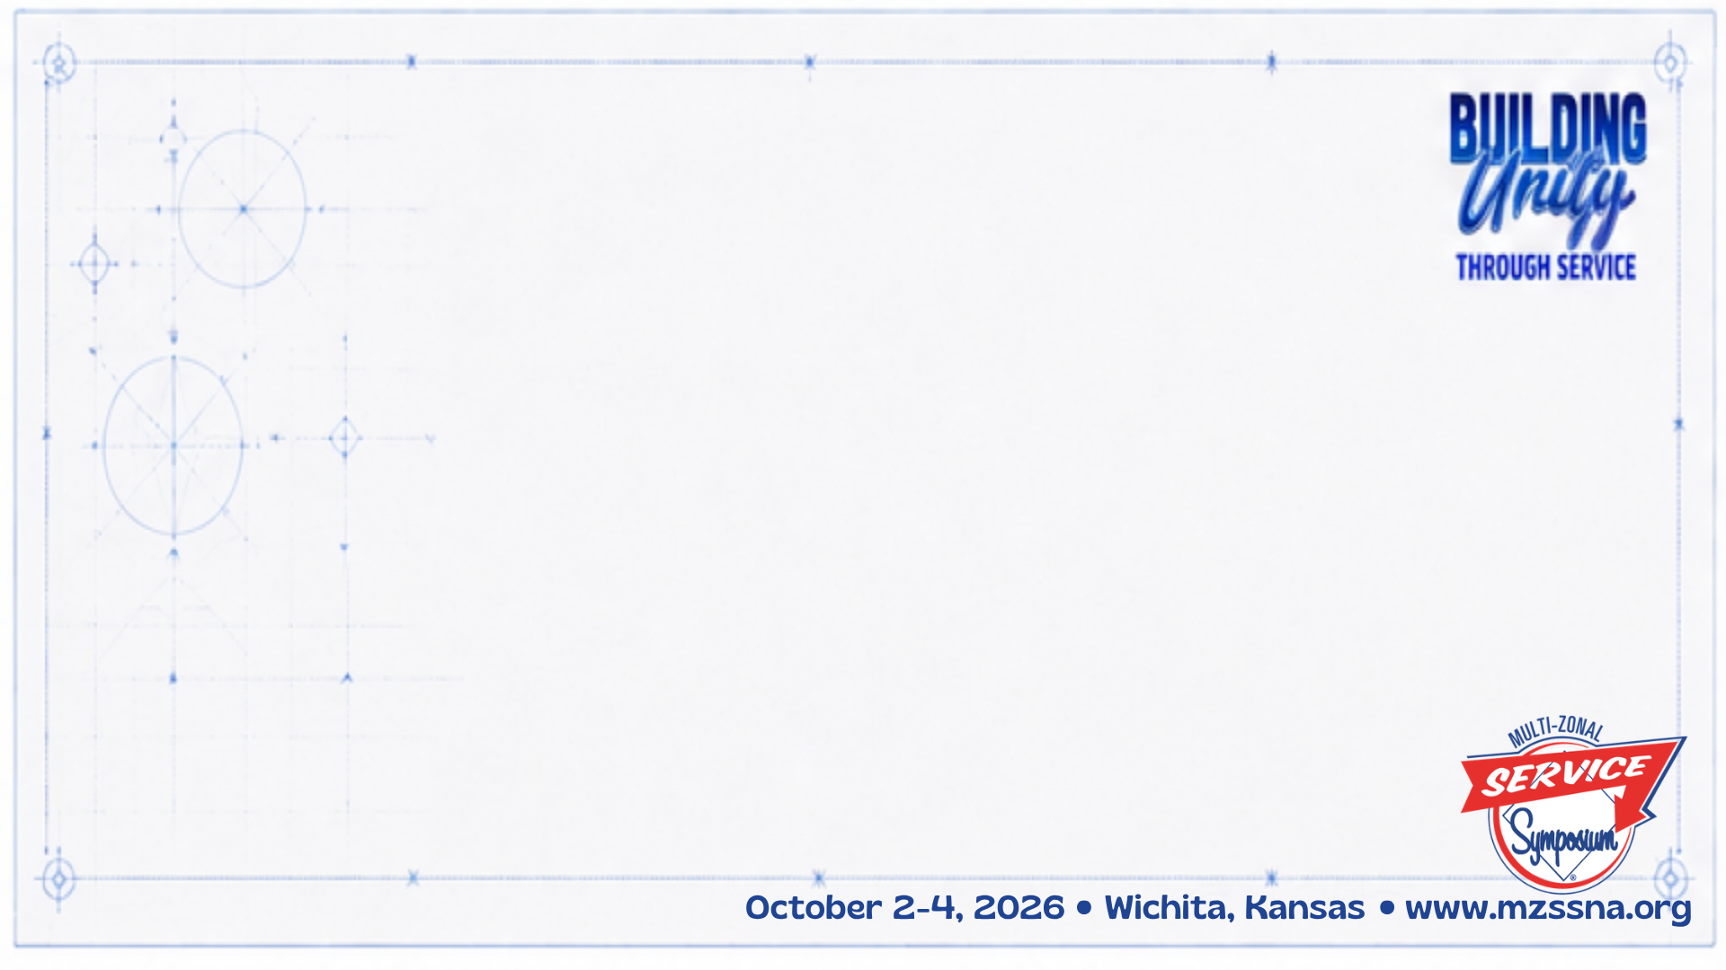
Literature on Tablets
Sarasota Jail - 2019
NEZF Professionals Day 2020
Ohio - January 2021
Arizona – April 2021
Sharing Session – May 2021 (included FL and OH professionals)
Indiana – Summer 2022
Notes:
Grassroots effort supported by NAWS

Slide 6
Growth & Unity in Relationships
Arizona Regional H&I coordinator meets every two weeks with AZ DOC; co-creates policy
Central Ohio Area meets once per month
  Guests from UK, California, Indiana, New York, Arizona, and Illinois
International Sharing Sessions
Show professionals the breadth and depth of our Fellowship
Notes:
Grassroots effort supported by NAWS

Slide 7
Effective Relationships
Literature disappeared from Ohio tablets
ODRC → Viapath
Viapath → Edovo and Cypherworx (aka, LMS)
Central Ohio + LMS + NAWS =
eLit to more than 1.2 million
IDEA: Add all resources from na.org to tablets
Notes:
Grassroots effort supported by NAWS

Slide 8
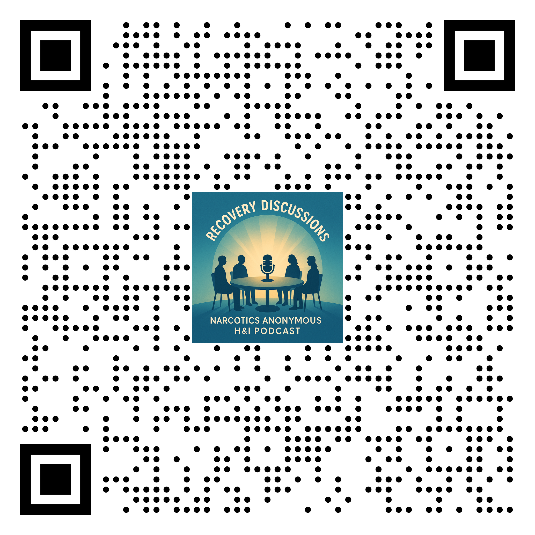
Local Tablet Content
Arizona makes content for Arizona
from members sharing the Message
Direct uploads, no LMS
https://arizona-na.org/episode/hospital-institutions-recovery-discussions/
IDEA → Make these available nationally!
Notes:
Grassroots effort supported by NAWS

Slide 9
Some numbers
2 million people incarcerated in the US at any given time; most will be released
Approximately 600,000 releases per year
eLit on tablets, and virtual meetings, helps people identify as members
Notes:
Grassroots effort supported by NAWS

Slide 10
Motion 4 - 2026 CAR
Initiated by Arizona Region, with support from Ohio, Florida, NorCal, SoCal, Utah, Sweden, and UK
Explore making book length NA material available on tablets
NAWS now recording the JFT
Notes:
Grassroots effort supported by NAWS

Slide 11
Secure virtual prison meetings
Aug 2023 – Freedom of Choice single proof of concept mtg in prep for WCNA shout out; Ryan M. was panel member
By May 2024, multiple facilities from multiple states, including Arizona (Steve has come)
Currently 5-10 prisons with up to 350 MBTW
Notes:
Grassroots effort supported by NAWS

Slide 12
Freedom of Choice gave rise to:
Virtual Freedom, 2024 – Indiana Region H&I
Miraculous Mondays, Feb 2025 – Colorado Region PR
There has never been an NA initiated cancellation, ever. Not once. (FoC, VF and MM)
  Portugal, 2026
Two jail meetings in Cleveland
Arizona and CCTV
  Arizona - Douglas Gila Unit (isolated & rural)
Notes:
Grassroots effort supported by NAWS

Slide 13
For women
Patte T, from AZ and now in MA, is convening women to help start a women’s virtual prison meeting
patte4191@gmail.com
Notes:
Grassroots effort supported by NAWS

Slide 14
What’s next?
Imagine multiple secure prison meetings per week, open to any prison in the US
Imagine all of our NA resources, including PR and H&I service material, available to 2 million people BTW
Fellowship Development – we have seen that participation & consistency helps develop members
Notes:
Grassroots effort supported by NAWS

Slide 15
What about lifers?
Provide opportunities for MBTW to lead lives of meaning and purpose regardless of length of sentence
Notes:
Grassroots effort supported by NAWS

Slide 16
Challenges
Abrupt changes of virtual platform
Staff promotions
Coordinating with people at all levels
Vetting and badging
Following guidelines (members)
Security through new Zoom links
Some cross talk
Notes:
Grassroots effort supported by NAWS

Slide 17
Group activity
What are you doing that works
Who could benefit from knowing about it
What could you adapt rather than reinvent?
Who could be at the table to contribute?
What did you learn here today that you will share with your HG, Area, and Region?
Notes:
Grassroots effort supported by NAWS

Slide 18

Thank You!
Steve S, Arizona
steven.servant.az@gmail.com
Paul M, Ohio
cbusnapaulm@gmail.com
WhatsApp: @PaulM_OH

Slide 19
Resources
Director at Midwestern state max security prison shares impact of virtual NA meetings on inmates - https://youtu.be/y-51g5QIqHU
Interview with 4 members behind the walls, talking about literature on tablets and virtual meetings. - https://youtu.be/pWhnuuyRyUA
Virtual Prison Meetings in Portugal - https://youtu.be/b3z-txA7qnI
Dept of Corrections Lunch and Learn, Sept 25, 2025 - https://youtu.be/eWkiKy5hAtU
Indiana State Prison reads Just For Today Group Reading - https://youtu.be/6MZWIaHlv_k
Kelly Storm, Director of Behavioral Health, Ohio Dept of Corrections - https://youtu.be/f2bB5XMzhow
Deanna Dwenger, Director of Behavioral Health, Indiana Dept of Corrections - https://youtu.be/DUFfzn9HZ0c
The Living Clean Podcast, featuring members behind the walls at minute 26 - https://youtu.be/lRn2aYSfzl8?si=CgtFooB-jT6U03D6
Notes:
Grassroots effort supported by NAWS

