Slide 1

Public Relations: Presentation to Professionals
Understanding
Narcotics Anonymous
A Vital Community Resource
Notes:
Understanding Narcotics Anonymous
A Vital Community Resource
Presentation to Professionals
MC: My name is___ and I am the __(service position)__. Intro others presenting:
Housekeeping:
Point out Bathroom locations.
Clarify any other building instructions.
Acknowledge zoom attendees, online moderators and any specific instructions for facilitating the meeting.

Slide 2
Agenda
  Understanding Narcotics Anonymous
  Who Are We?
  NA and the Professional Community
  NA Member Panel
  Introduction to the Meeting Experience
Notes:
Tell participants the general meeting format for the day.
What is NA & How it Works?
The NA Meeting
Who are NA Members?
NA and the Professional Community
(Short Break)
NA Member Panel
Intro to the Meeting (Mock Meeting)
Questions and Answers
Lunch (for In person participants)

Slide 3


Global, Non-Profit, Mutual-help
Community Based Organization
◆ Adapted from AA; NA meetings started in
Los Angeles, CA in 1953
◆ Worldwide 79,000+ meetings in 143 countries
◆ 24 Hour Virtual Access
◆ Therapeutic value of one addict helping another
◆ Process for change through the Twelve Steps
◆ Adjunct to treatment professionals in continuing care
◆ Wichita, KS site of historical importance to NA
What
is
Narcotics Anonymous
A Vital Resource
Notes:
Global, Non-Profit, Mutual-help
Community Based Organization
◆Adapted from AA; NA meetings started in Los Angeles, CA in 1953
◆ Worldwide 79,000+ meetings in 143 countries
◆ 24 Hour Virtual Access
◆ Therapeutic value of one addict helping another
◆ Process for change through the Twelve Steps
◆ Adjunct to treatment professionals in continuing care
◆ Wichita, KS site of historical importance to NA

Slide 4

How NA Works
The NA Meeting
  2 or more NA members a meeting
  Meetings promote atmosphere of recovery
  Members share their own personal experience
  Experienced members support newer members
  Meetings are self supporting by those who choose to contribute (no fees) - Pass the Basket
  Variety of Meeting Formats:
speaker, topic, open and closed, book study, etc.
◆ Regular meeting attendance
◆ Application of the 12 Steps
◆ Spiritual Principles
◆ Peer support and mentors
Notes:
+The NA message is "An addict, any addict, can stop using drugs, lose the desire to use, and find a new way to live.
---H.O.W?
Application of the 12 steps helps bridge the gap between abstinence and long-term recovery by supporting personal change, connection and accountability.
Language you might hear:
"Work the Steps", "It works if you work it", "Just for Today", "Keep it Simple", "Easy Does It", "Are you A friend of Jimmy K?"
Meetings are the meat of recovery - every member is equal
Recovery is a result of the application of the steps
++Safe, inclusive spaces with no requirement beyond the DESIRE to stop using.
--Self-supporting and self-organized.
What is Anonymity? a core principle of NA - to protect members privacy and helps create a safe and respectful environment.
++
We say - what is shared in a meeting, stays in the meeting. Members are not identified publicly as NA members and are not required to share last names or identifying details.
--
Anonymity helps people feel safe for honest sharing without fear of judgement, stigma or consequence.
--
Members are free to disclose they attend NA - but in public they should not identify others as members without their permission - example: Walmart - "HEY JO - (across the aisle) you going to NA tonight??."
Anonymous doesn’t mean secret, in fact a section of our literature says, “In order to fulfill our spiritual aim, Narcotics Anonymous must be known and respected” (trad10).
Anonymous IS
nameless, undisclosed, unidentified unnamed, unsigned.
--NA is NOT a clinical treatment program but can compliment clinical services and continuing care
++The true focus is connection and mutual support to achieve long-term recovery.

Slide 5


The NA Meeting
NA meetings provide an environment within which people can help one another stop using drugs and
learn to live drug free
Primary vehicle for delivering the NA message of recovery.
Notes:
The NA meeting...

Slide 6
Understanding NA: Three Important Topics
◆ Medication & Recovery
◆ Spirituality & Personal Choice
◆
◆ Court Referral and Constitutionality
Notes:
Medication and Recovery: Who Decides? NA does not endorse or oppose any specific treatment or medication. Membership is open to anyone with a desire to stop using drugs, regardless of medication status or treatment history.
Spirituality, Religion, and Personal Choice. NA is a spiritual, not religious program.
We do not require belief in any particular religion, creed, or definition of a Higher Power. Each member is free to develop their own understanding.NA does use the word ‘God’ and talks about a Higher Power, and we don't try to hide that. At the same time, NA requires no religious affiliation, has no creed or theology, and does not prescribe what an individual's Higher Power must be.
Can Clients Be Referred to NA?
Yes. NA is an available community recovery resource that clients may choose. Constitutional concerns focus on government coercion—not referral—so client choice and appropriate alternatives should be respected.
The Constitution doesn't regulate what Narcotics Anonymous is allowed to believe or say. NA is a private fellowship. The constitutional question concerns what the government may compel a person to do.
The safest practice is very simple: make NA available as one recovery-support option and provide a reasonable secular alternative if someone objects. That protects the client's constitutional rights without denying people access to Narcotics Anonymous.”

Slide 7

RECOVERY RESEARCH
The 2024 NA Membership Survey received responses from 125 countries. The average length of cleantime in NA is 13.79 years. Members surveyed attend an average of 2.90 in-person meetings and 2.69 online meetings per week.
◆
Evidence-based Articles & Data
White, W., Galanter, M., Humphreys, K., & Kelly, J. (2016). The paucity of attention to narcotics anonymous in current public, professional, and policy responses to rising opioid addiction. Alcoholism Treatment Quarterly, 34(4), 437–462. https://doi.org/10.1080/07347324.2016.1217712
Krentzman AR, Robinson EA, Moore BC, Kelly JF, Laudet AB, White WL, Zemore SE, Kurtz E, Strobbe S. How Alcoholics Anonymous (AA) and Narcotics Anonymous (NA) Work: Cross-Disciplinary Perspectives. Alcohol Treat Q. 2010 Dec;29(1):75-84. doi: 10.1080/07347324.2011.538318.
Notes:
NA IS EVIDENCE-BASED and has DATA.
Peer support, mutual aid and social support networks are critical to recovery.
Connection is the opposite of Addiction.
Research indicates that ongoing peer support improves engagement and outcomes. Anonymity helps create that environment.
++Data presented today is from our fellowships membership survey.

Slide 8
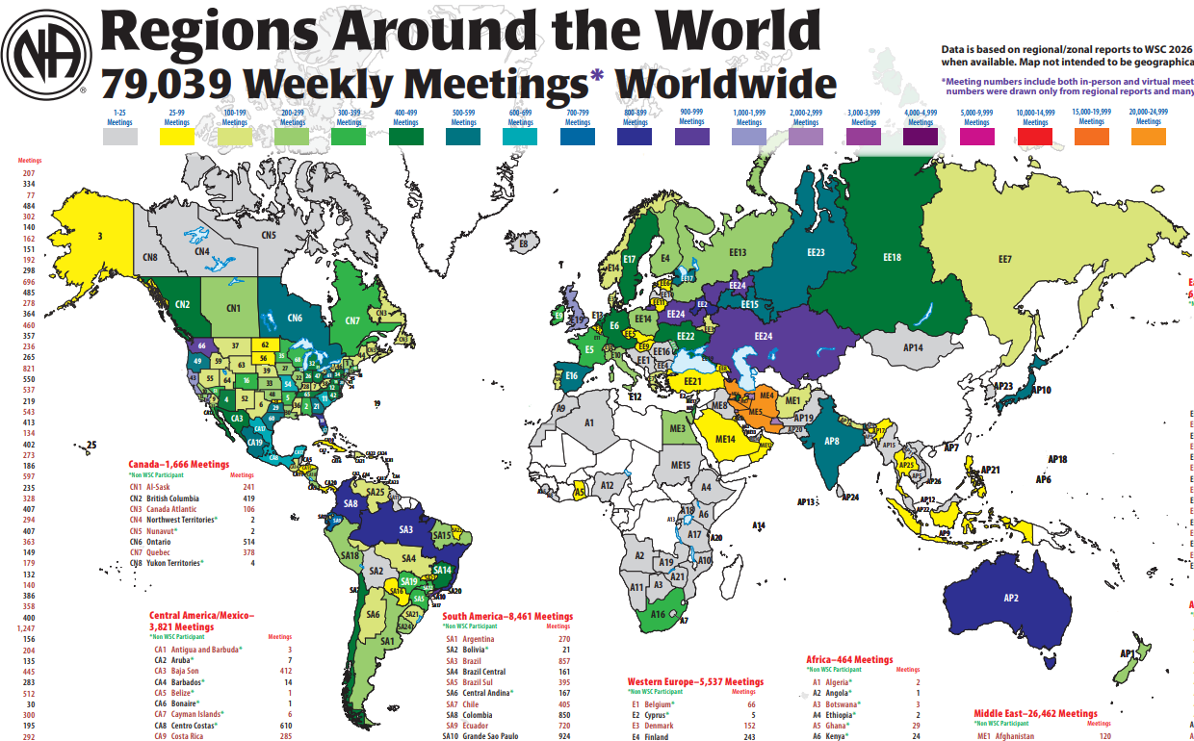
Map IS NOT intended to be geographically accurate.
Notes:
Data is based on regional/zonal reports to WSC 2026 and NAWS database
when available. Map IS NOT intended to be geographically accurate.
*World Meeting numbers include both in-person and virtual meetings from provided reports and may not be complete/accurate.
In the Mid-AM Region, there are 108 groups with 315 meetings per week reporting at the end of August 2026.
Literature is translated into more than 105 languages.
Members are welcomed to NA with keytags in 69 languages.
IP #1, Who What, How, and Why provides essential NA information in 61 languages.
The Basic Text in 40 languages offers addicts the opportunity for a new way of life.

Slide 9

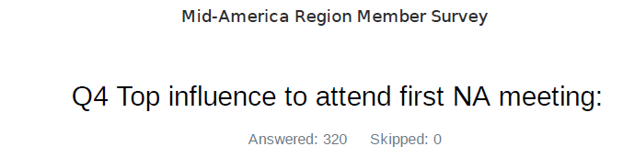
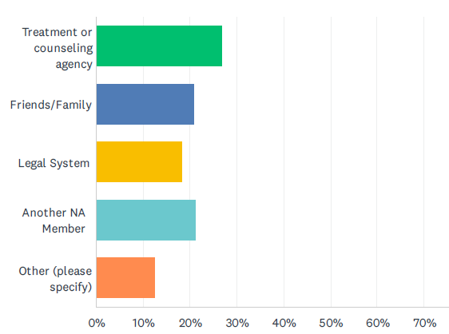
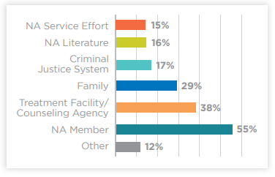
2024 World vs Region Membership Survey
Evidence-based Research and Data
◆ Top 3 influences to attend first NA meeting:
1.Another NA member
2.Treatment / counseling agency
3.Family
Citation
White, W., Galanter, M., Humphreys, K., & Kelly, J. (2016). The paucity of attention to narcotics anonymous in current public, professional, and policy responses to rising opioid addiction. Alcoholism Treatment Quarterly, 34(4), 437–462. https://doi.org/10.1080/07347324.2016.1217712
Notes:
Global NA membership survey biannually. Pandemic prevented this for several years. Most recent data is from 2024.
What Influences an addict to attend their first NA meeting?
Top 3 Globally:
1. Another Member
2 Treatment/ counseling
3. Family
Kansas MID-AM
1 Treatment
2 Another member
3 Friends and Family
4 Legal System
5 Other (public relations) :
Phoneline, Billboards, PSA,
Informational Pamphlet

Slide 10
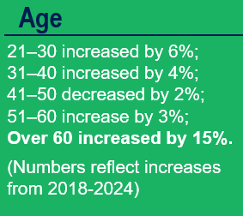
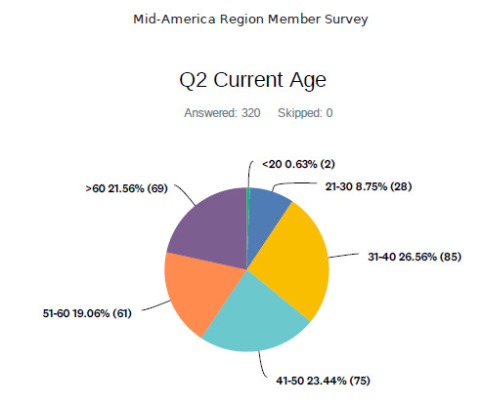
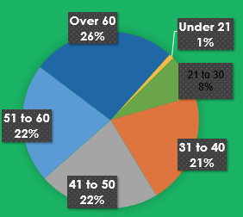
2024 World vs Region Membership Survey
Evidence-based Research and Data
Citation
White, W., Galanter, M., Humphreys, K., & Kelly, J. (2016). The paucity of attention to narcotics anonymous in current public, professional, and policy responses to rising opioid addiction. Alcoholism Treatment Quarterly, 34(4), 437–462. https://doi.org/10.1080/07347324.2016.1217712
Notes:
Ages of members
Similar data for World vs Region

Slide 11
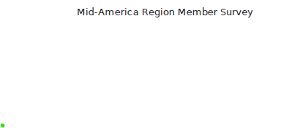


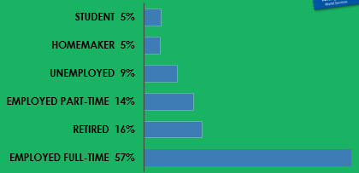
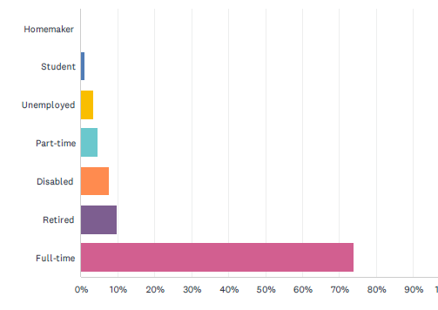
2024 World vs Region Membership Survey
Evidence-based Research and Data
Citation
White, W., Galanter, M., Humphreys, K., & Kelly, J. (2016). The paucity of attention to narcotics anonymous in current public, professional, and policy responses to rising opioid addiction. Alcoholism Treatment Quarterly, 34(4), 437–462. https://doi.org/10.1080/07347324.2016.1217712
Notes:
Regionally, our members are employed full time with a greater frequency . 75% compared to 57% globally

Slide 12

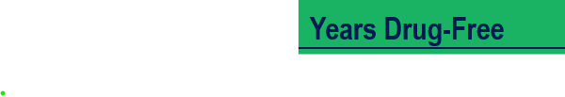

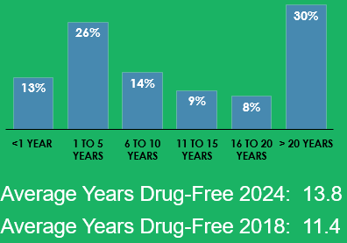
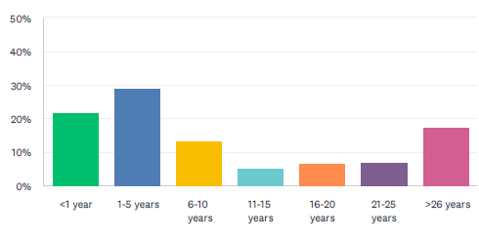
2024 World vs Region Membership Survey
Evidence-based Research and Data
Citation
White, W., Galanter, M., Humphreys, K., & Kelly, J. (2016). The paucity of attention to narcotics anonymous in current public, professional, and policy responses to rising opioid addiction. Alcoholism Treatment Quarterly, 34(4), 437–462. https://doi.org/10.1080/07347324.2016.1217712
Average Years of Time Clean: 14.3
Notes:
What is Clean time?
For NA clean time = continuous abstinence.
No debate.
(Medication is an OUTSIDE issue - don't get stuck here - move quickly - Make them ask in the Q&A about M.A.T.)
Not much statistically significant difference with the exception of members with less than one year.
In our region those members comprise over 20% of our fellowship compared to approximately 13% globally.

Slide 13
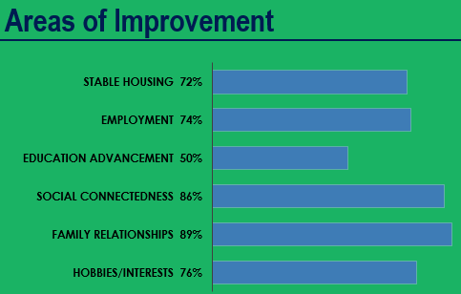
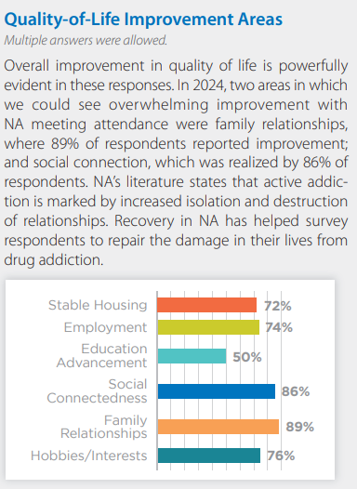
2024 World Membership Survey
Evidence-based Research and Data
Citation
White, W., Galanter, M., Humphreys, K., & Kelly, J. (2016). The paucity of attention to narcotics anonymous in current public, professional, and policy responses to rising opioid addiction. Alcoholism Treatment Quarterly, 34(4), 437–462. https://doi.org/10.1080/07347324.2016.1217712
Notes:
Areas of Improvement
This information reflects the aspect of our message that indicates that in Narcotics Anonymous we "find a new way to live".
Our greatest recovery is reported by us to be in our family relationships. Nearly 90% of us report improvement in this area of our lives. Social Connectedness is a close second with 86% reporting improvement.
In terms of significant community metrics:
74% report improvement in employment; 72% report maintaining stable housing; and 50% of us advance our education as members of narcotics anonymous.

Slide 14
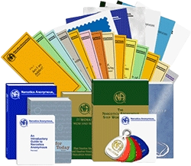
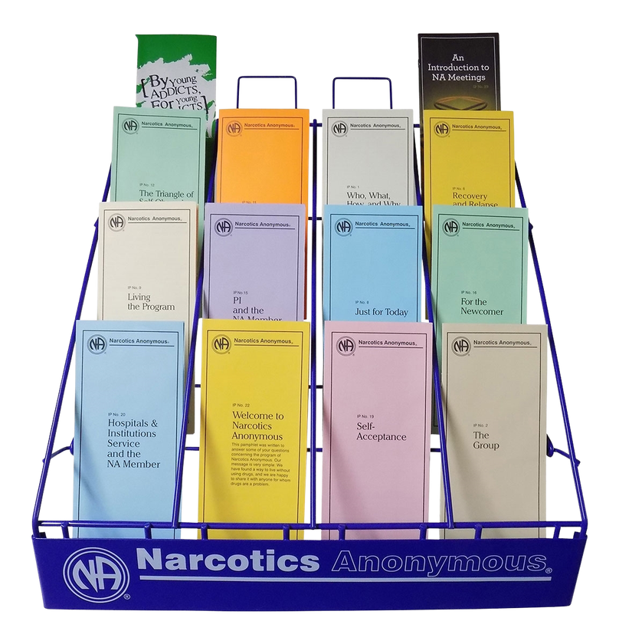
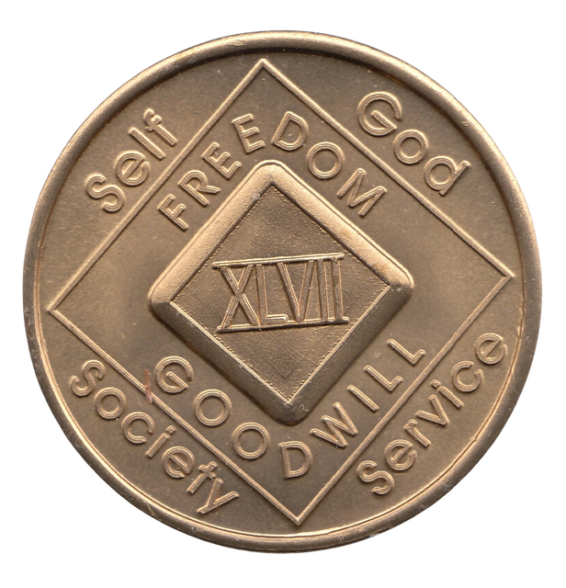

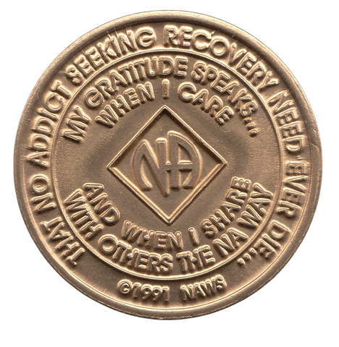
NA Literature na.org/literature
Whats an IP?
Notes:
Explain Basics of NA Literature AVAILABLE
What is the BASIC TEXT?
Is it required?
What's an IP?
Informational Pamphlets
Can we get an IP rack for the office?
YES! Get us your office info.
What is Clean Time? What is the language? "Clean" / "sober", recovery date, belly-button birthday vs recovery birthday
"anniversary date", "celebrated", "earned"
keytags and medallions
We seek opportunities for Conferences and Presentations - contact us - Public Relations.

Slide 15

Cooperating with Professionals
◆ Welcoming your clients to meetings
◆ Presentations to professionals and clients
◆ Printed materials, helplines, websites
◆ Subscription to NA newsletters and
Literature useful for client introduction to NA
◆ Virtual Meetings
◆ Meetings and Presentations available for
treatment facilities
◆ There is no charge or fee to attend NA
recovery meetings or for NA presentations
Notes:
++Many of our members may have once been referred to NA by someone in a professional position, like yours.
++PR committees provide presentations like this one.
There are a large number of virtual meetings available in this post pandemic world that were previously not an option.

Slide 16


Benefits to...
The Client:
  Assists with transition back into the community
  Can support clients while in treatment and
correctional facilities
  Provides a peer-based support network
  Drug-free role model reinforcement
The Professional:
  Research indicates: improves retention
  Immediate access to aftercare support
◆
Notes:
What is the benefit for attending NA?
Being able to identify with others in similar situation, support, connection.
Some groups employ meeting attendance verification cards and these can be signed as a service to your client and NA members that want them. Some groups have stamps or a process the member needs to identify with the meeting chairperson - it is their responsibility, not the groups.

Slide 17




Professionals Experience with NA
Notes:
Introduce Professionals speaking
2 speakers
and/or engage professionals from audience
(Limit each share for allotted time)
Announce BREAK after speakers

Slide 18


Member Panel
Notes:
Introduce Panel Members
3-4 members
(Limit each share for allotted time)

Slide 19
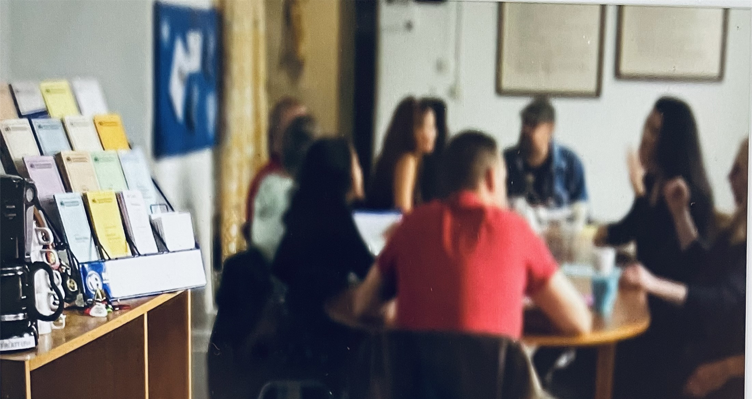
Experience the Meeting
Who is an Addict?
What is the NA Program?
Why are we here?
How It Works
The 12 Traditions of NA
We Do Recover
Just for Today
Notes:
We’d like to give you a brief opportunity to experience what a typical Narcotics Anonymous meeting may look and sound like.
Several NA members will demonstrate the opening and closing portions of a meeting using a format commonly used in our fellowship. You’ll hear some of the readings that help introduce members to NA, our program, and the meeting itself.
In a regular recovery meeting, this would be followed by time for members to share their experience, strength, and hope with one another. For today’s presentation, we’ll omit the sharing portion and move directly to the closing.
Our meeting chair will guide us through the experience. We invite you to simply observe and get a sense of what your clients may encounter when they attend an NA meeting.
Meeting chair:
An OPEN meeting is ANYONE is welcome to attend and participate in the meeting - family member, students: don't be shy to introduce yourself as a support person or simply an observer for a class.
CLOSED meeting is for addicts only - some groups require this to NOT include children as well.
As a professional or a support person, if you do NOT consider yourself to have a problem with addiction; you would attend an OPEN meeting.
We are now going to show you an example of a meeting- each group can set their own meeting style and formats may differ for each meeting or group.
After the readings, we will have an open share - for this purpose today, we will skip that and go to the close of the meeting.

Slide 20
Closing the Meeting
Gratitude Share and 3rd Step Quote
“My gratitude speaks, when I care and
when I share with others the N.A. way",
----
"Take my will and my life,
guide me in my recovery,
show me how to live".
Notes:
What's the chair in the middle for?
Some groups that sit in a circle may have an empty chair in the middle for the still suffering addict that has not arrived
--
Members may close the meeting by circling up and joining hands/arms and circling around an empty chair...or they may just stand where they are and join hands
closing the meeting usually ends with some type of prayer -and again, is reflective of the group members

Slide 21

QUESTIONS?
QUESTIONS?
Notes:
If there is still time for questions -
state how much time and / or move on to finishing up with the exit survey.

Slide 22

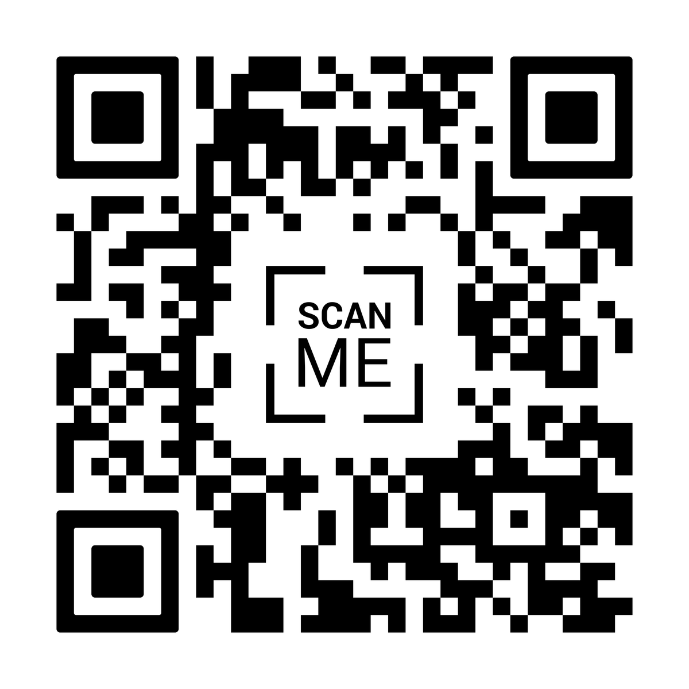


Notes:
Get your phones out and scan the QR code to tell us your thoughts about our presentation today.
What did you like? What worked? What can we do better?
If you need a paper survey, please raise your hand and we can provide that.

Slide 23
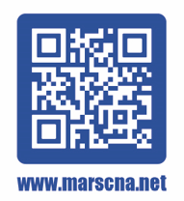

Contact Us
www.marscna.net
PublicRelations@marscna.net
Mid-America Region of Narcotics Anonymous
Phoneline 1-855-732-HOPE
Notes:
If you would like to host a presentation at your business or need a local connection to NA please use these contact methods.
QR code to regional Meeting Lists
Phoneline is a messaging service with an option to have a member contact you.
The phoneline is not a taxi service...Generally, if someone can get themselves to a meeting for the first time, they can get connected with other members and find rides to meetings.
LEAVE THIS PAGE UP AT THE END.

Slide 24


Thank You!
Contact Info:
Tonia : 316-734-2546
Craig : 615-207-2530
Notes:
IF you must...leave this up at the end OR go back and leave the other one up.
Thank you to all the audience members including zoom participants, professionals, members, volunteers and observers.
[This presentation was curated and presented in cooperation with the Mid-America Region of Narcotics Anonymous Public Relations Subcommittee. 2026]

Slide 25


Slide 26


