Slide 1

Serving Addicts Behind the Walls through P3, SBTW/WSR, & Re-entry Resource Fairs
Amanda M (Nebraska)
Mark B (Nebraska)
Rob F (Nebraska)
Sharleen S (South Dakota)
Kristin D (Show Me)
Keith T (OK Region)
“The therapeutic value of one addict helping another is without parallel.”

Slide 2


Mark B (Eastern Nebraska Area)
Rob F (Eastern Nebraska Area)

Slide 3
FORMATION
FORMED EARLY IN 2006
BASED ON WISCONSIN’S PROJECT HOPE
START UP FUNDS OF $350
FORMED AS A SUBCOMMITTTEE OF ENNA PR

Slide 4


Slide 5
IN THE BEGINNING
HAND DELIVERED TO JAILS & PRISONS
MERCHANDISE SALES AT LOCAL FUNCTIONS & CONVENTIONS
STRONG SUPPORT FROM NEIGHBORING AREAS & REGIONS

Slide 6


Slide 7
CHALLENGES
ADDICTS NOT ABLE TO ACCESS LITERATURE
AMOUNT AND TYPES OF LITERATURE REQUESTED
TURN AROUND TIME ON SHIPPING
CONVERSION TO PAPERLESS FACILITIES AND USE OF TABLETS

Slide 8
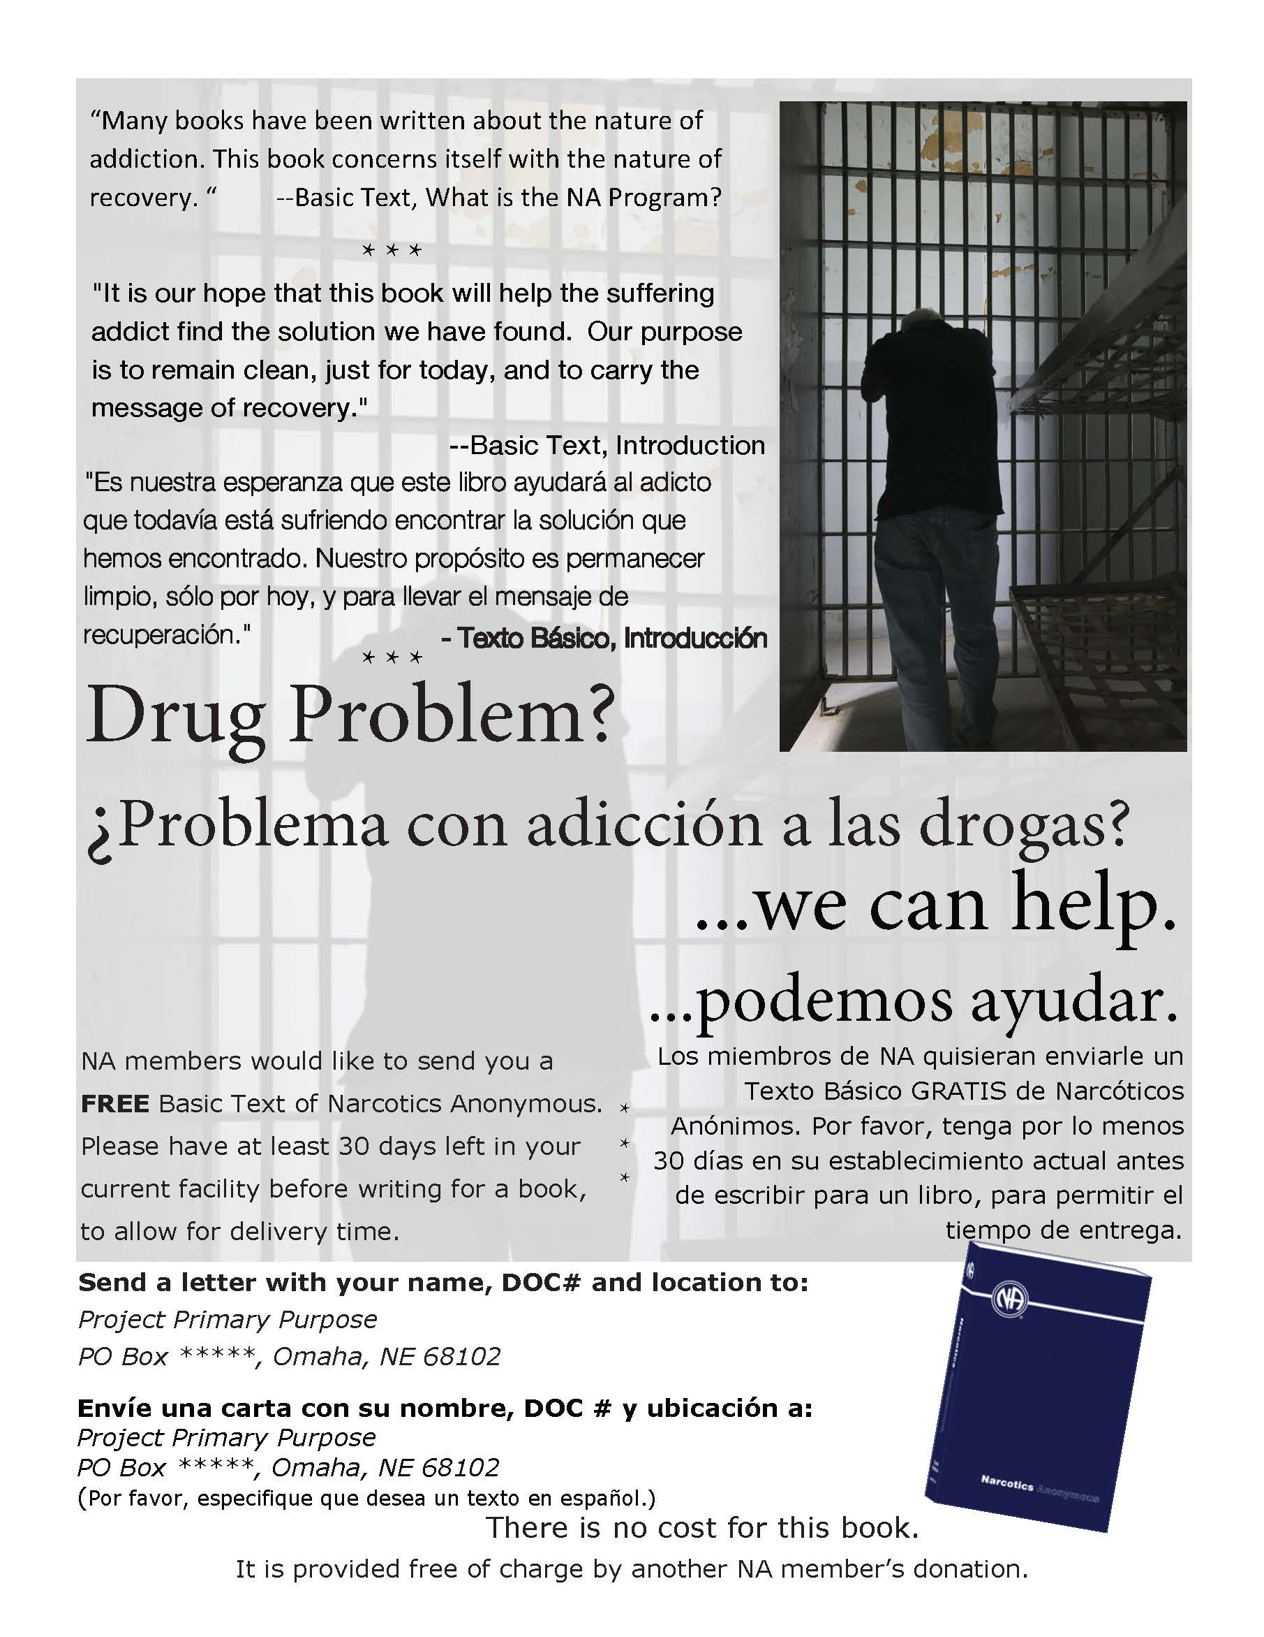

Slide 9


Slide 10
GROWING
ADDING OTHER REGIONS/REGULATING GROWTH
FUND RAISING
THREE LOCAL EVENTS ANNUALLY
ZONAL, REGIONAL, AREA, GROUP & INDIVIDUAL SUPPORT
UPDATING MERCHANDISE

Slide 11
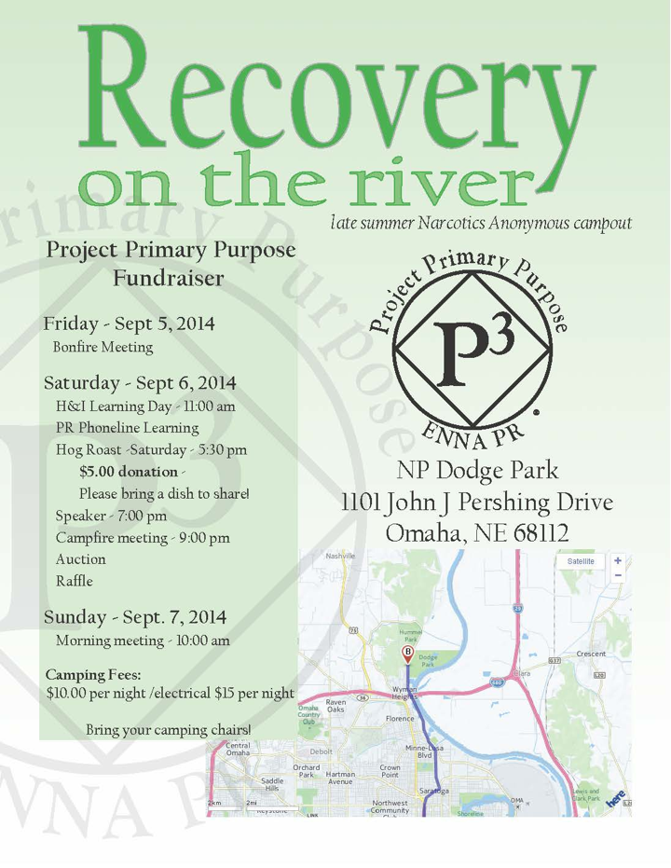

Slide 12
WHERE WE ARE AT NOW
REGIONS WE CURRENTLY MAIL TO: NE, IA, KS, SD, OK, BLR/TX
OTHER REGIONS WE HAVE MAILED TO: AR, CA, CO, ID, IL, FL, MA, MO, MN, NM & WY
OVER 8700 BT SINCE 2006
271 BT TO DATE 2026

Slide 13


Slide 14
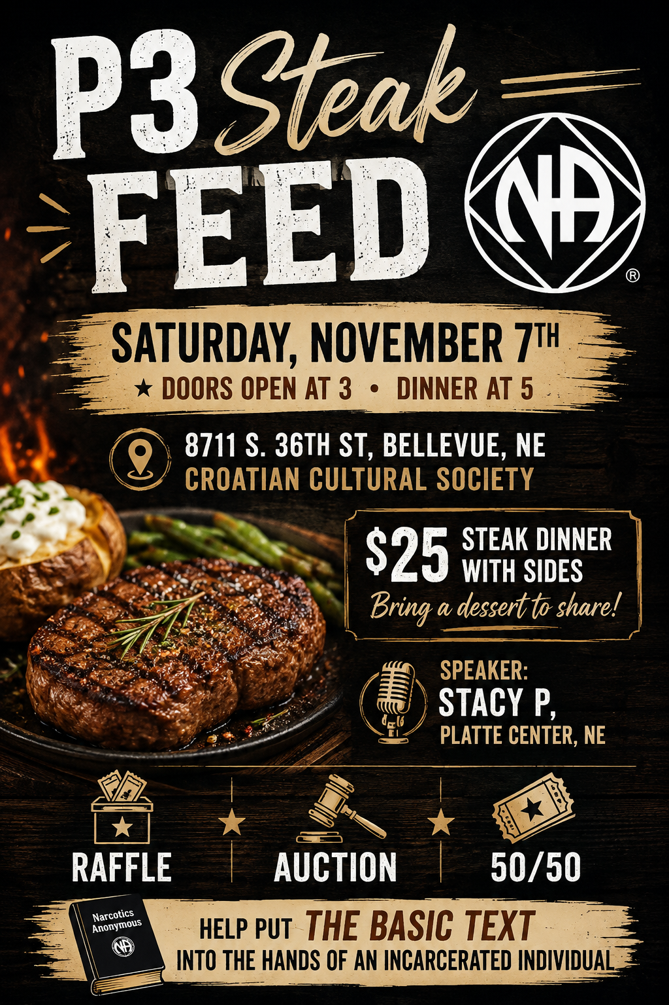

Slide 15
(SBTW) Sponsorship Behind The Walls & (WSR)Writing Steps for Recovery
Sharleen S (South Dakota)
Kristin D (Show Me)
“The therapeutic value of one addict helping another is without parallel.”

Slide 16

SPONSORSHIP BEHIND THE WALLS
Plain States Zonal Forum

Slide 17
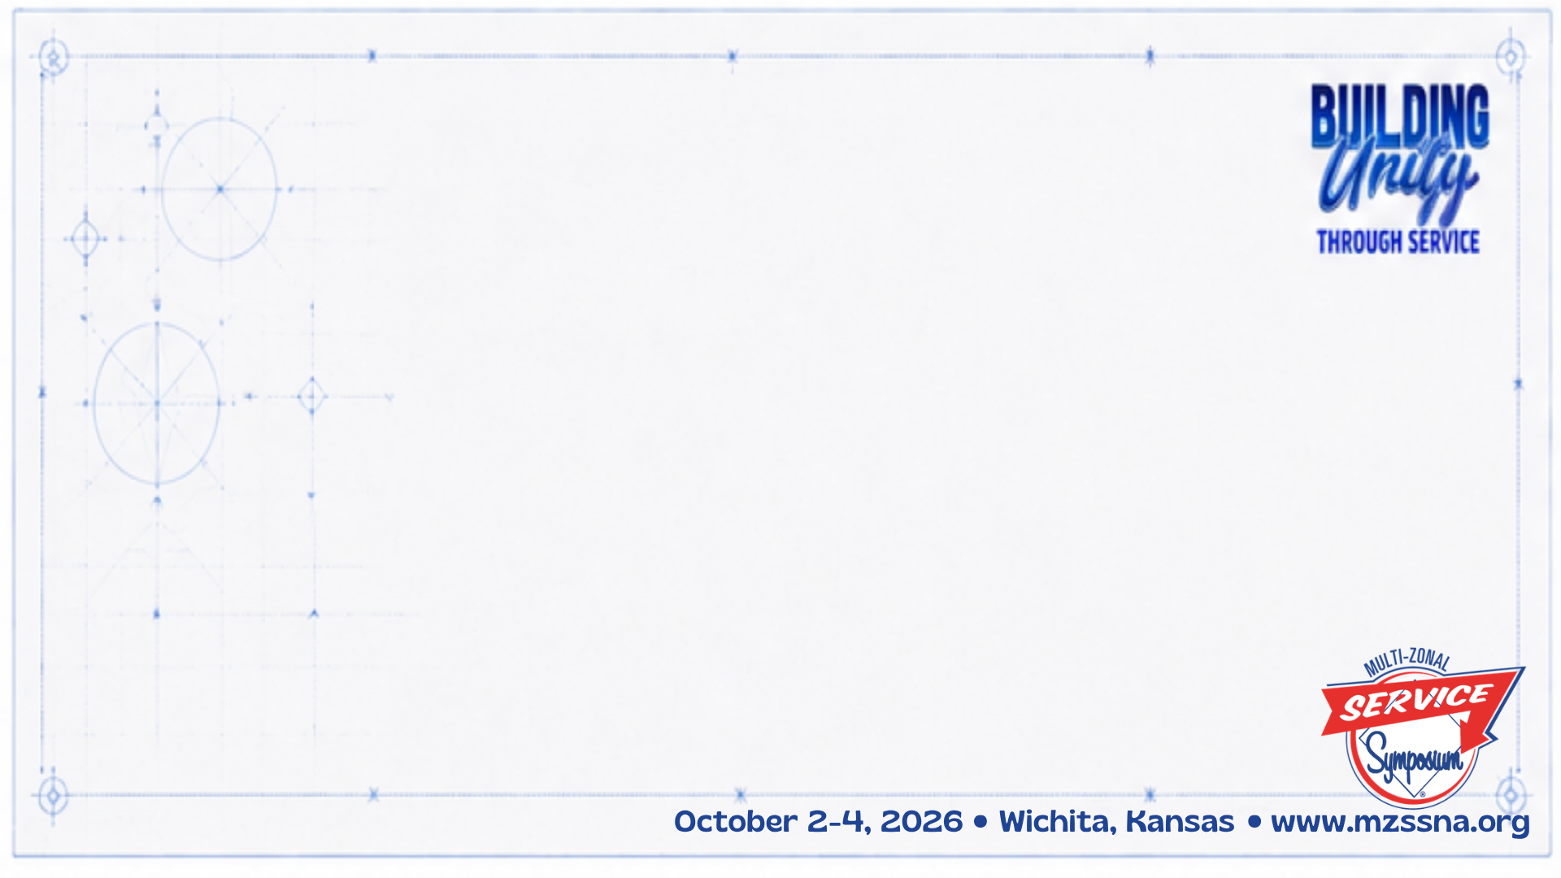
Our Purpose
To carry the message of recovery to the addict who still suffers behind the walls and allow them to experience the miracle of recovery and a new way to live through the 12 steps of NA, despite their limited access to Narcotics Anonymous and sponsorship while incarcerated.

Slide 18
Our Purpose
To efficiently utilize limited human resources within region members and provide a wider range of service opportunities to members of PSZF regions.

Slide 19

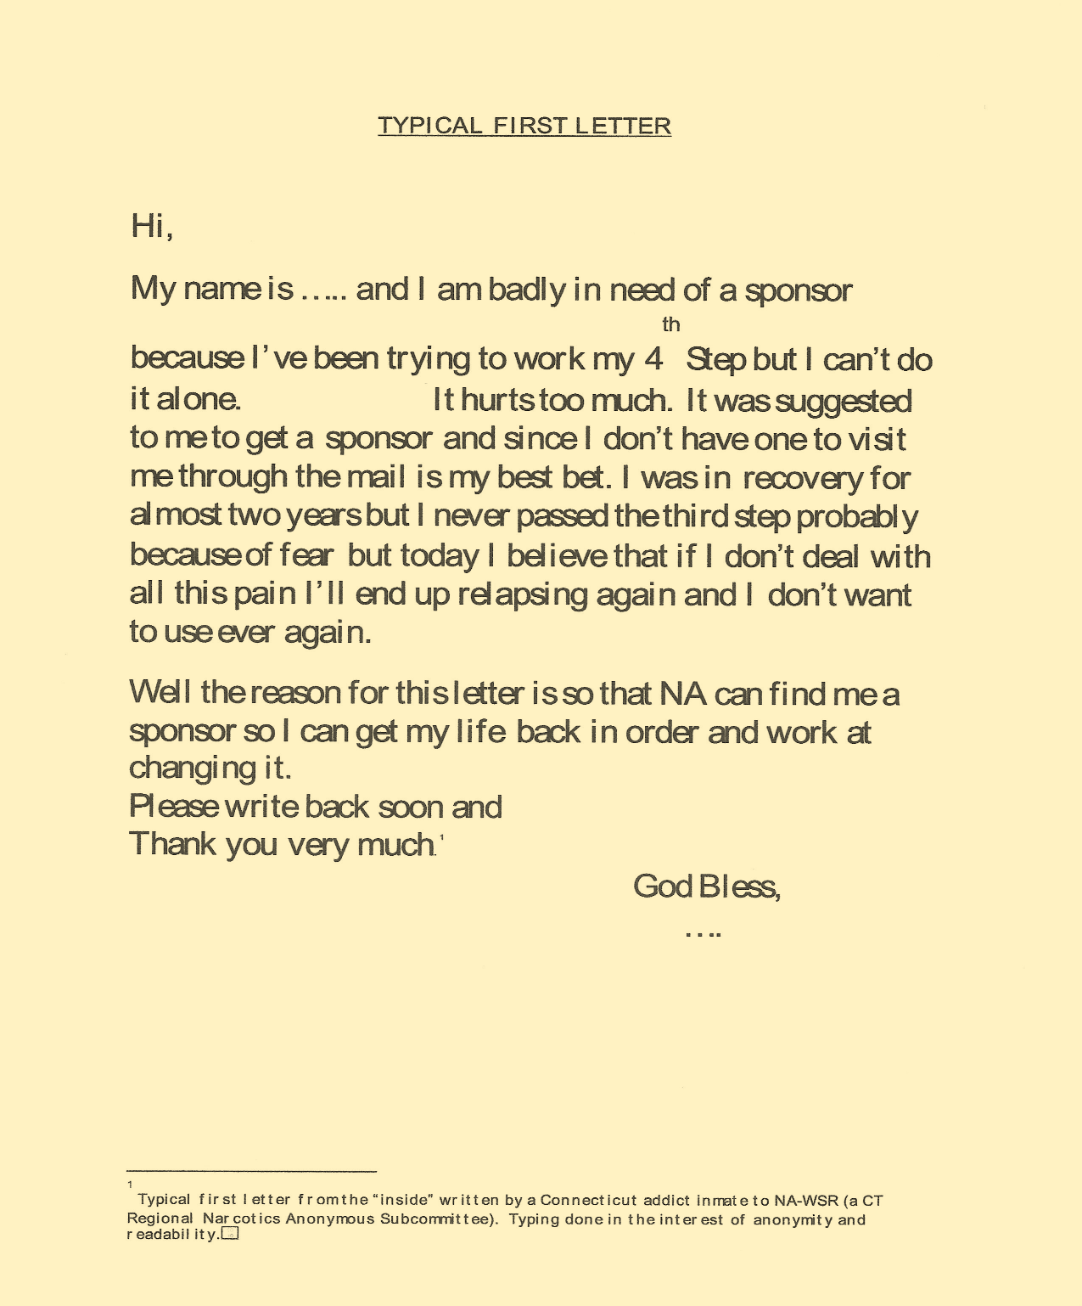

Slide 20
SBTW Do’s & Don'ts
In keeping with Tradition 12, we respect the anonymity of our correspondents. All correspondence from sponsees will be sent to a PO Box. Postal Coordinator to forward mail.
There should be no personal contact in person or by phone (including after release) between sponsor & sponsee
Never give out your address, phone number, home group, Area, Region, etc.
For your own anonymity & protection, you will be required to use your first name only or a pen name in you choose to do so.
When we engage in this type of service, it should always be men writing to men and women writing to women. We believe it is best that no romantic involvements develop.
Never write anything you don’t want the world to read. All correspondence is opened & subject to monitoring by the institution.

Slide 21
SBTW Do’s & Don'ts
You must work a Narcotics Anonymous program using only fellowship-approved literature.
NA members with correctional facility clearances may not correspond with inmates in those facilities.
We introduce ourselves briefly in our opening letter so the addict can get to know and identify with us. We always stay focused on recovery.
Remember, it only takes two addicts to have a meeting. Writing is no different, so let the inmate know that as in all forms of sharing, corresponding helps us as much as it helps him/her. Let them know they are never alone. We share our experience, strength, and hope and being clean in recovery. Since change happens as a result of wrong/applying the principles behind the Twelve Steps of NA, we encourage you to be a guide through the step writing process.
Encourage the inmate to participate in Twelve Step meetings available to them in their facility.

Slide 22
WRITING STEPS FOR RECOVERY
Show Me Region

Slide 23

STEP WRITER & STEP GUIDE
Who is who?

Slide 24
STEP WRITER
      Addict in a jail or institution, from anywhere without an active “writing step committee “, i.e., sponsorship behind the walls.
      Will be in the jail/ institution for at least 6 months.
      Provides us with approximate length of sentence to best match them w/ a Step Guide.
      Has no knowledge of, or has ever been an acquaintance of the Step Guide prior to incarceration.

Slide 25
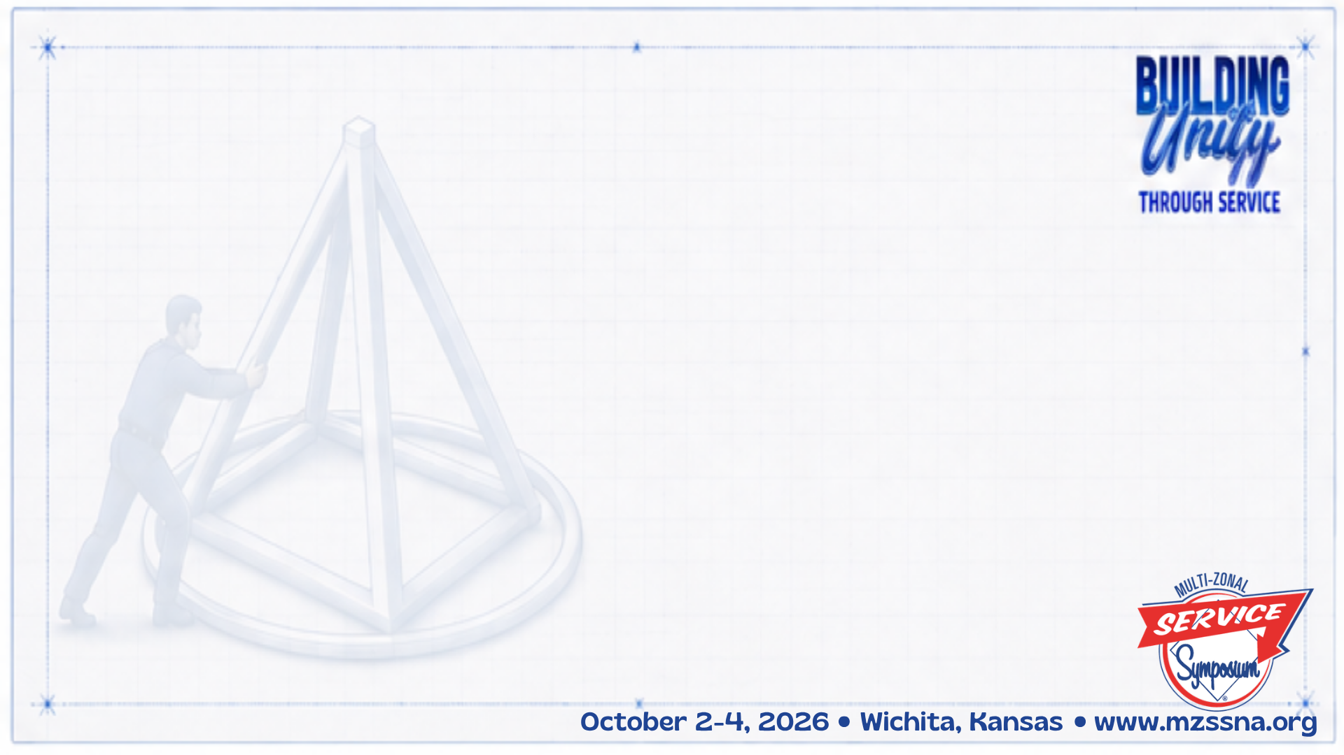
STEP GUIDE
      NA Member from the Show Me Region, Southern Zonal Forum or in a community w/out a step guidance committee.
      2 Years clean or more.
      Completed 1st 5 steps in NA.
      Has an NA sponsor .
      Must be attending NA meetings regularly.
      Has no knowledge of, or have ever been an acquaintance of the Step Writer.

Slide 26
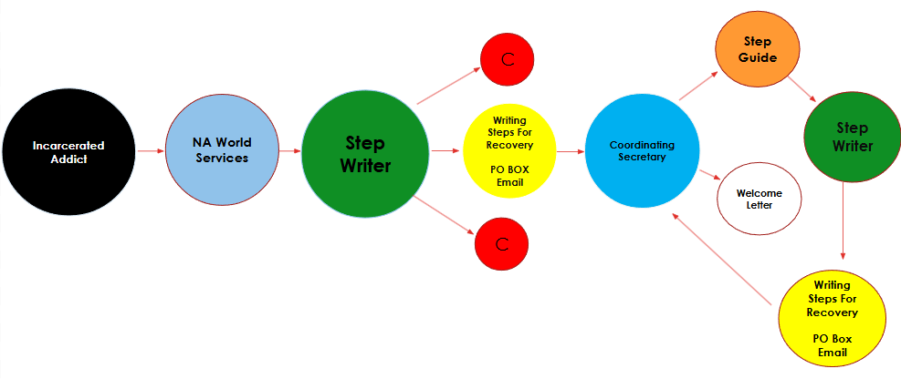
HOW DOES IT WORK ?

Slide 27
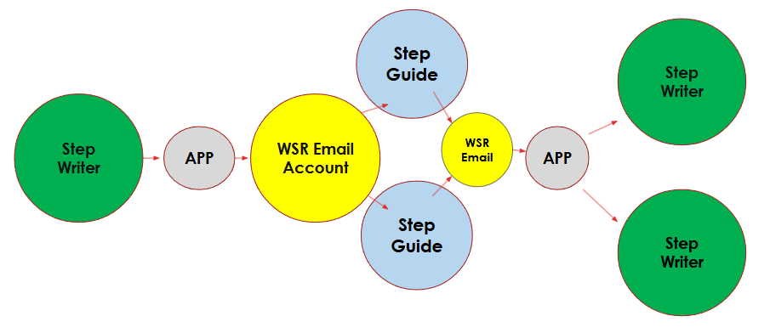
OUR JOURNEY AHEAD……

Slide 28
STEP AGREEMENT GUIDE
As a step guide, I agree to:
Limit my contact with the step writer to writing only.
Refrain from using abusive or profane language in my correspondence.
Respect the confidentiality of my step writer.
Refrain from supplying my step writer with any materials for correspondence including envelopes, stamps, pre-stamped envelopes, writing paper and writing implements.
Refrain from sending my step writer, any books, tapes or items of this nature.
Refrain from supplying my step writer with my telephone number, address, and any other information prohibited by the program.
Refrain from visiting my step writer or having any contact with him/her outside the facility.
Refrain from contacting anyone whom my step writer might ask me to contact.
Refrain from revealing any damaging personal information as outlined in guidelines.
Attest to not having been a victim or an accomplice of a crime with someone who is presently incarcerated as a result of that crime.

Slide 29
Thank You!
Contact Info:
Sponsorship Behind the Walls
www.pszfna.org
www.pszfna.org/sponsorship-behind-the-walls/
Writing Steps for Recovery
www.missourina.org
wsrshowmeregion@gmail.com

Slide 30
Re-entry Resource Fairs
Keith T (OK Region)
“The therapeutic value of one addict helping another is without parallel.”

