Slide 1
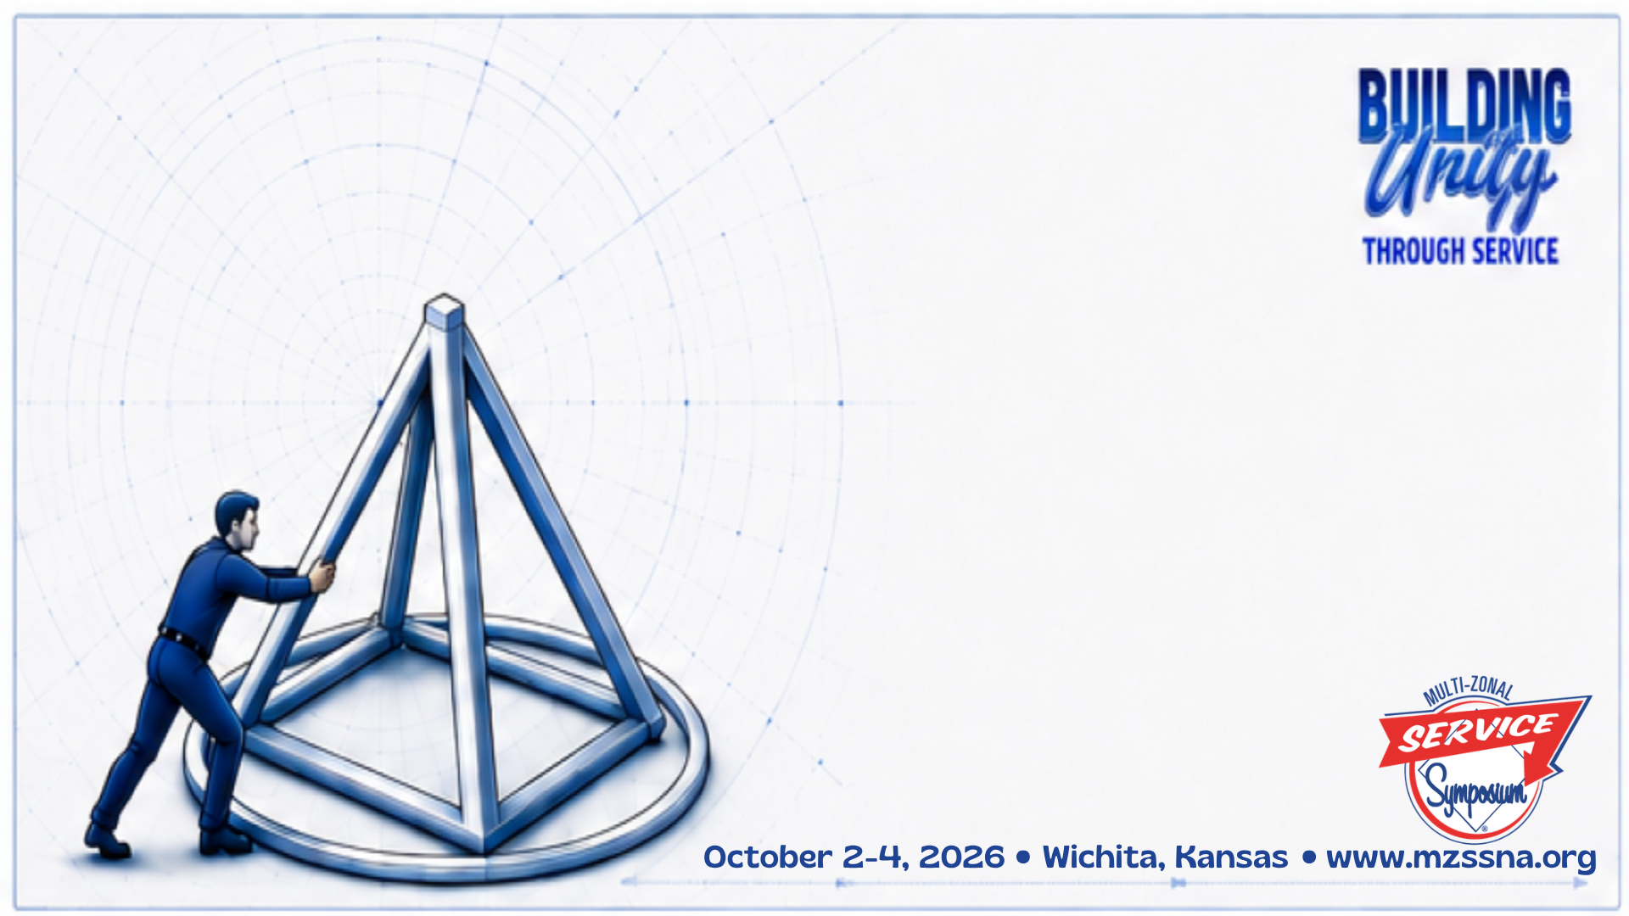
Social Media
Strategies, Pitfalls and Opportunities
Kristen R. & Anne K.V.P.
Southern Zone

Slide 2
The digital world has transformed how people communicate, gather information, and seek help. Narcotics Anonymous now faces both opportunities and challenges as social media becomes part of everyday life
For nearly seventy years, NA's message has been carried through personal recovery, meetings, literature, public information efforts, and word-of-mouth attraction. Today, social media has become one of the primary ways people learn about organizations and recovery resources. The purpose of this presentation is not to determine whether social media is good or bad. Instead, we will explore how NA's spiritual principles can be applied to modern communication platforms.

Slide 3
When Someone Needs Recovery Today...
Do they:
Open a phone book?
Call a hotline?
Visit a website?
Search Facebook?
Search TikTok?
Search Instagram?

Slide 4
Why This Matters
Social Media Has Changed Communication
Today people communicate through:
Facebook
Instagram
TikTok
YouTube
LinkedIn
X
The question is no longer:
"Should NA use social media?"
The question is:
"How can NA use social media while honoring our Traditions?"

Slide 5
"Our public relations policy is based on attraction rather than promotion; we need always maintain personal anonymity at the level of press, radio, and films."
The Foundation Tradition Eleven

Slide 6
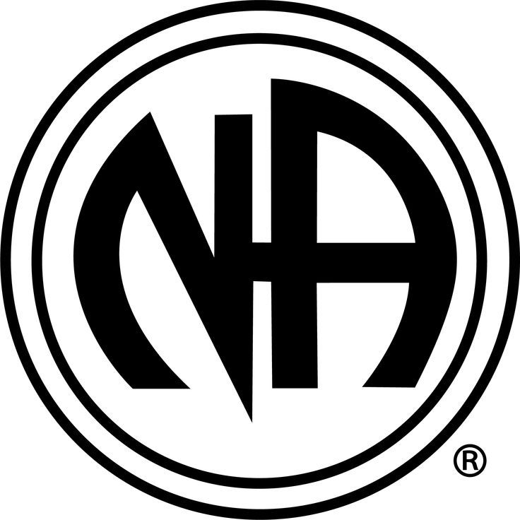

What Tradition Eleven Protects
Two Key Principles
Attraction Rather Than Promotion
and
Personal Anonymity

Slide 7
Press, Radio, and Films
When Tradition Eleven Was Written
Traditional Mass Media:
Newspapers
Radio
Television
Movies
These were one-way communications
Social media changed everything.

Slide 8
Defining Social Media Today
Public Communication Platforms
Social media includes:
Facebook
Instagram
TikTok
LinkedIn
X
YouTube
Podcasts
Livestreams
For many people:
Social media = today's press, radio, and films

Slide 9
Digital Recovery Landscape
How Recovery Information Is Found Today
Infographic:
Past:
Hear → Call → Meeting
Present:
Search → Click → Message → Meeting
Many potential newcomers first encounter recovery digitally.

Slide 10
Major Impact #1
Anonymity
Challenges:
Photos
Tags
Videos
Public comments
Livestreams
Question:
Can content remain anonymous after it is shared?

Slide 11
Major Impact #2
Public Perception
For many people:
Your social media page may be their first experience with NA.
When a person viewing NA through a smartphone.

Slide 12
Anonymity in Practice
Examples
✅ Meeting announcement
✅ Literature quote
✅ Event flyer
⚠ Self-identifying recovery video
⚠ Public member testimonial
⚠ Tagged member photographs

Slide 13
Attraction vs Promotion
The Balancing Act
Attraction:
Information
Hope
Accessibility
Promotion:
Marketing
Advertising
Self-promotion
Discussion: Where is the line?

Slide 14
Attraction in Action
Examples:
✅ Meeting Finder
✅ Event Information
✅ Literature Resources
✅ Recovery Information
Avoid:
❌ Celebrity-focused content
❌ Influencer culture
❌ Personality-driven messaging

Slide 15
Major Impact #3
Unity
Social media rewards:
Strong opinions
Controversy
Emotional reactions
Traditions emphasize:
Unity
Humility
Respect

Slide 16
Major Impact #4
Outreach Opportunities
Benefits:
Reach newcomers
Share meeting information
Increase visibility
Improve accessibility
Question:
Could social media become today's digital hotline?

Slide 17
Should Tradition 11 Be Updated?
The Debate
Three viewpoints:
No changes needed
Clarification needed
Explicit digital language needed
Discussion slide.

Slide 18
What Would Updating Mean?
Potential additions:
Social media
Podcasts
Livestreaming
Digital identities
Online influencers

Slide 19
Tradition 12 Connection
Anonymity Is the Spiritual Foundation
Key ideas:
Humility
Equality
Unity
Fellowship before self

Slide 20
Public Relations and Social Media
Opportunity or Threat?
Answer:
Both.

Slide 21
Platform Strategy Overview
Facebook Instagram TikTok LinkedIn X
Purpose / Strength / Risks

Slide 22
Facebook Strategy
Best For:
Public Information
Events
Meeting Access
Community Awareness

Slide 23
Instagram Strategy
Best For:
Visual messaging
Recovery quotes
Event promotion
Stories and reels

Slide 24
LinkedIn Strategy
Best For:
Professionals
Healthcare
Corrections
Employee Assistance Programs

Slide 25
TikTok Strategy
Best For:
Educational content
Myth vs Fact
Recovery information
Meeting awareness
Risk: Influencer culture

Slide 26
X Strategy
Best For:
Announcements
Quick updates
Public information
Risk: Controversy and public debate

Slide 27
Pitfall #1
Becoming "The Voice of NA"
Risks:
Personal influence
Celebrity servants
Opinion replacing conscience
Solution: Team-based account management

Slide 28
Pitfall #1
Members Breaking Their Own Anonymity
Examples:
Public recovery posts
Recovery videos
Identification as NA members
Question:
Educate or police?

Slide 29
Pitfall #3
Anonymous Comment Moderation
Scenario exercise:
Member publicly identifies themselves.
What should PR committees do?
Interactive audience discussion.

Slide 30
Pitfall #4
Tradition Ten
NA Has No Opinion
High risk:
Politics
Elections
Drug policy
Public controversies

Slide 31
Pitfall #5
Endorsements and Affiliation
Discussion:
How can social media create unintended affiliations?

Slide 32
The Algorithm Challenge
Social media rewards:
Personality
Controversy
Emotion
NA rewards:
Humility
Anonymity
Attraction

Slide 33
Opportunity #1
Universities and Internships
Potential Support:
Graphic Design
Analytics
Web Development
Accessibility
Question: How do we honor Tradition 6?
An NA group ought never endorse, finance, or lend the NA name to any related facility or outside enterprise, lest problems of money, property, or prestige divert us from our primary purpose.

Slide 34
Opportunity #2
New Members with Digital Skills
Strengths:
Social media knowledge
Platform expertise
Content creation
Need:
Tradition guidance
Mentorship

Slide 35
Together: Modern communication + spiritual principles
Experienced Members:
Traditions
Group Conscience
Policy
Digital Members:
Technology
Content
Analytics

Slide 36
The Five-Question Filter
Before Every Social Media Post Ask:
Does this help an addict find NA?
Does it express an opinion?
Does it identify a member?
Could it be viewed as an endorsement?
Does it place personalities before principles?

Slide 37
Strategic Vision for the Future
Social Media as a Digital Doorway to Recovery
Goal:
Reach the next addict while protecting:
Anonymity
Unity
Neutrality
Attraction rather than promotion

Slide 38
Key Takeaways
✅ Social media is today's public communication platform
✅ Tradition 11 remains relevant
✅ Technology changes, principles do not
✅ Visibility and anonymity can coexist
✅ The message matters more than the medium

Slide 39
Discussion and Questions
Open Forum
Suggested Questions:
What concerns you most about social media?
What opportunities excite you?
How should local service bodies approach social media?
Does Tradition 11 need clarification?

Slide 40

Thank You!
Contact Info:
Anne K.V.P 636-279-0518
rakimbrough1@gmail.com
Show Me Region RD
Kristen R. 903-752-3571
Kristenroach5789@gmail.com
Lone Star RD

