Slide 1
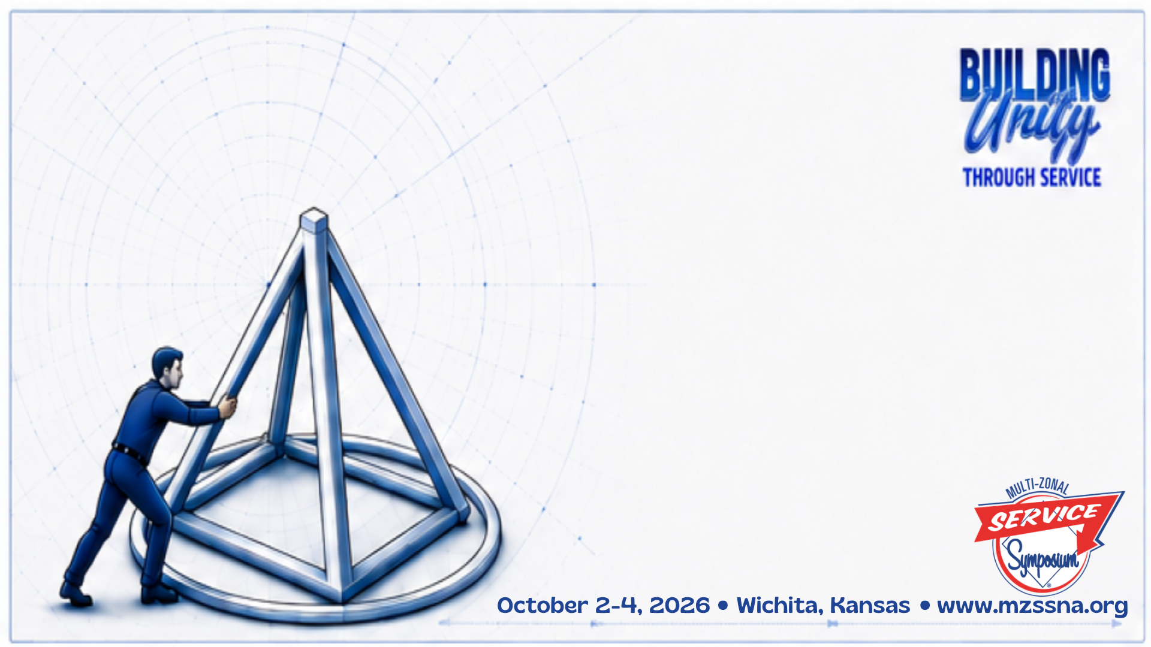
Something about the Concepts
Matt F (Iowa)
Tommy N (Nebraska)
Presentation adapted from 12 Concepts Workshop by Cumberland Steps & Traditions – Vancouver Island North and Powell River Area of Narcotics Anonymous

Slide 2
Introduction
STEPS:
The Twelve Steps guide us as individuals in our personal recovery.
TRADITIONS:
The Twelve Traditions guide our groups in meeting their primary purpose.
CONCEPTS:
The Twelve Concepts guide the NA service structure in supporting NA groups.

Slide 3

Introduction
In 1988, the Fellowship directed the WSC to create an Ad Hoc Committee and tasked it with developing a set of guidelines to guide NA service bodies. This committee delivered the Twelve Concepts for NA Service back to the WSC in November 1991, and they were presented to the Fellowship in the 1992 CAR.

Slide 4

Concept 1
To fulfil our fellowship’s primary purpose, The NA groups have joined together to create a structure which develops, coordinates, and maintains services on behalf of NA as a whole.
Principle: Responsibility - The opportunity or ability to act independently and make decisions without authorization.
Allows groups to remain focused on their primary purpose.
Delegates secondary functions to the other service bodies.
Notes:
While recovery meetings a NA’s most important service. They are not the only means we have of fulfilling our primary purpose. Other NA services attract the still suffering addict to our meetings, carry our message to addicts in institutions, make recovery literature available, and provide opportunities for our groups to share their experience with on another. No one of these services, by itself, comes close to matching the value of group recovery meetings in carrying our message; each, however, plays its own indispensable part in the overall program devised by the Fellowship to fulfill its primary purpose.

Slide 5
Concept 2
The final responsibility and authority for NA services rests with the NA groups.
Principle: Authority - A person or group having power or control in a particular, typically administrative sphere.
Home groups set the direction for service activities at all levels.
Despite delegation of certain functions to other service bodies, the NA home groups are always in charge.
Notes:
The NA service structure has been created by the groups to serve the common needs of the groups, Our fellowship’s service boards and committees exist to help groups share their experience with on another, provide tools which help groups function better, attract new members to group recovery meetings, and carry the NA message further than any single group could carry it alone. Because the groups have created the structure, they have final authority over all its affairs. By the same token, groups also have the final authority for the support of all its activities

Slide 6
Concept 3
The NA groups delegate to the service structure the authority necessary to fulfill the responsibilities assigned to it.
Principle: Delegation - The transfer of responsibility for specific tasks from one group to another.
This concept encourages the delegation of service activities not directly involved in carrying the message of recovery to other service bodies for completion.
The groups must the trust these service bodies to carry out their duties faithfully and with minimal oversite.
Notes:
The NA groups maintain final responsibility and authority for the service structure they have created. Yet if they must involve themselves directly in making decisions for all of our service boards and committees, the groups will have little time or energy left to carry the recovery message in their meetings. For this reason, the groups entrust the service structure with the authority to make necessary decision in carrying out out the tasks assigned to it.

Slide 7

Group
Discussion
Concepts 1,2, and 3
Notes:
Some questions that might spur discussion:
What are some reasons groups do not perform some or all services?
What is the difference between authority and responsibility?
Why is it so important to trust service bodies in NA?
How do you, your group, and your service bodies practice the principles of responsibility, authority, and delegation?

Slide 8
Concept 4
Effective leadership is highly valued in Narcotics Anonymous. Leadership qualities should be carefully considered when selecting trusted servants.
Principle: Leadership - A trait of a person who has a commanding authority or influence
Any NA member can be a leader, and every NA member has the right to serve the Fellowship.
Anyone may serve as a trusted servant within the bounds of the requirements of the position (i.e., clean time, transportation, computer skills, prior experience, etc.)
We have an obligation to fill trusted servant positions with the best candidates possible to get the best results.
Notes:
The trust necessary to confidently delegate service authority is founded on the careful selection of trusted servants. No leader will exemplify all the qualities listed in the 4th Concept; they are the ideals of effective leadership to which every trusted servant aspires. The more we consider these qualities when selecting NA leaders, the better our services will be.

Slide 9
Concept 5
For each responsibility assigned to the service structure, a single point of decision and accountability
should be clearly defined.
Principle: Accountability - The quality or state of being accountable (subject to giving an account)
Responsibilities and deliverables must be clearly defined, ideally in writing so there is no cause for ambiguity or confusion over what is expected of a trusted servant or service body. Policy and guideline documents often accomplish this
Notes:
When we decide a certain service task should be done, and clearly say which trusted servant, service board, or committee has the authority to accomplish the task, we avoid unnecessary confusion. We don’t have two committees trying to do the same job, duplicating efforts or squabbling over authority. Project reports come straight from the single point of decision for the project, offering the best information available. An assigned service responsibility can be fulfilled swiftly and directly, because there is no question of whose responsibility it is. And if problems in a project arise, we know exactly where to go in order to correct them. We do well when we clearly specify to whom authority is being given for each service responsibility.

Slide 10
Concept 6
Group conscience is the spiritual means by which we invite a loving God to
influence our decisions.
Principle: Spiritual Guidance - Relating to or consisting of spirit;
The act or process of guiding
Group conscience is the sum of all the individual consciences in the room, hopefully working together toward common goals.
We seek spiritual unity (unanimity) in our decision making processes more than simple majority votes.
Notes:
When addicts whose individual consciences have been awakened in the course of working the steps come together to consider service-related questions, either in their NA group or in a service committee meeting, they are prepared to take part in the development of a group conscience. The exercise of group conscience is the act by which our members bring the spiritual awakening of our Twelve Steps directly to bear in resolving issues affecting NA. As such, it is a subject which must command our most intent consideration.

Slide 11
Group
Discussion
Concepts 4, 5, and 6
Notes:
Some questions that might spur discussion:
What qualities should be sought when selecting trusted servants?
Why is a single point of decision making and accountability important? How does that work in your home group or family when power or control is evenly shared (While practicing anonymity)?
How does group conscience differ from individual conscience?

Slide 12
Concept 7
All members of a service structure bear substantial responsibility for that body’s decisions and should be allowed to fully participate in its decision-making processes.
Principle: Participation - Ability for people to be involved in activities and decisions that affect their lives.
Diversity in our breadth of perspective and experience across our members is our strength.
In significant matters affecting the groups, a service body will want to ask for guidance directly from the groups.
Notes:
NA service is a team effort. Our service representatives are responsible to the NA Fellowship as a whole, rather than any special constituency; so are all the other trusted servants on the team. The full participation of each member of the team is of great value as we seek to express the collective conscience of the whole.

Slide 13
Concept 8
Our service structure depends on the integrity and effectiveness of our communications.
Principle: Communication - The successful conveying and receiving
of information, ideas or feelings.
To maintain the unity and effectiveness of our groups, honest , open , and straightforward and regular communication is required in and between all of our service bodies.
Clear, frequent two-way communication is an important prerequisite for delegation and oversight of all our service functions.
Without the full picture, seen from all sides, our groups, service boards, and committees cannot develop and informed group conscience.
Notes:
Clear, frequent two way communication is an important prerequisite for delegation. When our groups ask the service structure to fulfill certain responsibilities on our behalf, we delegate to the structure the authority need to make the decisions related to those responsibilities. We need to be able to trust our trusted servants before we can confidently delegate to them that degree of authority. This kind of trust depends in large part on continuing communication. So long as our service boards and committees regularly issue complete, candid reports of their activities, we can be confident that we have delegated our authority wisely.

Slide 14
Concept 9
All elements of our service structure have the responsibility to carefully consider all viewpoints in their decision making processes.
Principle: Open – mindedness - Willingness to search actively for evidence against one’s favored beliefs, plans, or goals, and the weighing of such evidence fairly when it is available.
When making a decision, our groups, service boards, and committees should actively seek out all available viewpoints.
We are responsible fort share our thoughts and our conscience with our fellow members, carefully explaining our position and listening with equal care to the position of others.
Many service boards or committees set aside a portion of their agenda for open forums, when members can speak their minds on issues before the body.
Notes:
Concept nine encourages us, individually, to frankly speak our minds in discussions of service issues, even when other members may think differently. This concept does not mean we become nay-sayers, objecting to anything agreed to by the service body. It does say however, that we are responsible to share our thoughts and our conscience with our fellow members, carefully explaining our position and listening with equal care to the position of others. When we show the courage necessary to speak our mind, while also showing respect for one another, we can be confident that we act in the best interest of the NA Fellowship. By insisting on through discussion of important issues, the worst we can do is take a little of each others time; at best, we protect the fellowship from the consequences of a hasty or misinformed decision.

Slide 15
Group
Discussion
Concepts 7, 8, and 9
Notes:
Some questions that might spur discussion:
What does full participation mean?
Why is two-way communication so important between the group and service bodies?
Why is it important to consider everyone’s opinions when making decisions for NA services? What about in other areas of your life?

Slide 16
Concept 10
Any member of a service body can petition that body for the redress of a personal grievance, without fear of reprisal.
Principle: Fairness - Impartial and just treatment or behavior without favoritism or discrimination.
Together, the Ninth and Tenth Concepts support an atmosphere in which our members feel free to express themselves frankly on matters at hand. This open atmosphere is essential in developing an effective group conscience.
Notes:
The Tenth Concept is our fellowship’s guarantee of respect for the individual trusted servant. This concept may seem self-evident, but our belief in the principle involved is so strong that we want to say it loudly and clearly. Narcotics Anonymous is a spiritual society, with high ideals for how we treat each other. Our members, however, are only human, and we sometimes mistreat one another. The Tenth Concept is our spiritual society’s promise that if one of us is wronged in the service environment, the aggrieved trusted servant may ask that the wrong be made right.

Slide 17
Concept 11
NA funds are to be used to further our primary purpose, and must be managed responsibly.
Principle: Prudence - Acting with or showing care and thought for the future.
With NA’s primary purpose in mind, our services will avoid wasting money, using the funds they’ve been given to carry our message as effectively as possible.
High on our list of priorities should be a commitment to further the goals of NA as a whole.
Notes:
NA members around the world contribute money to help our fellowship fulfill its primary purpose. It is incumbent upon every element of our service structure to use those funds to carry the NA recovery message as far as possible. To do that, our service bodies must manage those funds responsibly, accounting fully and accurately for its use to those who have provided it.

Slide 18
Concept 12
In keeping with the spiritual nature of Narcotics Anonymous, our structure should always be one of service, never of government.
Principle: Service - Contribution to the welfare of others.
In service, we express our gratitude for the recovery others have shared with us by carrying ours to others. Nothing could be further from the drive to rule or direct than this spirit of selfless service.
Our groups have joined together to create a service structure, a cooperative effort designed to help them carry the message further than they could carry it separately.
When any one element attempts to act as an agency of government, rather than a vehicle for service, it strains the ties that bind us all together, threatening our fellowship’s overall effectiveness in fulfilling its primary purpose. Humility is an essential attribute of non-governing service in Narcotics Anonymous.
Notes:
Selfless service is an essentially spiritual endeavor. Our Twelfth Step says, in part, that “having had a spiritual awakening,” we individually “tried to carry this message to addicts.” Our collective service efforts arise from that same spiritual foundation. Having experienced the results of this program in our own lives, we join together to carry the recovery message farther than we could individually. NA service is not about forcing our will or our ideas on others; rather, it is about humbly serving them, without expectation of reward.

Slide 19
Group
Discussion
Concepts 10, 11, 12
Notes:
Some questions that might spur discussion:
When is it appropriate to apply the tenth concept? When is it not appropriate?
What are some of the ways in which concept 11 is applied in your lives, groups, and/or service bodies?
How does NA’s primary purpose and spiritual identity determine the nature of our service structure?

Slide 20

Thank You!
Contact Info:
Tommy N. – tommynewcombe@yahoo.com
Matt F. -

