Slide 1

The Heart of Service:
Connecting Members, Regions & Resources
Laura M. Chicagoland Region
&
Kirby M. Ohio Region

Slide 2
The Heart of Service:
Connecting Members, Regions & Resources
Connecting with our members
by combining our services through Public Relations, H&I, Phonelines and Fellowship Development to strengthen communication, collaboration and
our ability to carry the message on all levels of service.

Slide 3

Today we will be sharing on….
Public Relations
H&I (Hospitals and Institutions)
Phonelines
Fellowship Developement
Later on we will collaborate in our Small Groups on….
The Three C’s
Communication
Collaboration
Carry the message

Slide 4


Public Relations

Slide 5
Public Relations
What is Narcotics Anonymous?
Narcotics Anonymous is a global, community-based organization with
a multilingual and multicultural membership. NA was founded in 1953, and our membership growth was minimal during our initial twenty years as an organization. Since the publication of our Basic Text in 1983, the number of members and meetings has increased dramatically. We have over 79,000 meetings in 122 countries and our literature is translated into 105 different languages. We offer recovery from the effects of addiction through working a twelve-step program, including regular attendance at group meetings. The group atmosphere provides help from peers and offers an ongoing
support network for addicts who wish to pursue and maintain
a drug-free lifestyle.

Slide 6

Why is public relations important to the NA member?
The Narcotics Anonymous message is “that an addict, any addict,
can stop using drugs, lose the desire to use and find a new way to
live.” Our relations with the public enable us to share this message
broadly so that those who might benefit from our program of recovery can find us. We perform public relations service to increase the awareness and credibility of the NA program. We share our message openly with the public at large, with prospective members, and with professionals. Maintaining an open, attractive attitude in these efforts helps us to create and improve relationships with those
outside the fellowship. Establishing and maintaining a
Commitment to these relationships, can help us to
further our primary purpose.

Slide 7

The purpose of Public Relations in Narcotics Anonymous is to inform the public that NA exists and offers recovery from the disease of addiction. A public relations committee helps to ensure that accurate information about our fellowship is available to the public.

Slide 8

What does “Public Relations” mean for NA members?
For our purposes in Narcotics Anonymous, the term “public relations” refers to all of the relationships we create and maintain with the general public, professionals, potential members, and each other in our groups and service communities. We have been establishing relationships with the public all along, whether we have made a choice to be aware of and participate in those relationships or not. It is time to look more closely at how we relate to the rest of society as well as to fellow members. It is time to gather our collective
experience, and improve our service efforts so
NA can continue to become a more reliable and
recognizable program of recovery.

Slide 9

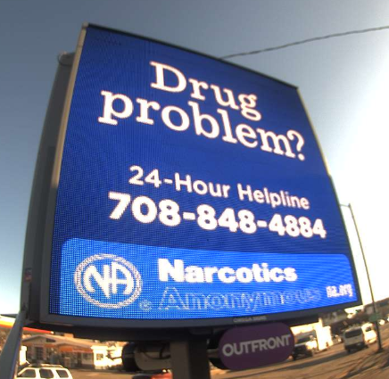


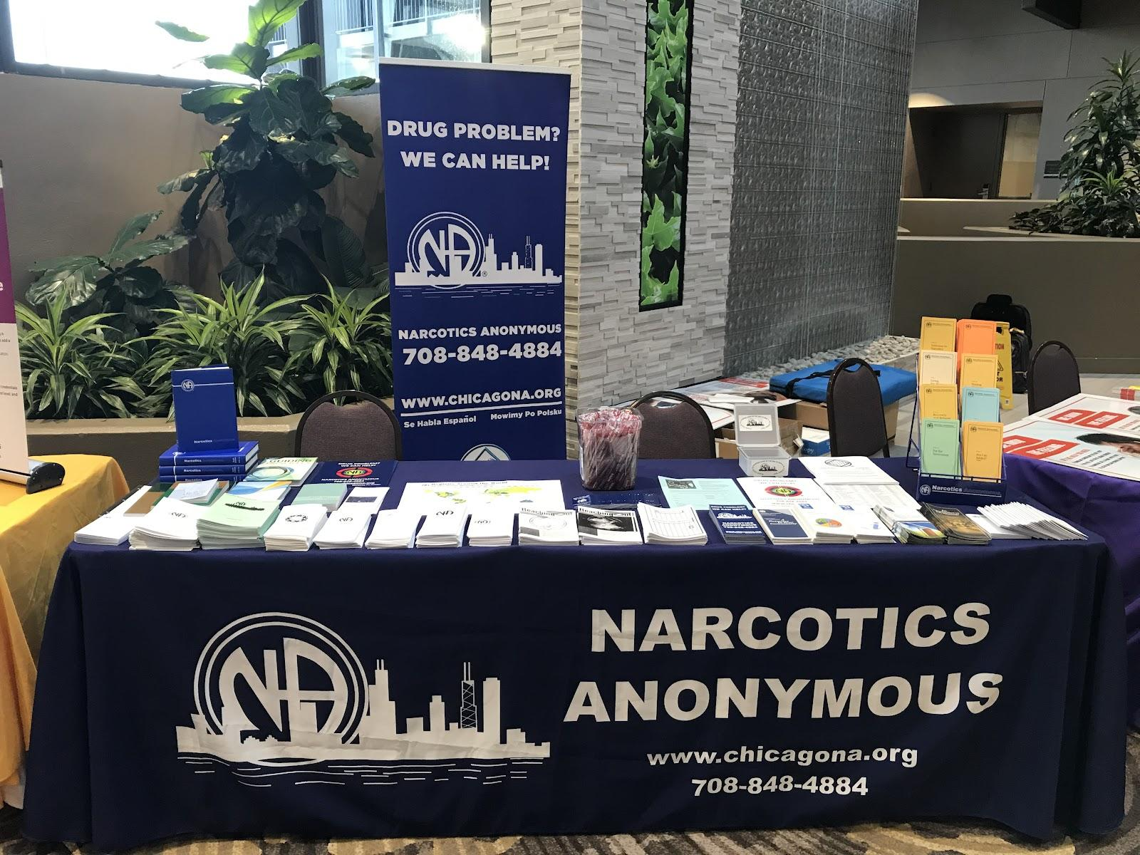
Chicagoland Region Public Relations
This is what's under our Umbrella
(Structure)
Hospitals & Institutions
Phonelines
Website
Writing Behind the Walls
Public Relations
Includes 15 Area’s

Slide 10
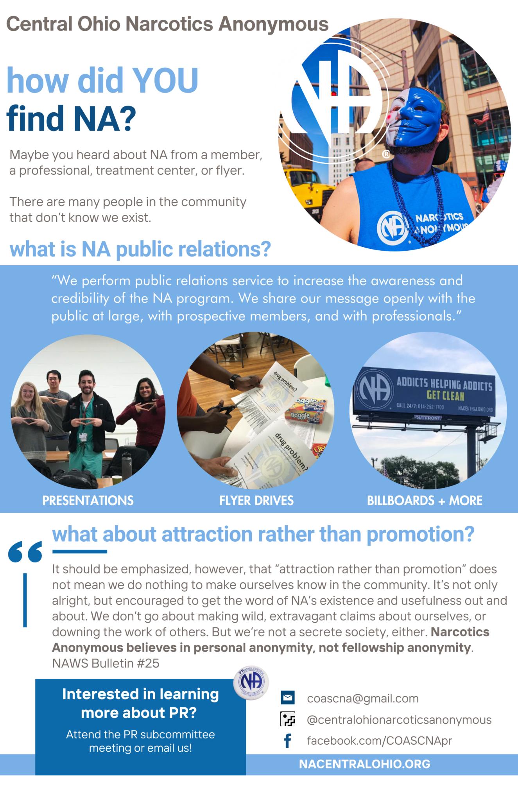
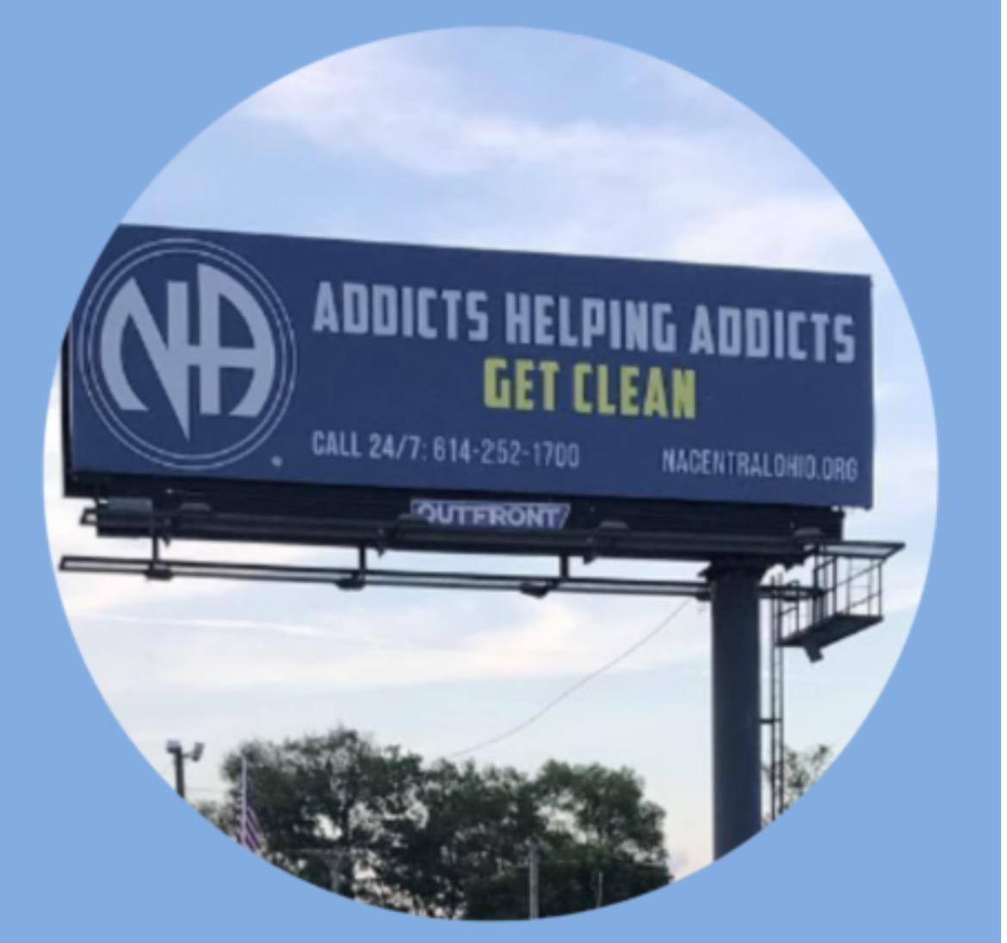
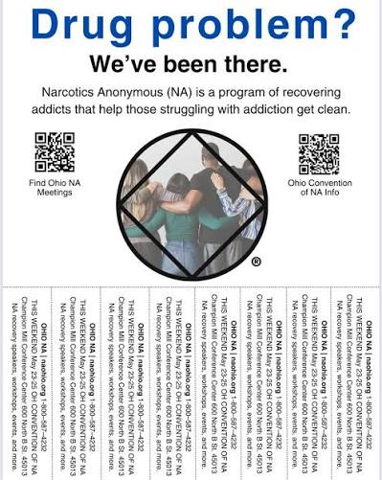

Ohio Region Public Relations

Slide 11

Hospitals and Institutions

Slide 12
H&I meetings can carry the NA message of recovery to addicts who do not have full access to regular Narcotics Anonymous meetings. H&I is an important service in our public relations efforts to inform the public and the potential member about our program. When addicts seeking recovery know who we are and where to find our meetings, our efforts have been successful. H&I meetings and presentations,
except for those in long-term facilities,
are intended to introduce attendees to
some of the basics of the NA program.

Slide 13
H&I/PI/PR COOPERATION
Rules of Thumb for Cooperation between H&I and PI/PR
1. Remember, we all belong to the same fellowship and our
primary purpose is the same no matter to which subcommittee we belong.
2. Communication between the two subcommittees ahead of time (that means planning together on how to proceed) will help avoid problems and promote unity.
3. Flexibility will allow for cooperation that responds to the needs of the facility while upholding our traditions.
4. “I can’t, but we can” applies to subcommittee members and subcommittees.
5. Work together. When we don’t, we divert ourselves from our primary purpose.
There may be instances where the most effective and productive presentation can only be accomplished by a combined effort of representatives from H&I and PI/PR. This, of course, is a perfect application of our Twelve Steps and Twelve Traditions working together to carry the message of NA recovery to the still-suffering addict.

Slide 14
An H&I meeting provides the first exposure to recovery in Narcotics Anonymous for many addicts, so it is imperative that we carry a clear and consistent message of Narcotics Anonymous recovery, and project a positive image of our fellowship. This also applies
to how we handle the facility
administration. In order to keep
any difficulties to a minimum, take
care to maintain consistent contact
between the facility and the subcommittee.

Slide 15
SERVICES OTHER THAN MEETINGS
Often H&I subcommittees are requested to provide services
other than H&I meetings/presentations. In responding to
such requests it is essential that we are clear about what kinds of services are appropriate for an H&I subcommittee to provide. Treatment facilities and correctional institutions cannot be expected to completely understand the scope and function of an H&I subcommittee. They may make requests which we are either unable or unwilling to meet. It is the responsibility of the H&I subcommittee to establish limits to their services based on the Twelve Traditions, the H&I structure, and current resources.
Many of the services requested will call for cooperation and coordination between the H&I and PI/PR subcommittees, since much of this work could reasonably fall into the domain of either subcommittee.

Slide 16



Slide 17

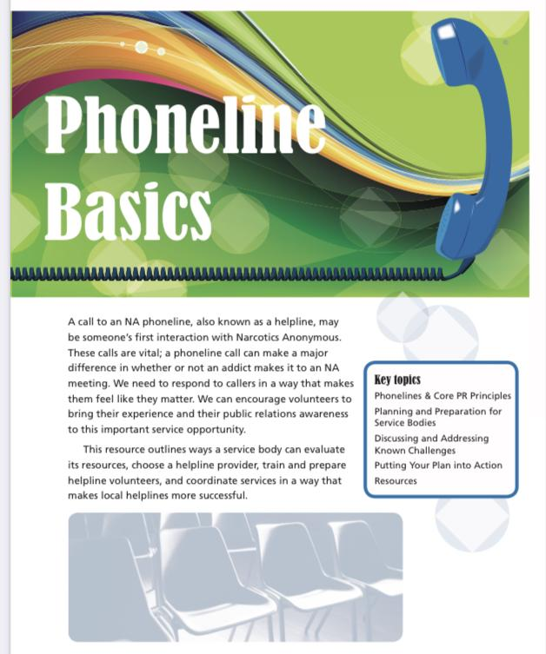

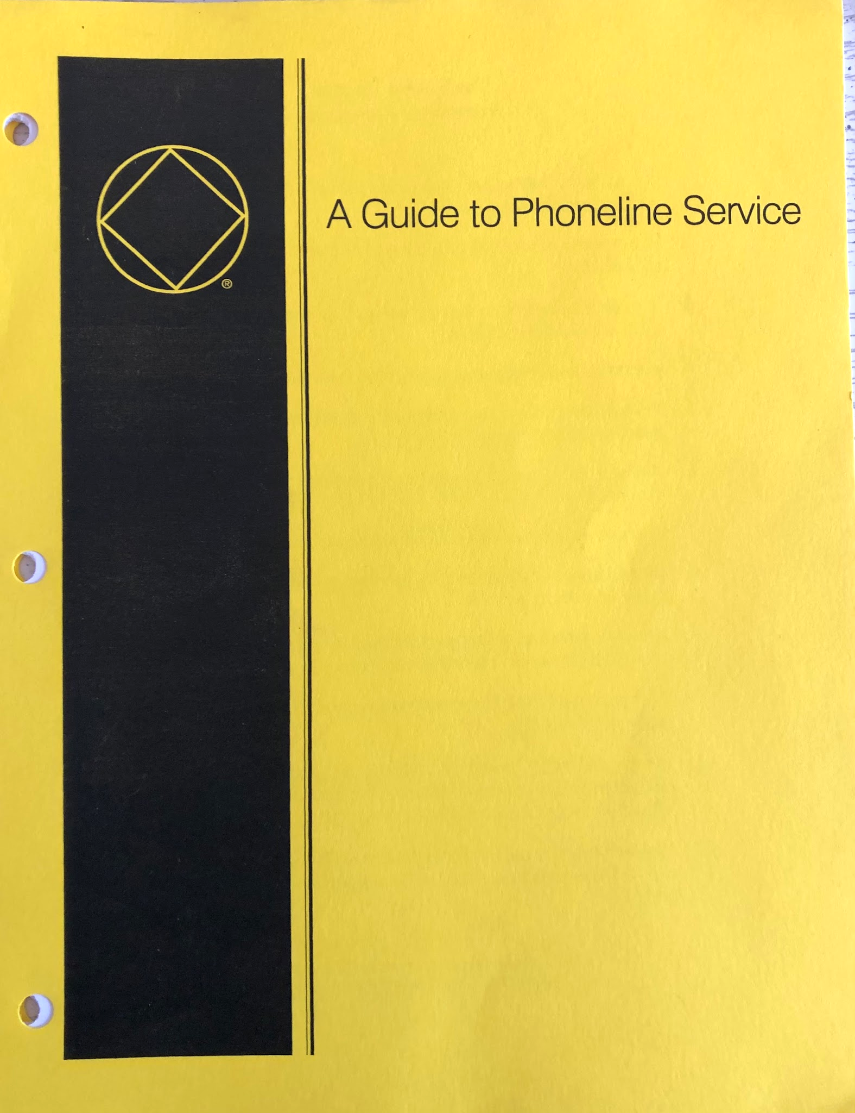
Phonelines

Slide 18
A call to an NA phoneline may be someone’s first interaction with Narcotics Anonymous.
These calls are vital; a phoneline call can make a
major difference in whether or not an addict makes
it to an NA meeting.
We need to respond to callers in a way that makes
them feel like they matter.
We can encourage volunteers to bring their
experience and all their public relations
awareness to this important
service opportunity.

Slide 19
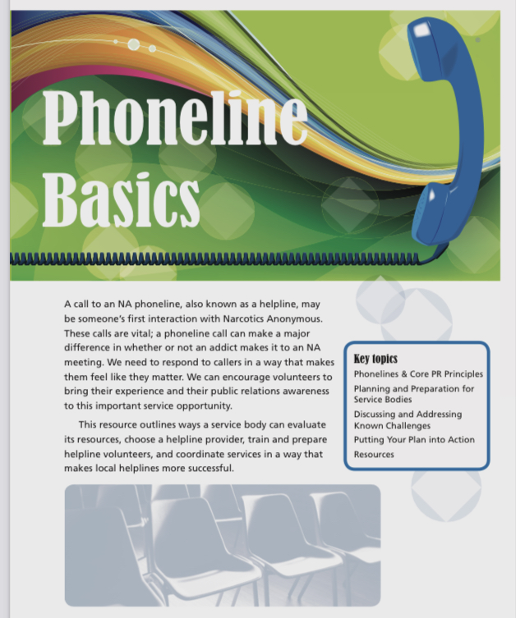
NA Phoneline Literature Available
In different Areas & Regions of the world the Helpline is the
same in our purpose yet possibly different in our functionality.
For some members, the Helpline is our first contact to Narcotics Anonymous.
NA.Org has literature available & guidelines to explain how to facilitate & answer the helpline. Some examples are;
PR Handbook
Phoneline Basics
A Guide to Phoneline Service
Our shared experience is invaluable to the Newcomer & the NA Member who wants to get involved with our local NA Helpline!
Notes:
Charles

Slide 20
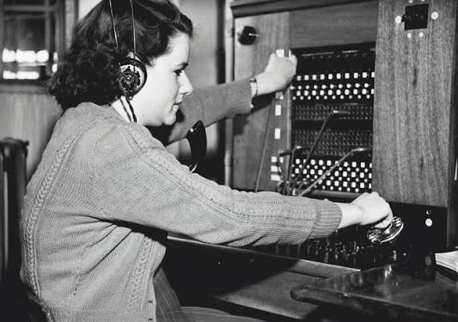


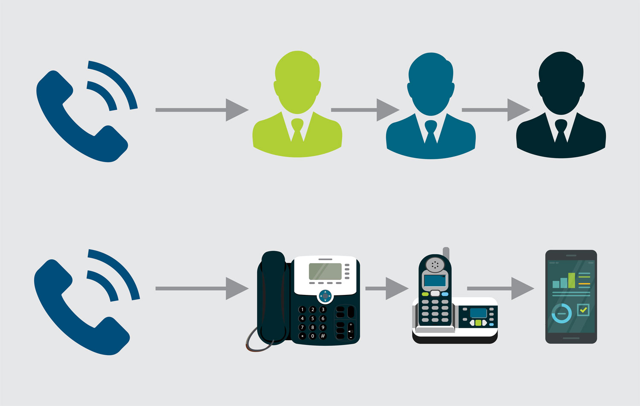
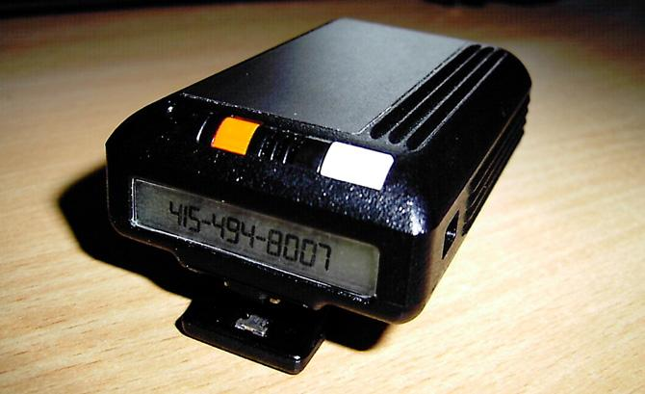

The Evolution of the NA Helpline
Traditional Hardwired Phoneline
Answering Service
Answering Machine or Voicemail
Beeper
Call Forwarding
Live Volunteer Answering the Phone call
Yap through the BMLT (automated attendant & meeting finder)
Notes:
Charles

Slide 21
Metro Detroit Region of Narcotics Anonymous helpline uses YAP
The YAP helpline solution provides automated meeting information and the option to connect to a live addict when calling our regional helpline.
Callers who call our helpline first hear a greeting:
“Thank you for calling the Metro Detroit Region of Narcotics Anonymous helpline.
Callers that press 1 to speak to a live addict:
Will be routed to volunteers scheduled during the current time shift.
Callers that press 2 to use the automated meeting search will hear the following:
“press 1 to search for meetings by city or county, press 2 to search for meetings by zip code.”
The closest 5 meeting results are read to the caller and the caller is presented with
a voice prompt “Press 1 if you would like these results to be texted to you.”
If the caller selects 1 for a text message to be sent.

Slide 22

Fellowship Development
(Outreach)
The Goal of any Fellowship Development effort is to communicate with
and assist NA members and groups

Slide 23
In some areas Fellowship Development may be called Outreach.
Some might be structured in their development and some may not be.
These service structures often approach fellowship development in a comprehensive and coordinated fashion.
Fellowship Development gives us an
opportunity to practice public relations
with our own members.

Slide 24
Fellowship Development Principles
Priciples such as self-support, autonomy, carrying the NA message, and unity are essential to fellowship development service.
Trusted servants can strive to find the balance between carrying the message and respecting individuals’ and groups’ autonomy.

Slide 25
Members often need to be encouraged
To recognize their ability to support themselves and how their contributions are apart of NA’s principle of self support.
Empowering members and groups with the necessary service materials and support is an important foundation of strong
fellowship development efforts.

Slide 26
Incarcerated members - Inmate correspondence
An inmate correspondence program is another form of Fellowship Development. It can make the difference in NA’s overall growth and effectiveness. Our ability to support those in need can mean the difference between a strong and thriving NA community and one that is isolated. Successful efforts can also make a difference in a new or incarcerated member’s ability to connect with the NA program and find recovery. We can aspire to make it so that every action we take in service demonstrates our desire to carry NA’s
message of recovery.

Slide 27

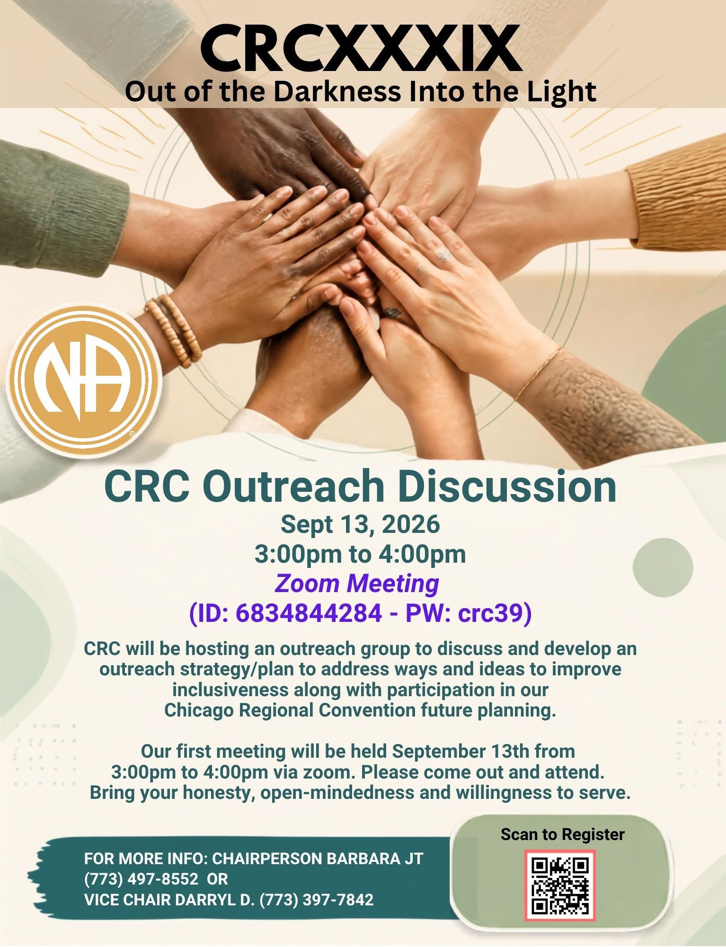

Slide 28
Thank You!
Contact Info:
Laura M. Chicagoland Region
zbellalaura@gmail.com
773-983-3577
Kirby M. Ohio Region
kirbside361@yahoo.com
419-618-6890

Slide 29
References & Resources
Public Relations Handbook
Copyright (2006,2007) by
Narcotics Anonymous World Services, Inc.
Hospitals & Institutions Handbook
Copyright (1986, 1987, 1989, 1997) by
Narcotics Anonymous World Services, Inc.
Planning Basics
Copyright (2011) by
Narcotics Anonymous World Services, Inc.

Slide 30

Notes:
PR Video

